Slide 1
A re-interpretation of the influence of the Atlantic Ocean
on the climate of the Sahel
Atlantic sector climate variability over the last millennium
and the near-term future
Wednesday, October 17, 2012, Lamont hall
Alessandra Giannini, IRI
alesall@iri.columbia.edu

Slide 2
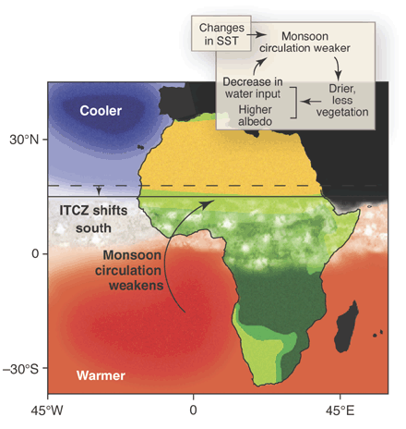
The canonical view on the influence of the Atlantic Ocean
on the West African monsoon
Zeng, Science 2003

Slide 3
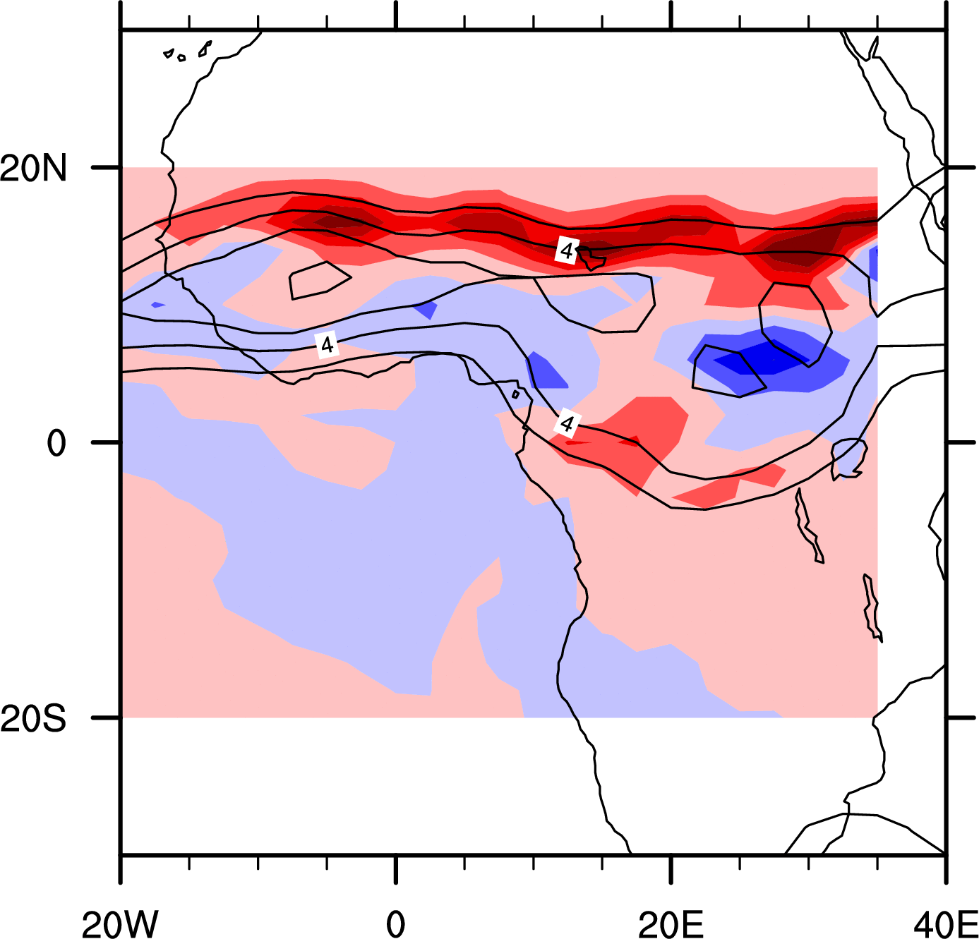
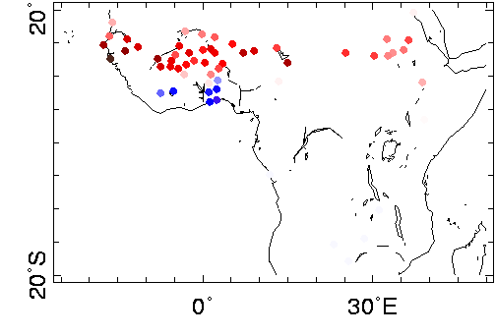
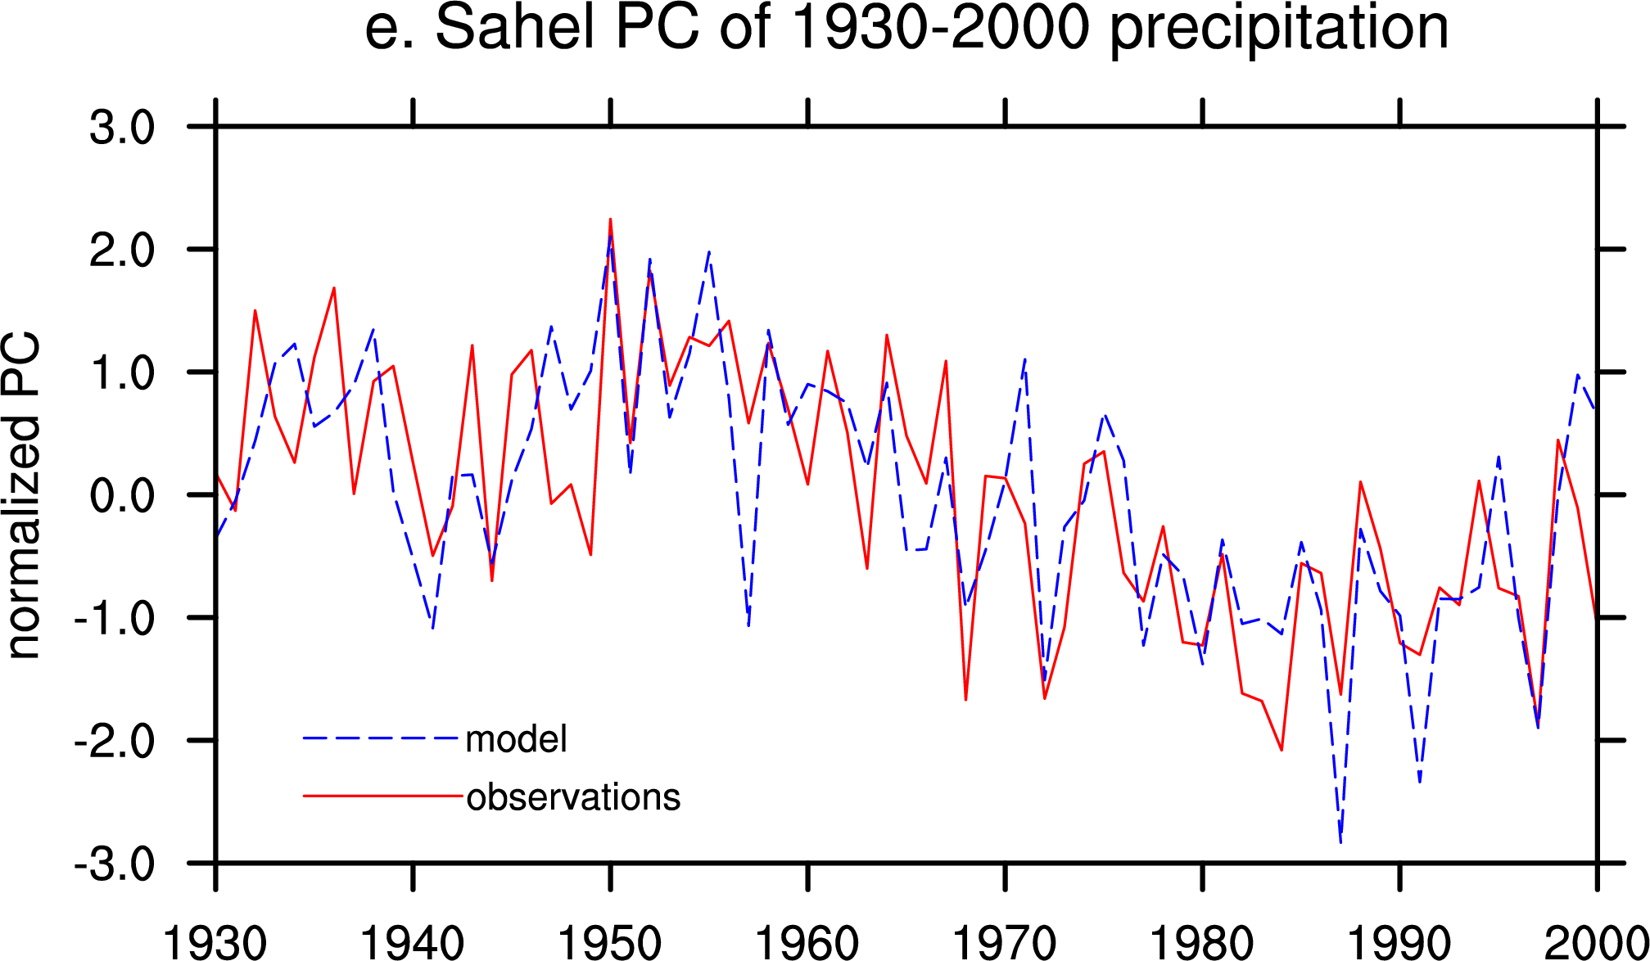
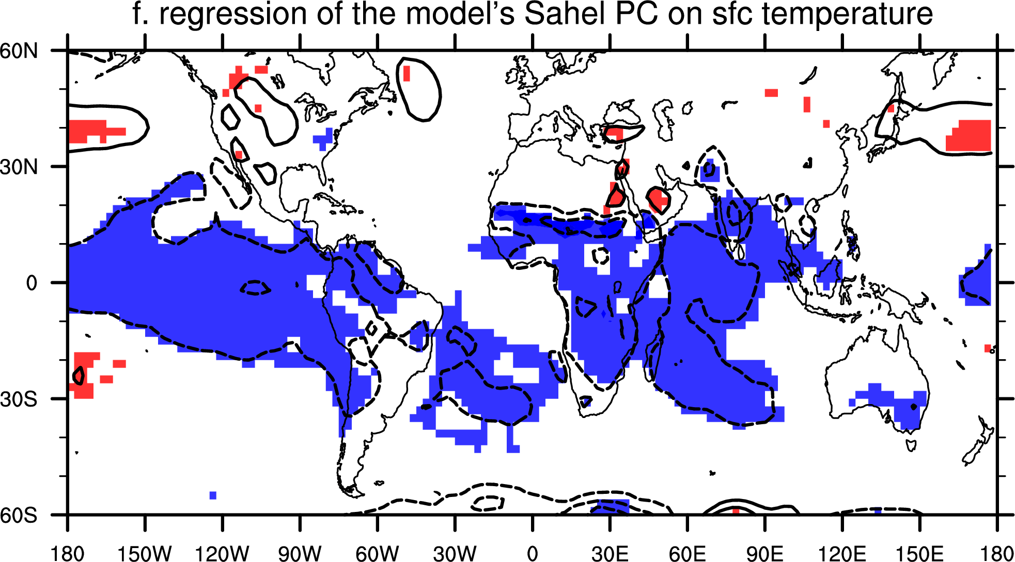
Variability in Sahel rainfall – the West African monsoon
(25% in obs, 21% in ens-mean)
Giannini, A, R Saravanan, P Chang, 2005 in Clim. Dyn.

Slide 4
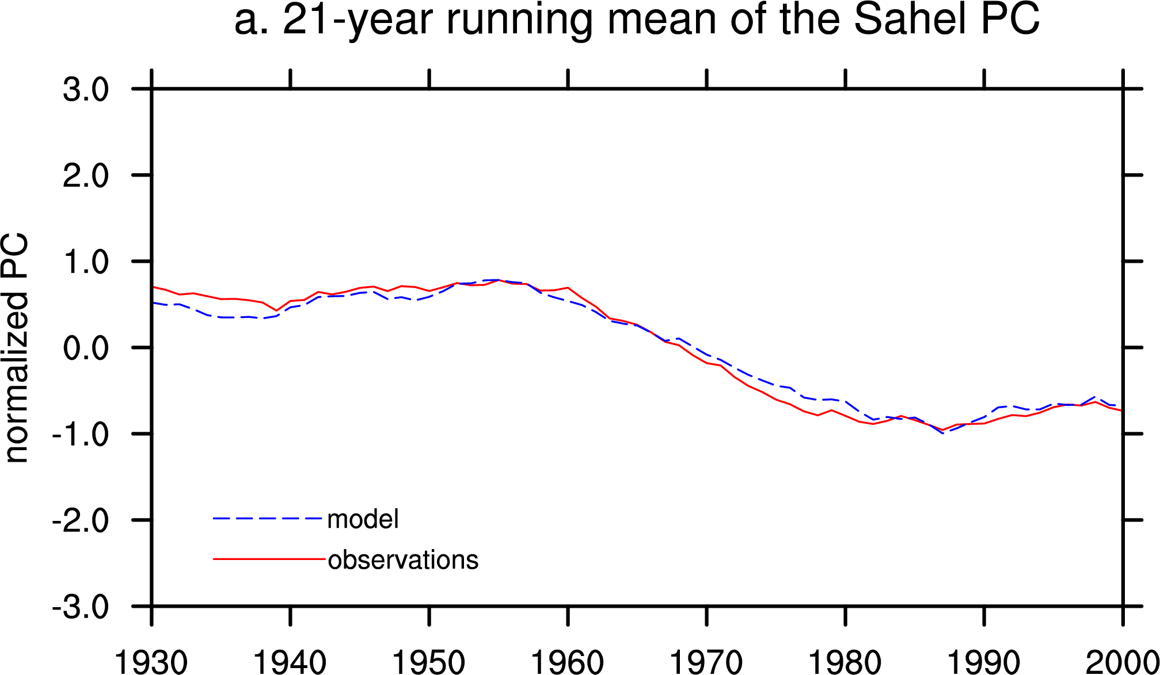
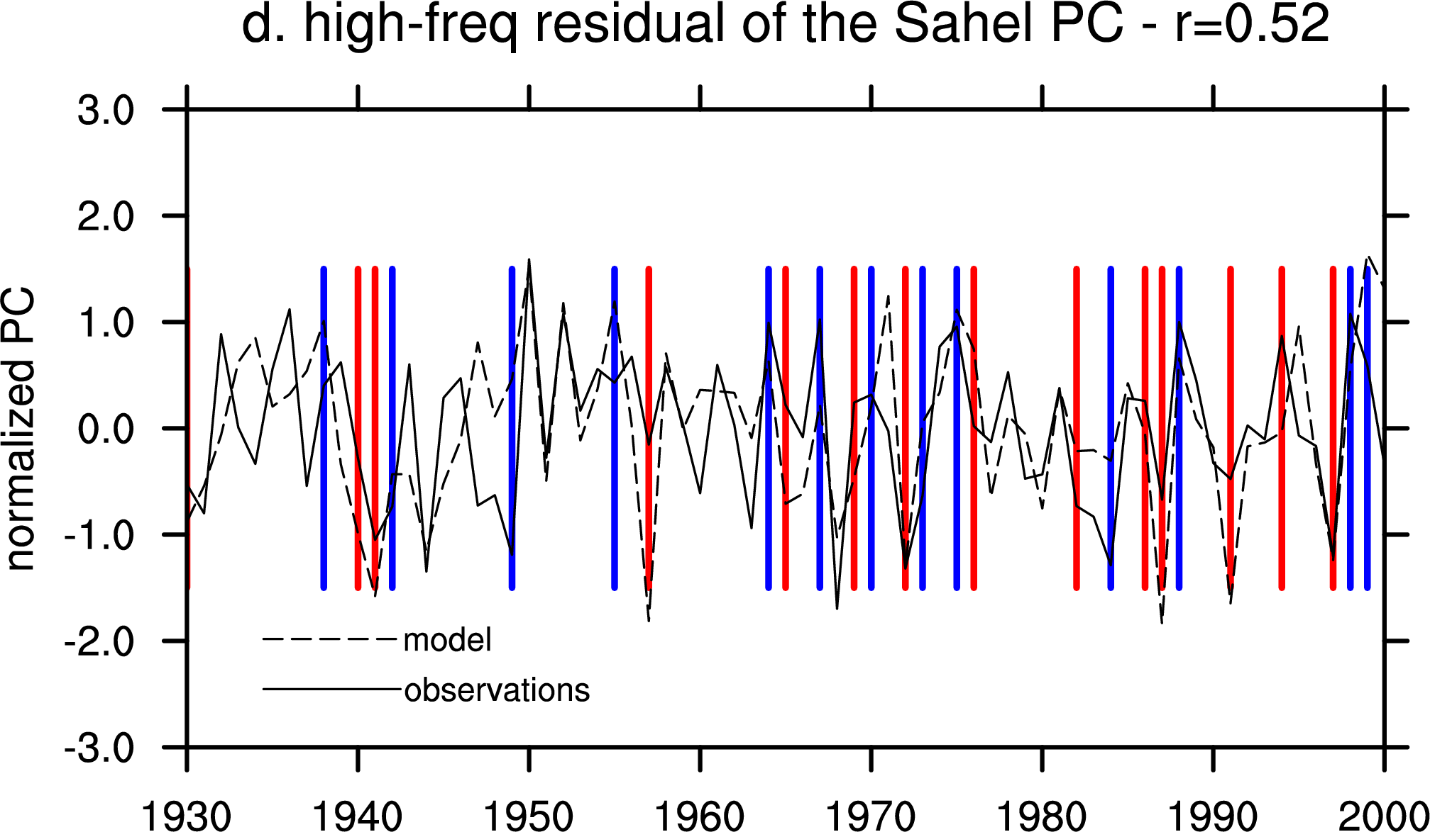
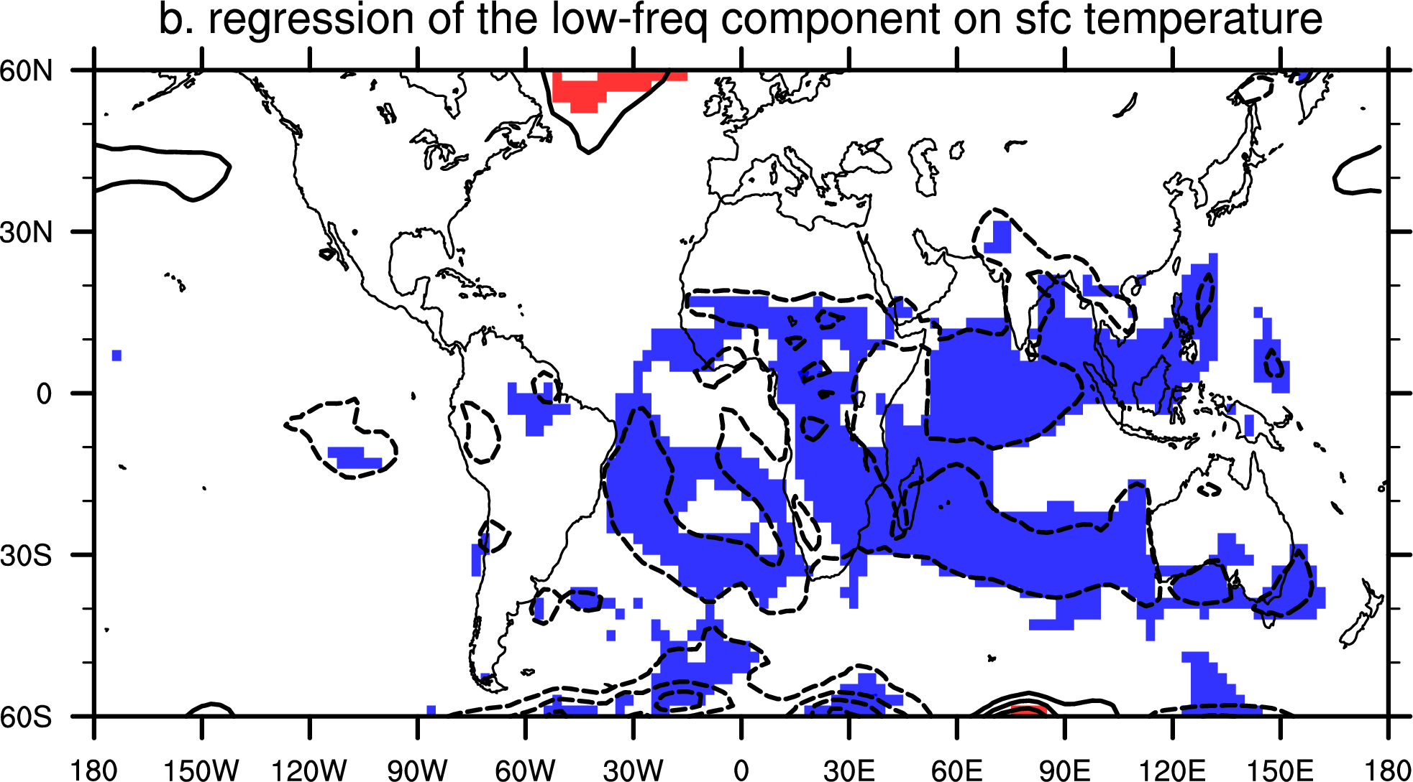
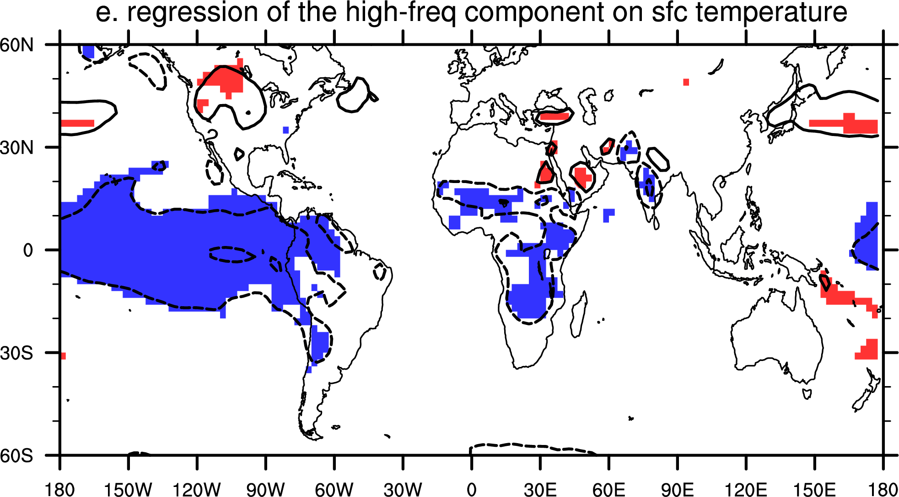
Variability in Sahel rainfall:
separation of interdecadal and interannual time scales
Giannini, A, R Saravanan, P Chang, 2003 in Science

Slide 5
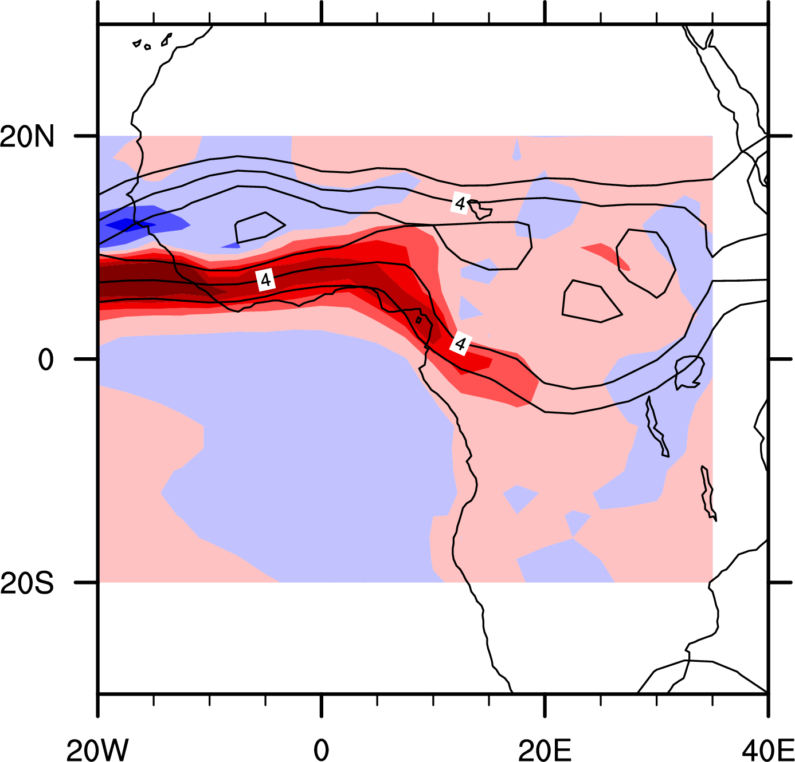
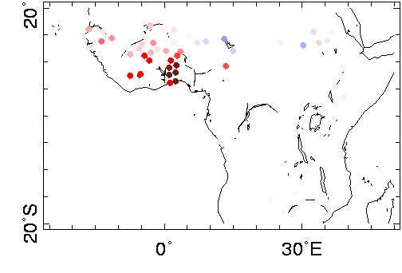
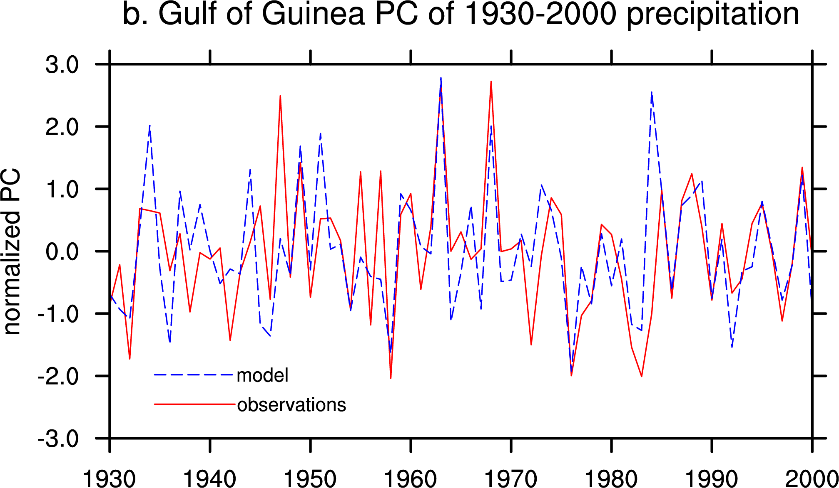
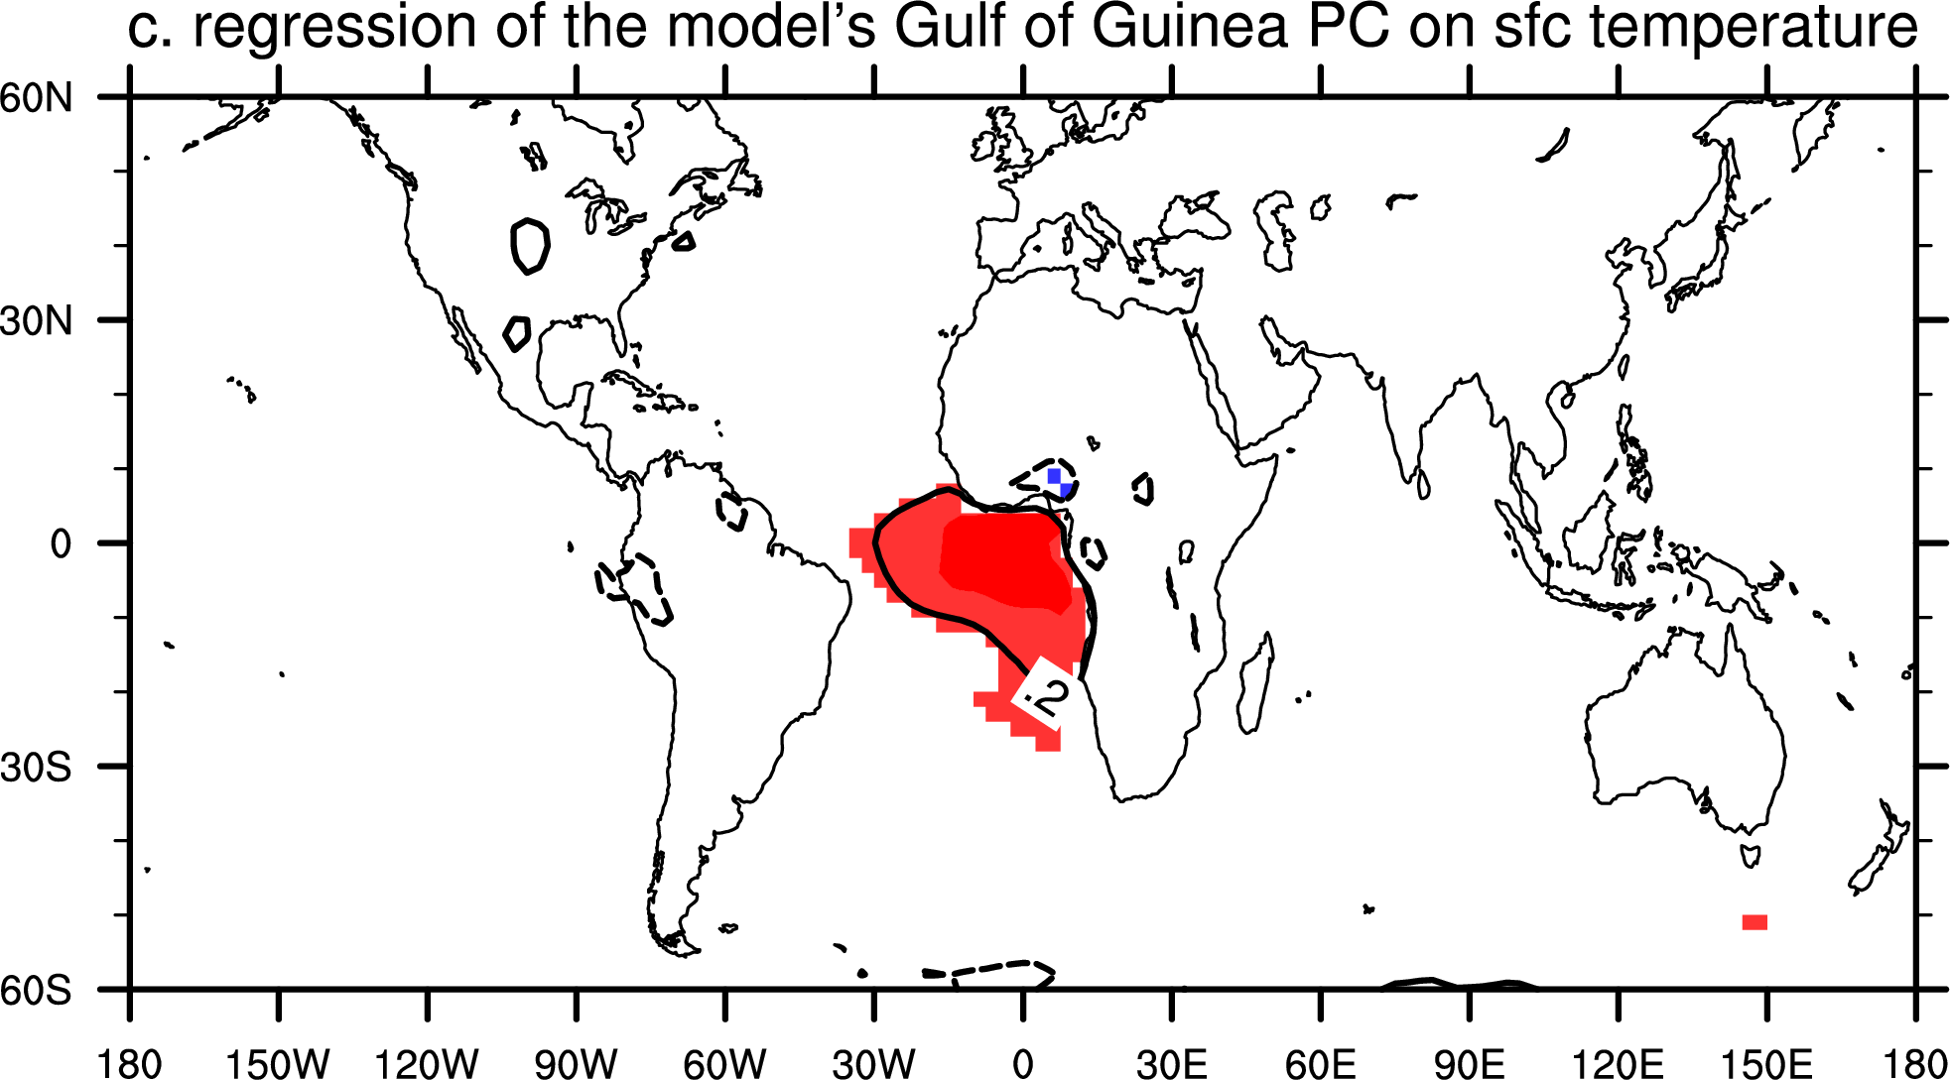
Variability in Gulf of Guinea rainfall – linked to the oceanic ITCZ
(15% in obs, 32% in ens-mean)
Giannini, A, R Saravanan, P Chang, 2005 in Clim. Dyn.

Slide 6
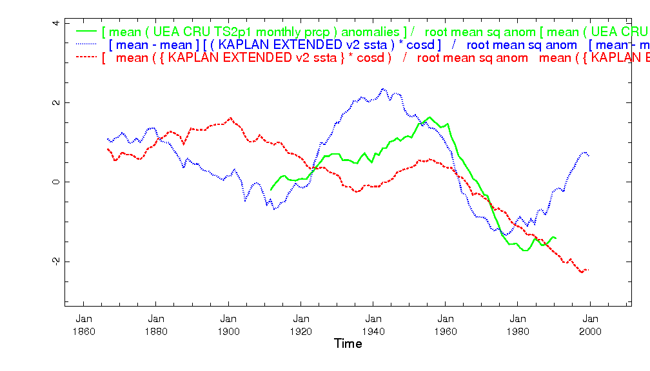
The relative roles of the Atlantic and Indian Oceans
green – Sahel rainfall
blue – north Atlantic SST (minus global mean)
red – equatorial Indian Ocean SST (with sign reversed)
Notes:
Indian Ocean/warming of the tropical oceans
⬅➔ controls vertical stability
⬅➔ related to frequency of daily rainfall?
Atlantic Ocean/
⬅➔ controls moisture supply
⬅➔ related to intensity of daily rainfall?

Slide 7
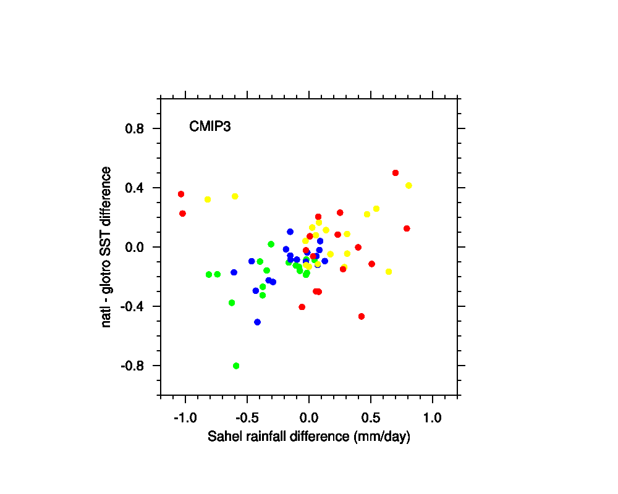
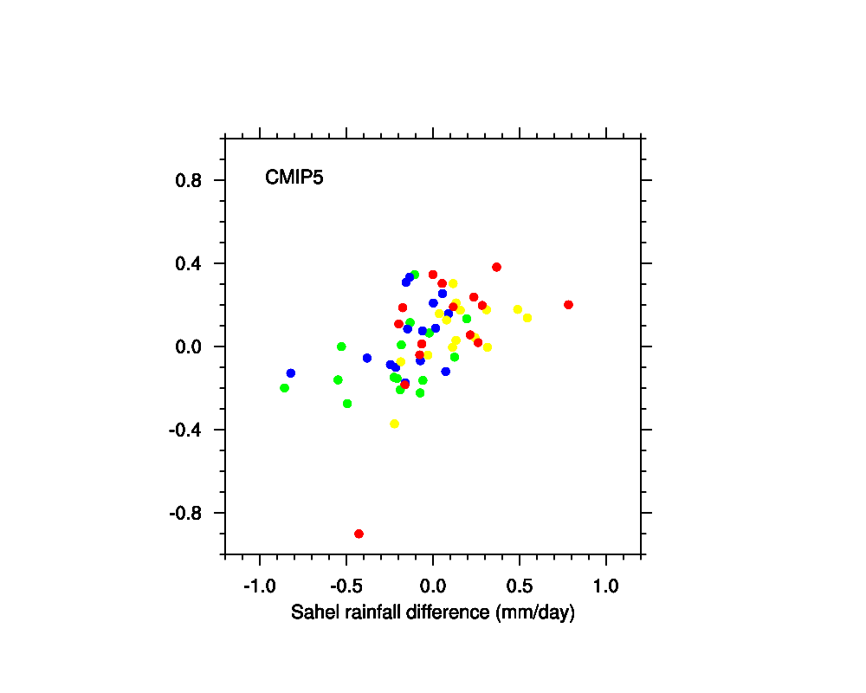
Models say that IF the subtropical North Atlantic warms up
more than the global tropics, then the Sahel could get wetter…
Past
Green: end 20th century – pre-Industrial
Blue: end – beginning 20th century
Future
Yellow: mid-21st (A1B) – end 20th
Red: end 21st – end 20th

Slide 8
A re-interpretation…
We need to consider all ocean basins simultaneously,
rather than independently,
look at relative changes between basins.
Global tropical oceans set the threshold for convection
Local ocean [in the case of the Sahel, the Atlantic]
provides the moisture to meet the threshold
Zeng, Science 2003

