Slide 1
Analysis of 20th Century
Atlantic hurricane potential intensity and
Tropical Cyclone Activity in the CMIP5 models
Suzana J. Camargo
Lamont-Doherty Earth Observatory
Columbia University
Atlantic Sector Climate Variability over the Last Millennium and the Near Term Future Workshop
LDEO, Palisades, NY, October 17, 2012

Slide 2
OUtline
Local and remote influences of Atlantic hurricane potential intensity
Tropical cyclone activity in the CMIP5 models

Slide 3
Local and Remote Influences on Atlantic Hurricane Potential Intensity
Suzana J. Camargo,
Mingfang Ting and Yochanan Kushnir
Lamont-Doherty Earth Observatory,
Columbia University
Thanks to Donna Lee, Naomi Naik and Cuihua Li

Slide 4
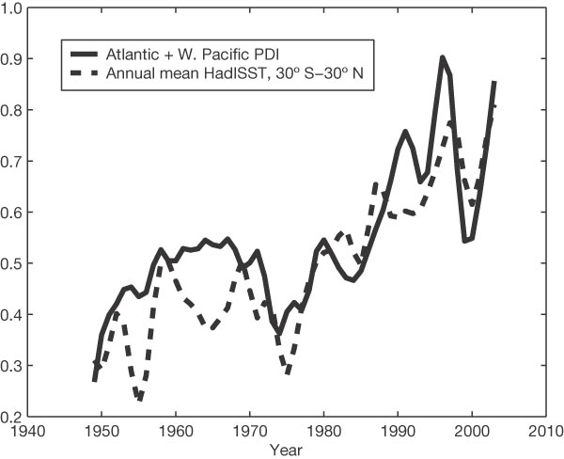
Atlantic PDI (power dissipation index ~ V³_{max}) and tropical SST
Emanuel, 2005

Slide 5
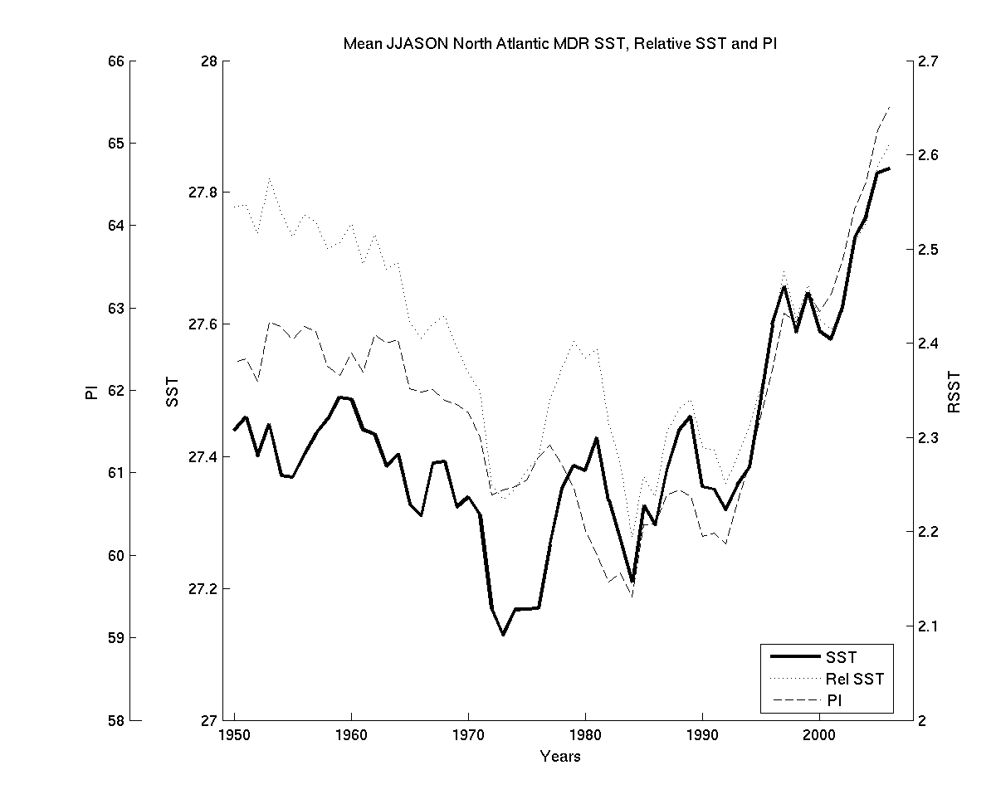
20th century North Atlantic SST and
Potential Intensity (PI)

Slide 6
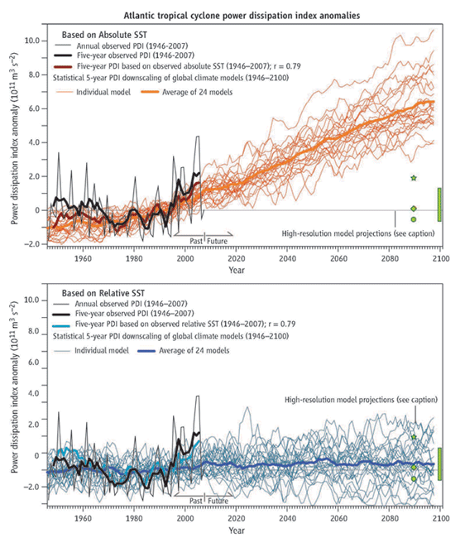
PDI and SST
PDI and relative SST
Vecchi and Soden 2007

Slide 7
Objective:
  Contributions of natural variability and anthropogenic trend to North Atlantic potential intensity
CCM3 simulations forced with fixed SST
  GOGA: global SST
  TAGA: tropical Atlantic SST
    16 ensemble members, 1856-2006
    See description in Seager et al. (2005)
  IOPOGA: Indo-Pacific SST
    8 ensemble members, 1856-2006

Slide 8
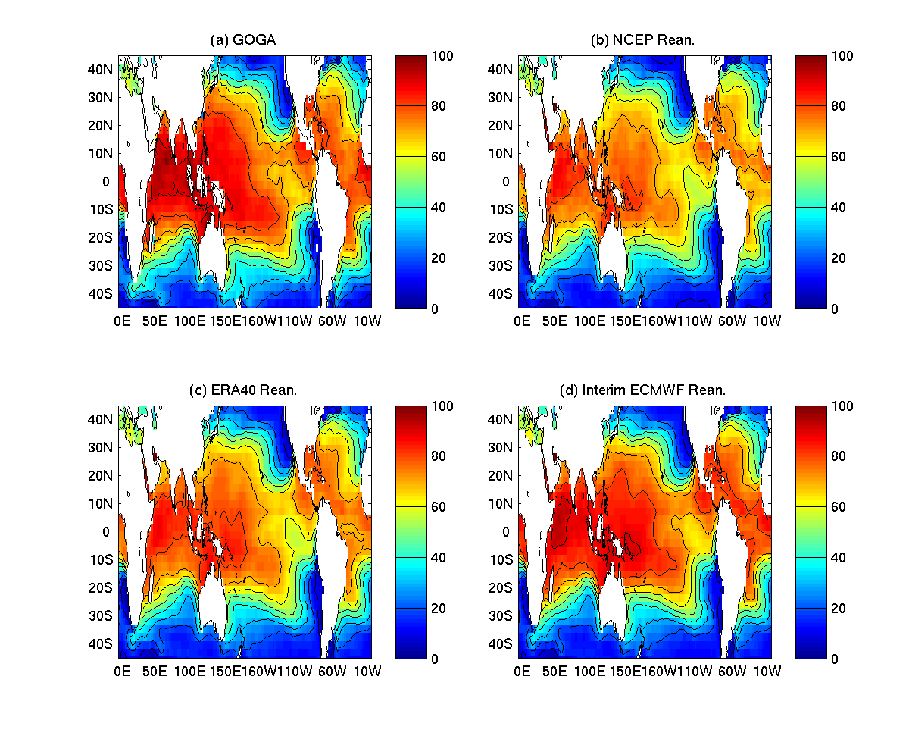
PI GOGA & Reanalysis I
Climatological Annual Maximum

Slide 9
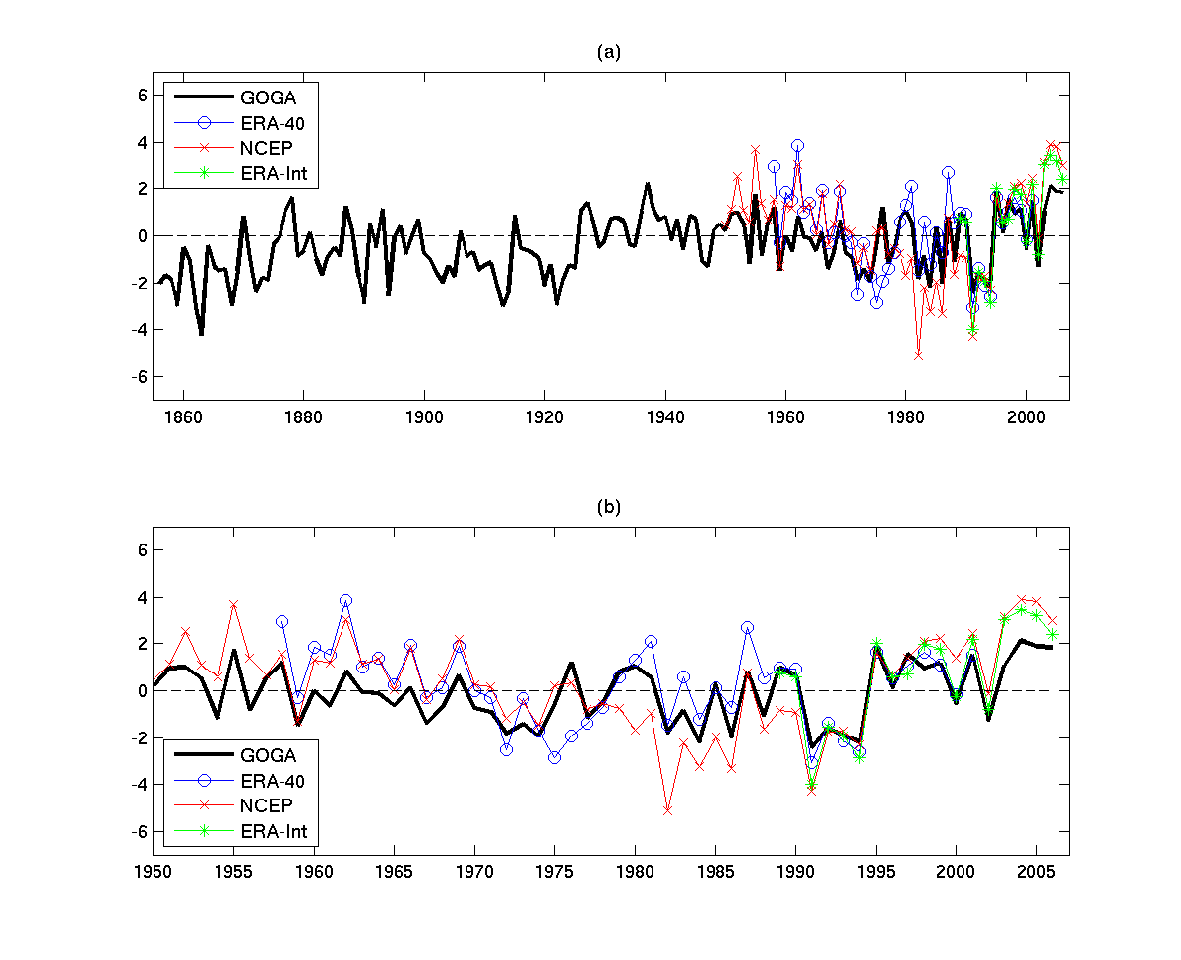
PI Anomaly GOGA and Reanalysis
Atlantic Main Development Region (MDR)

Slide 10
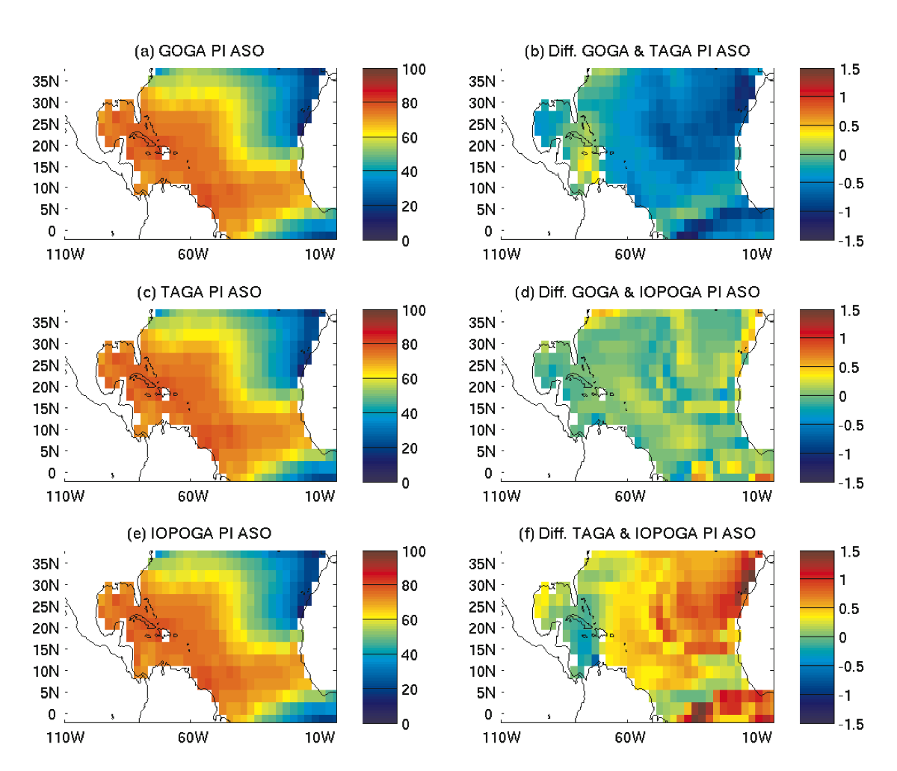
PI GOGA, TAGA & IOPOGA

Slide 11
PI and Relative SST: GOGA, TAGA & IOPOGA

Slide 12
Climate Change and Internal Variability (AMV) indices
Ting et al., 2009

Slide 13
Regression with SST

Slide 14
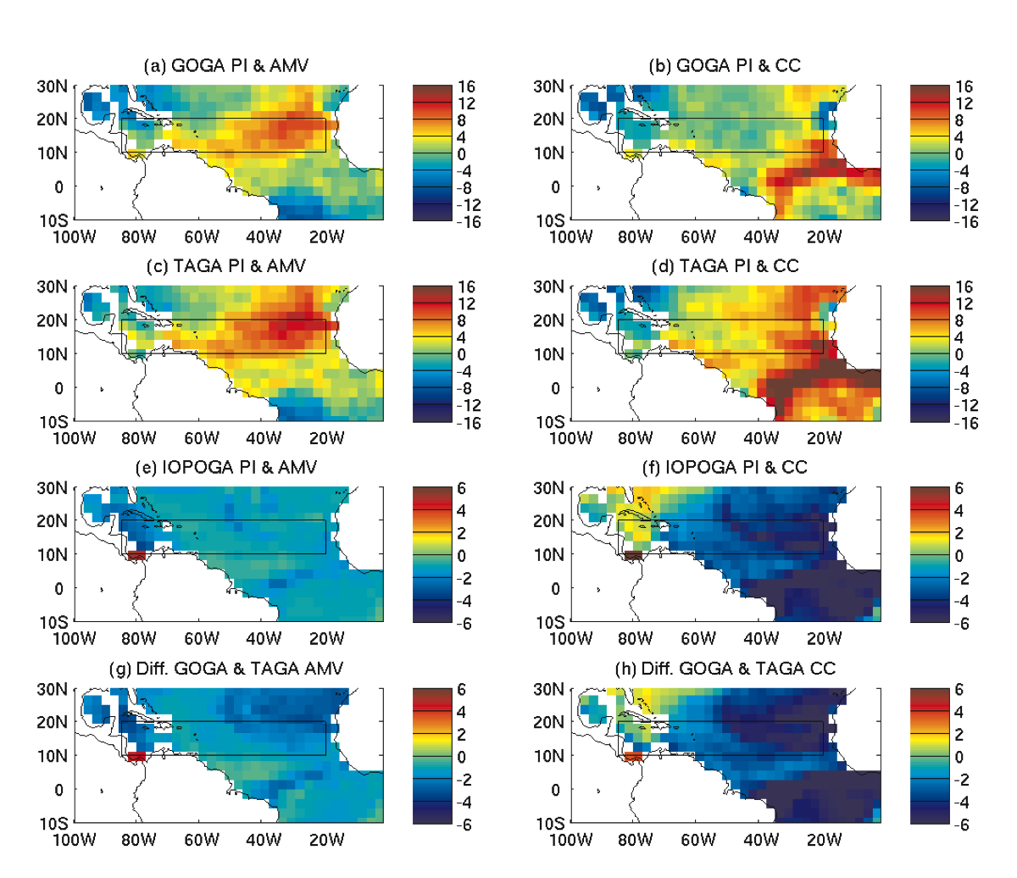
PI Regression Patterns:
CC

Slide 15
PI Regressions time-series:

Slide 16
Summary
Remote SST reduces trend of North Atlantic PI (confirming Vecchi and Soden 2007).
Remote SST also slightly reduces AMV effect on PI in the North Atlantic.
Differences of PI for GOGA and TAGA not due to Atlantic extra-tropical SST.
Late 20th century PDI upward trend (Emanuel 2005) probably not dominated by climate change, but internal variability (AMV) as hinted in DelSole et al. 2010 with a small contribution of climate change.
Next step analysis of PI in the 21st century in the CMIP5 simulations.
Camargo, Ting & Kushnir, Climate Dynamics, 2012

Slide 17
Tropical Cyclone activity in the CMIP5 models
Suzana J. Camargo
Lamont-Doherty Earth Observatory
Columbia University
Thanks to Haibo Liu and Naomi Naik for the CMIP5 dataset!

Slide 18
Objectives
Analyze the tropical cyclone (TC) activity in the CMIP5 models:
  Globally
  Atlantic
Storms in the models and environmental variables
Comparison with CMIP3
Choice of models: availability of 6-hourly data!

Slide 19
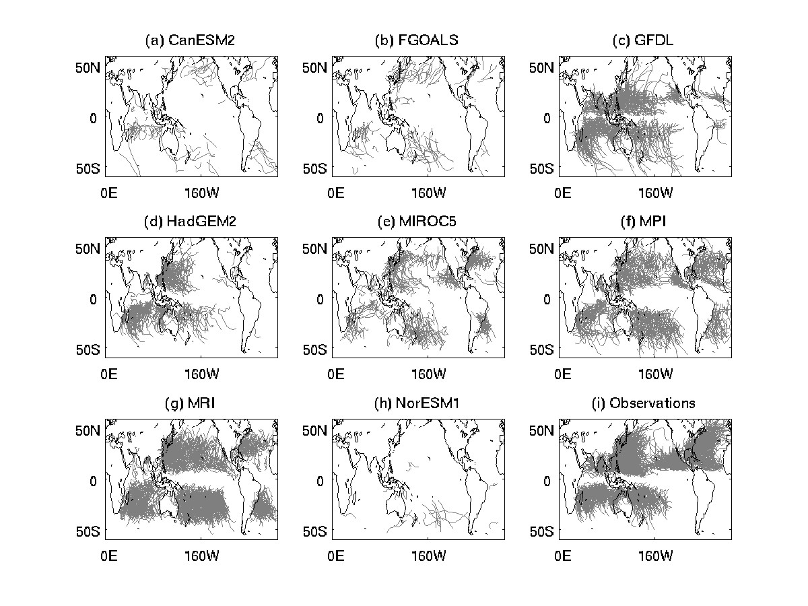
Tracks of TCs in Historical Runs

Slide 20
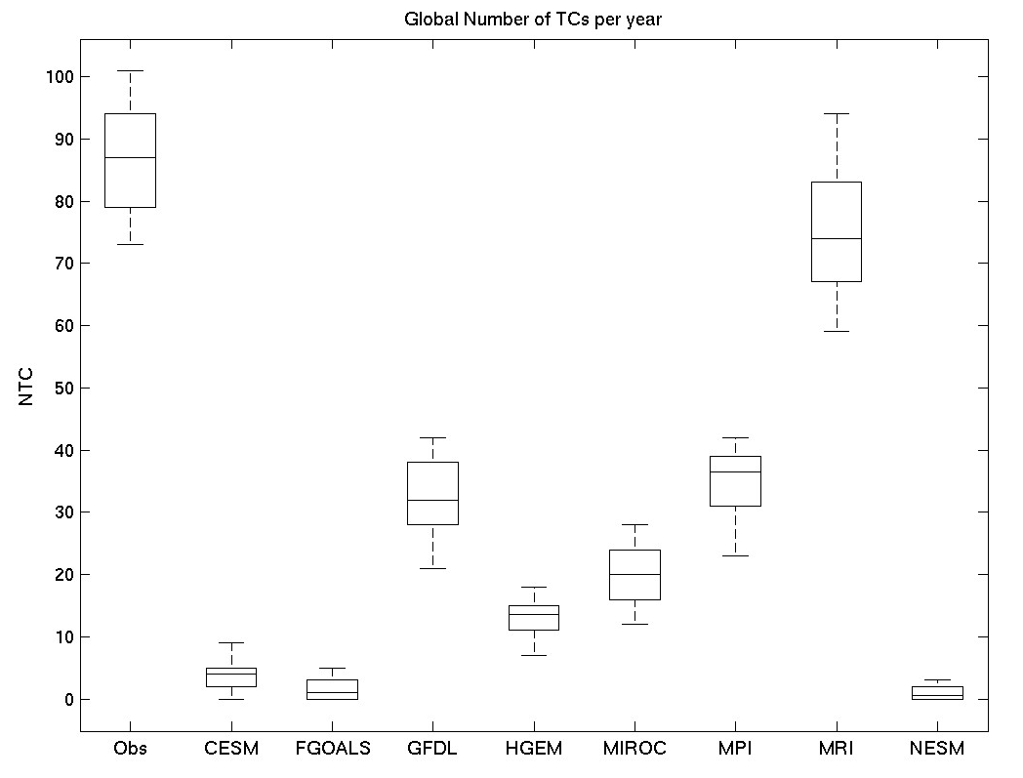
Global Number of TCs per year

Slide 21
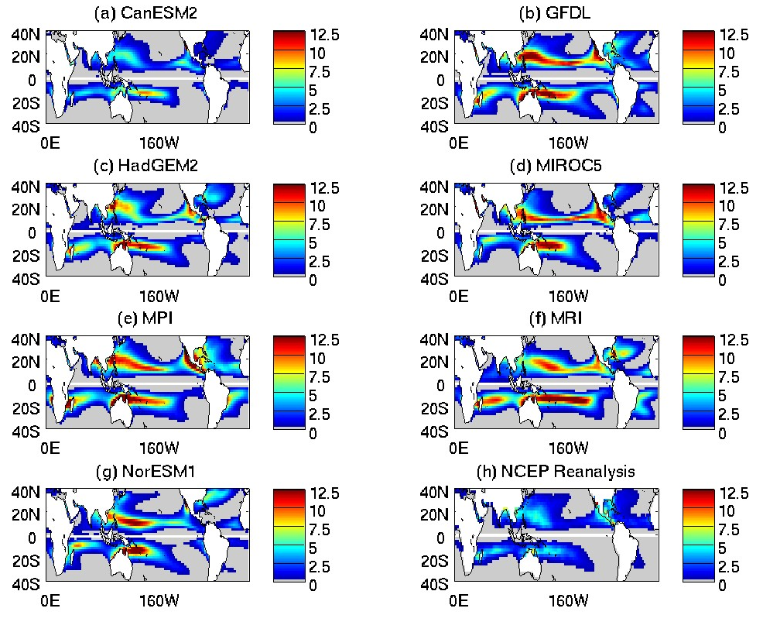
Genesis Potential Index

Slide 22
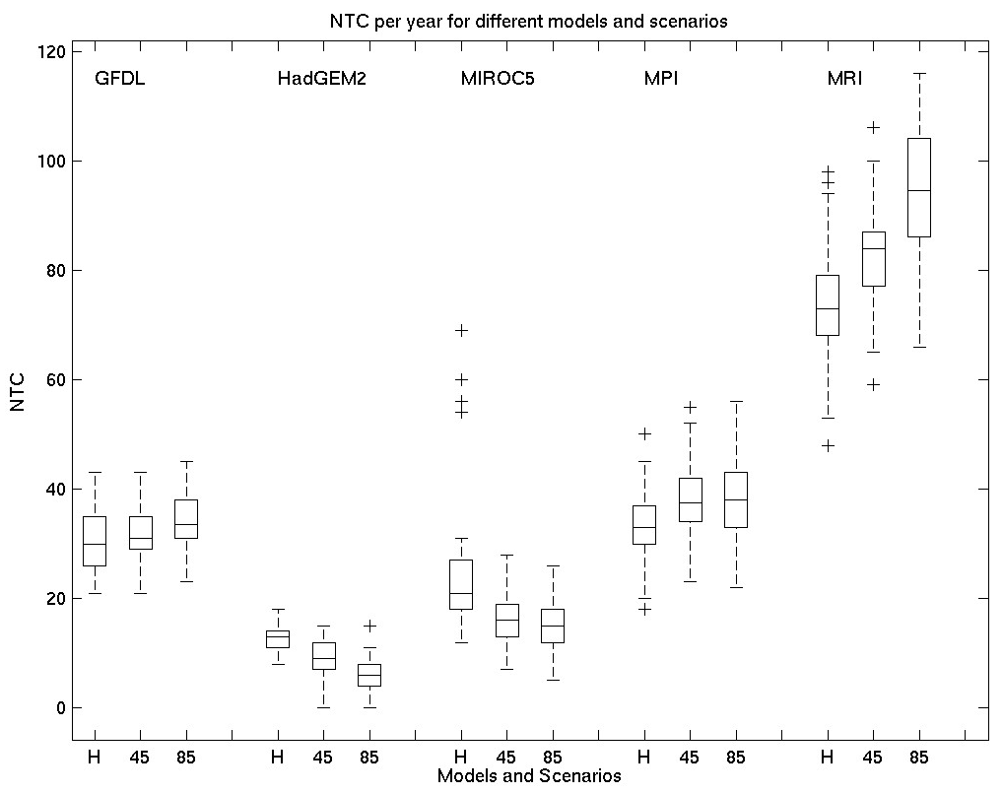
GLOBAL Number of TCs Future & Present

Slide 23
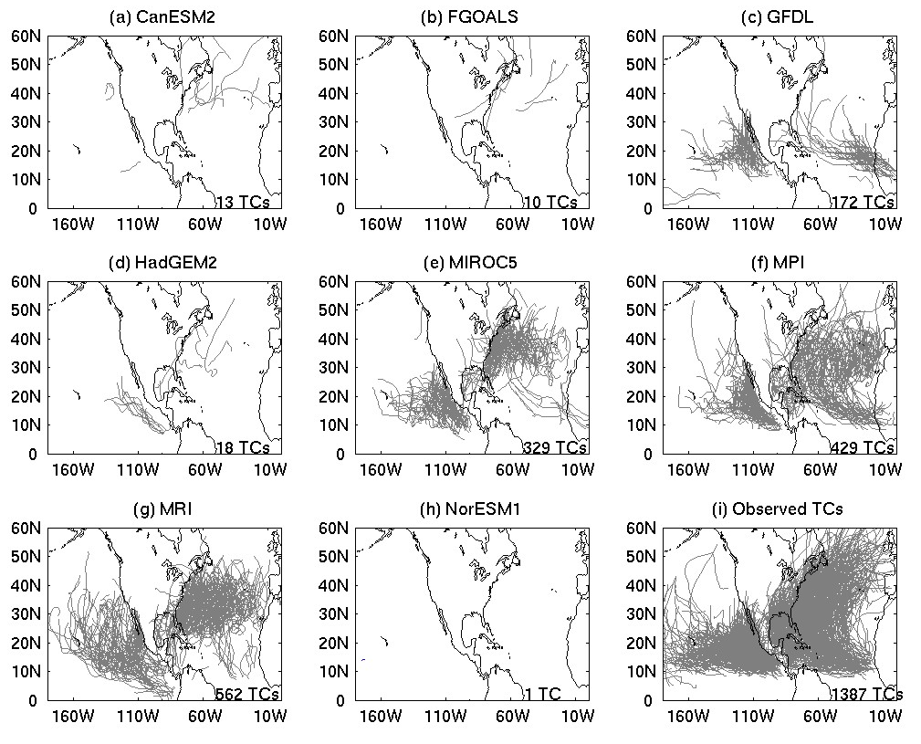
Tracks Atlantic and Eastern North Pacific

Slide 24
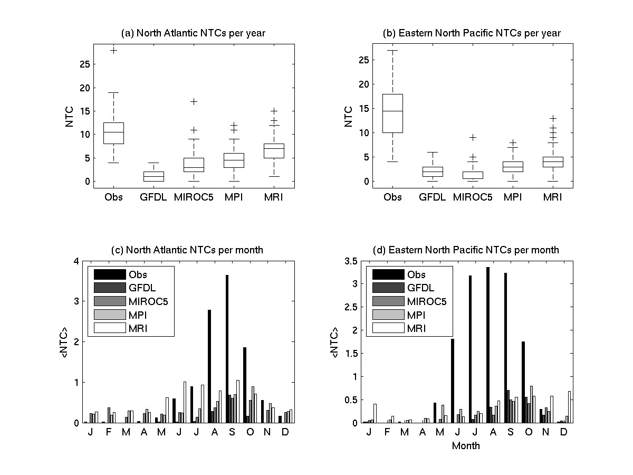
Atlantic Number of Tropical Cyclones

Slide 25
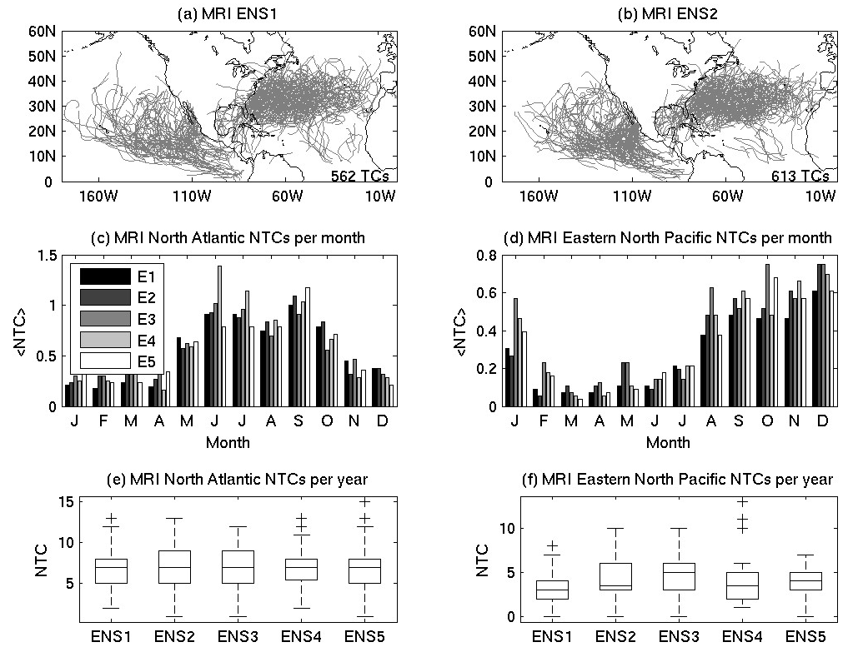
MRI TC activity – 5 ensembles

Slide 26
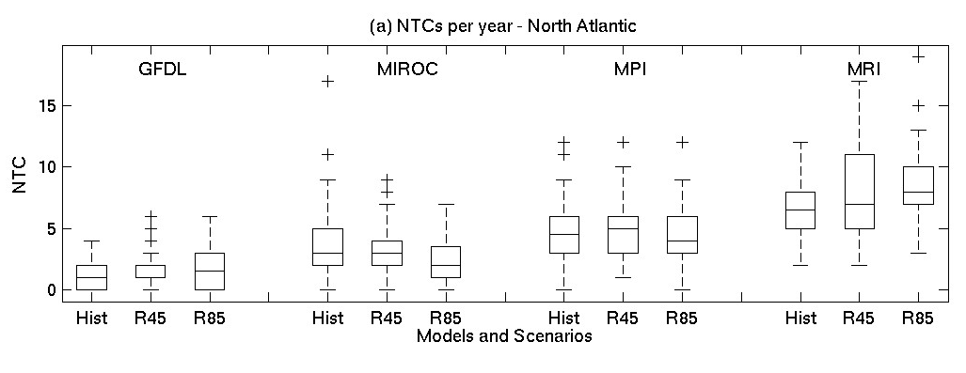
Number of Atlantic Tropical Cyclones Future & Present

Slide 27
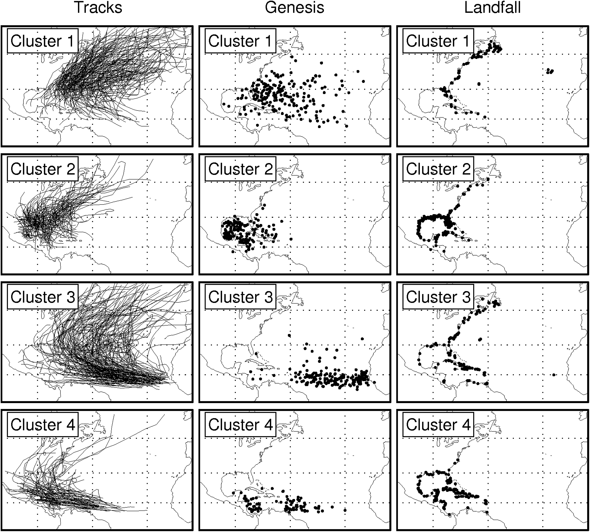
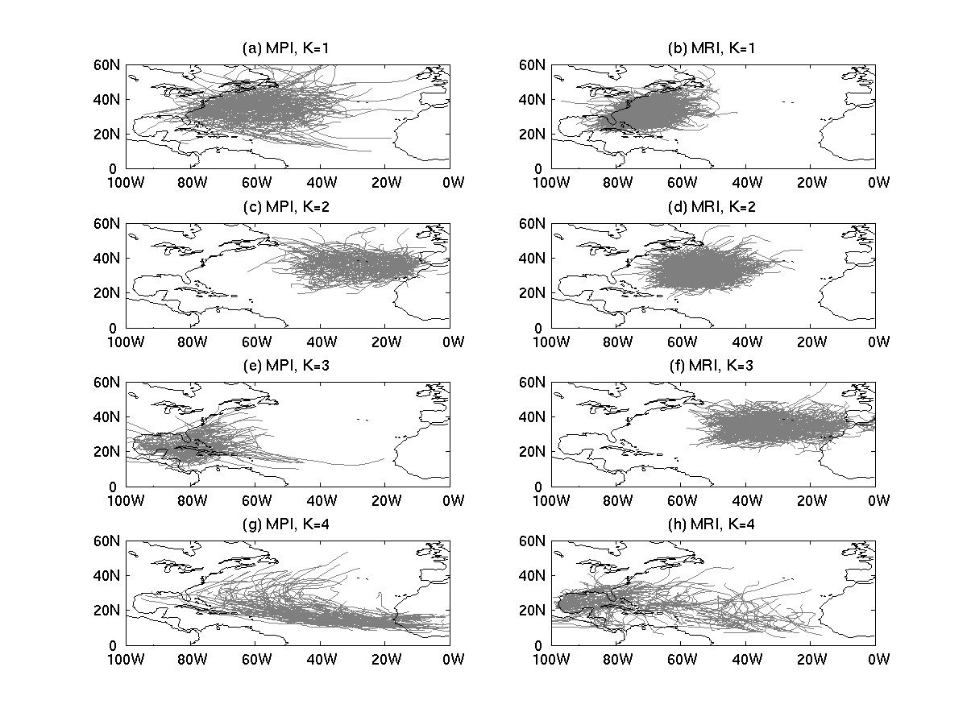
Cluster Analysis: Tracks Atlantic
Observations
Kossin, Camargo and Sitkowski, J. Climate 2010
Models

Slide 28
Track Changes Atlantic:
MPI:
  Increase: subtropical storms
  Increase: eastern subtropical storms
  Large Decrease: Deep tropics storms
MRI:
  Decrease: eastern subtropical storms
  Increase: western subtropical storms

Slide 29
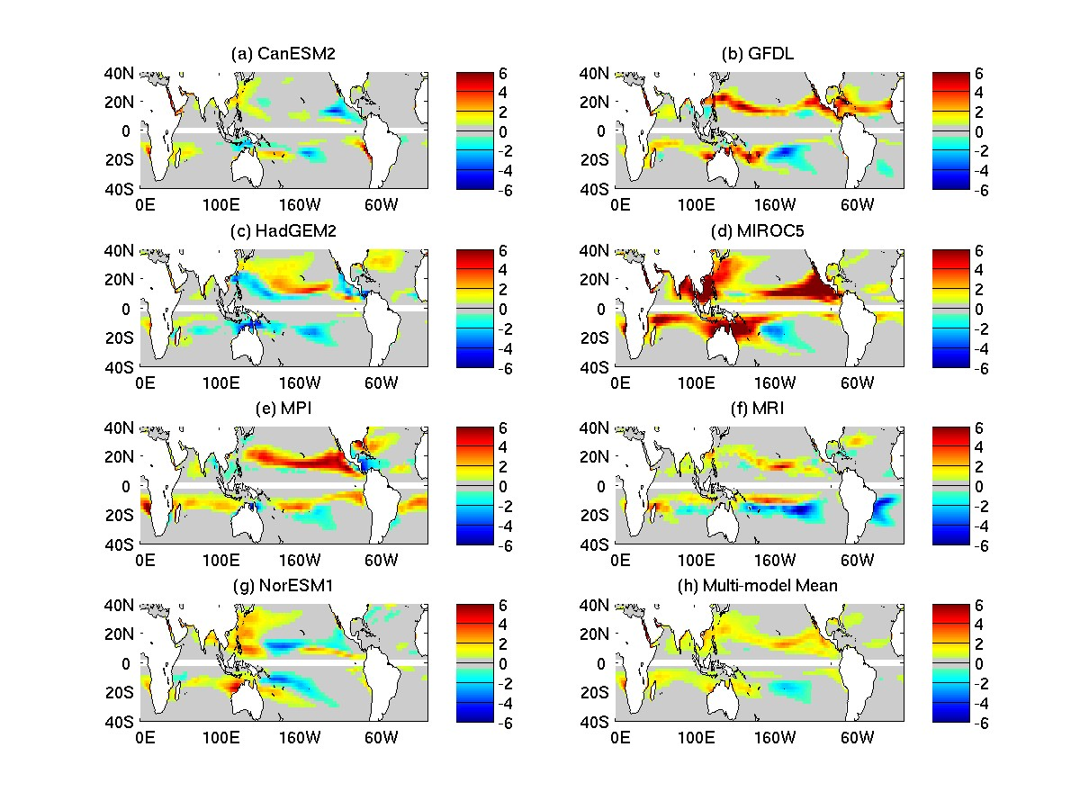
GPI changes

Slide 30
GPI differences – comparison with CMIP3
22 CMIP3 models – June to November
GPI multi-model differences
Vecchi and Soden, 2007
7 CMIP5 models:
Northern Hemisphere: ASO
Southern Hemisphere: JFM

Slide 31
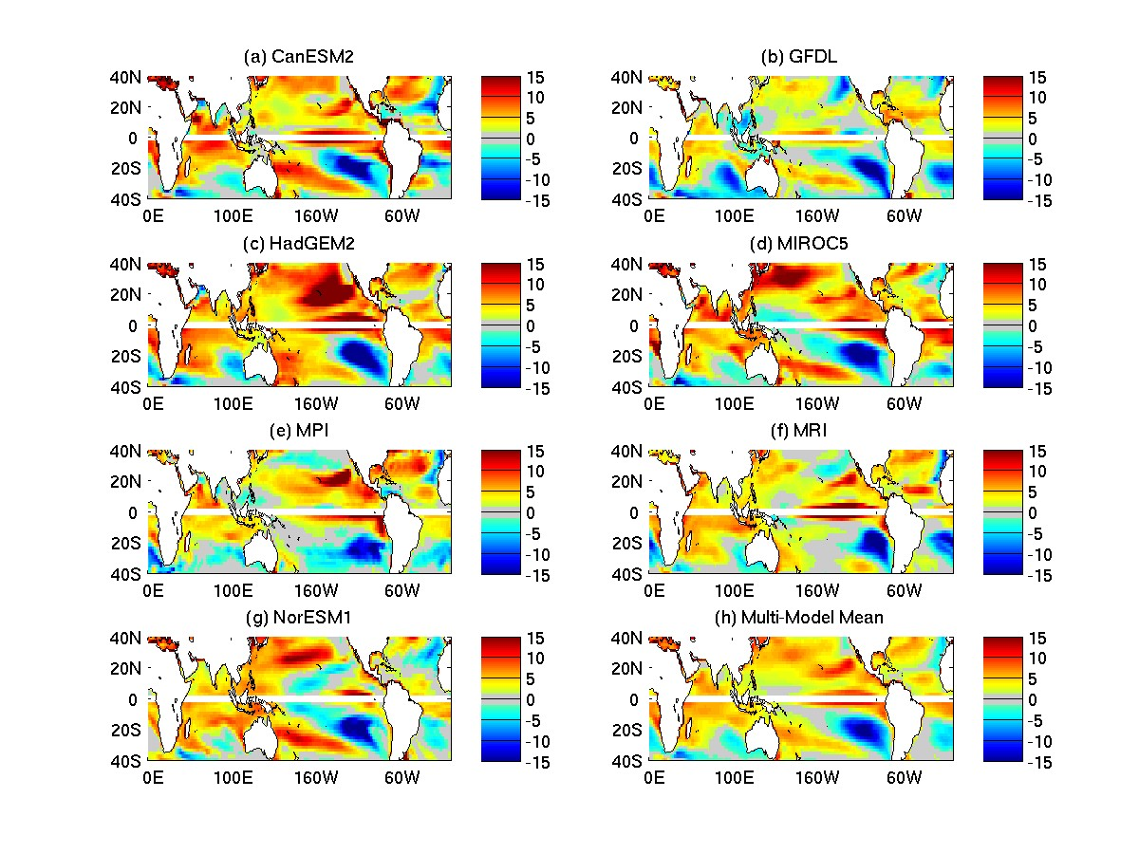
PI differences: comparison with CMIP3
22 CMIP3 models – June to November
PI multi-model differences
Vecchi and Soden, 2007
7 CMIP5 models:
Northern Hemisphere: ASO
Southern Hemisphere: JFM

Slide 32
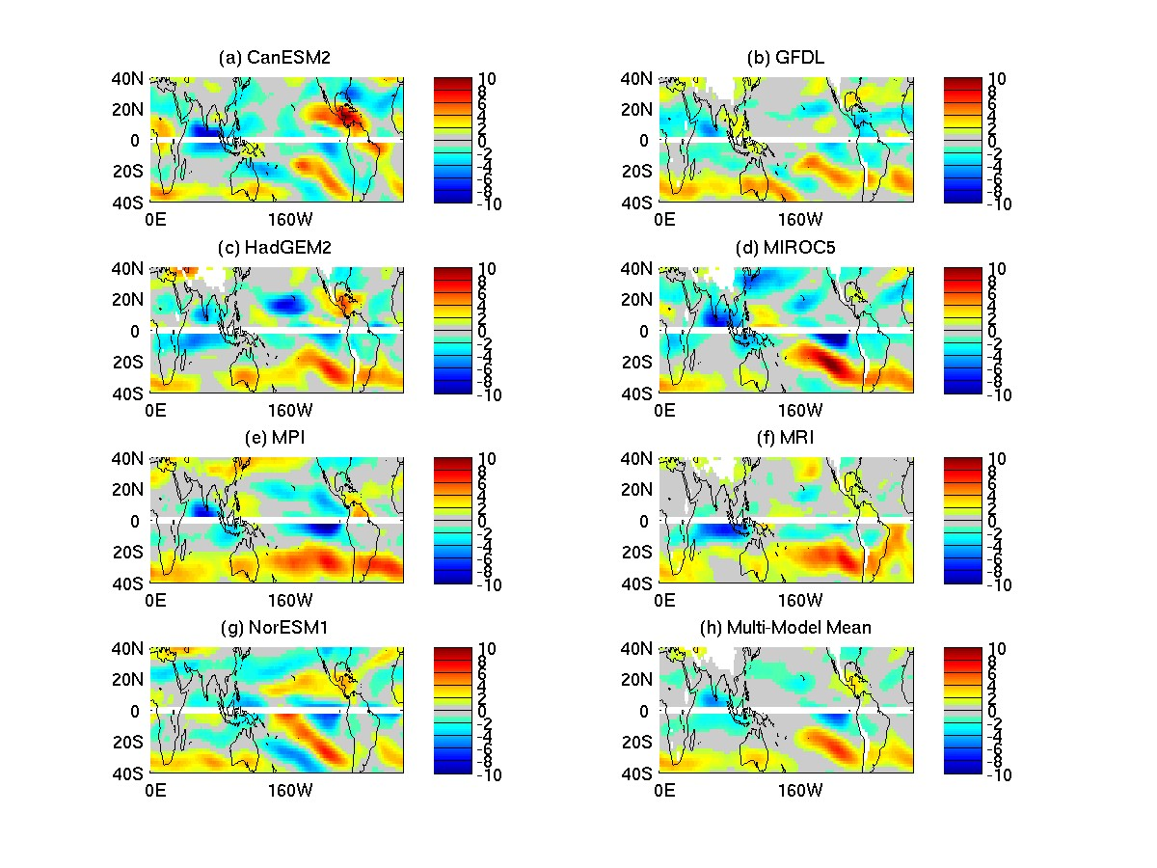
Vertical Wind shear differences: comparison with CMIP3
22 CMIP3 models – June to November
PI multi-model differences
Vecchi and Soden, 2007
7 CMIP5 models:
Northern Hemisphere: ASO
Southern Hemisphere: JFM

Slide 33
Summary
TC activity in the models analyzed not very realistic yet.
Models have a low bias in TC counts, that improves with horizontal resolution.
No robust changes in TC frequency: globally or regionally.
Environmental changes: very similar to CMIP3 results
Need of downscaling (statistical, dynamical) and/or higher resolution runs
Submitted to J. Climate, CMIP5 MAPP North American Climate special issue.

