Slide 1
Influence of local and remote SST on North Atlantic tropical cyclone potential intensity
Suzana J. Camargo,
Mingfang Ting and Yochanan Kushnir
LDEO, Columbia University
GloDecH Meeting, OCP, LDEO, December 14, 2011.

Slide 2
Atlantic PDI (power dissipation index ~ V³_{max}) and tropical SST
Emanuel, 2005

Slide 3
20th century North Atlantic SST and Potential Intensity (PI)

Slide 4
PDI and SST
PDI and relative SST
Vecchi and Soden 2007

Slide 5
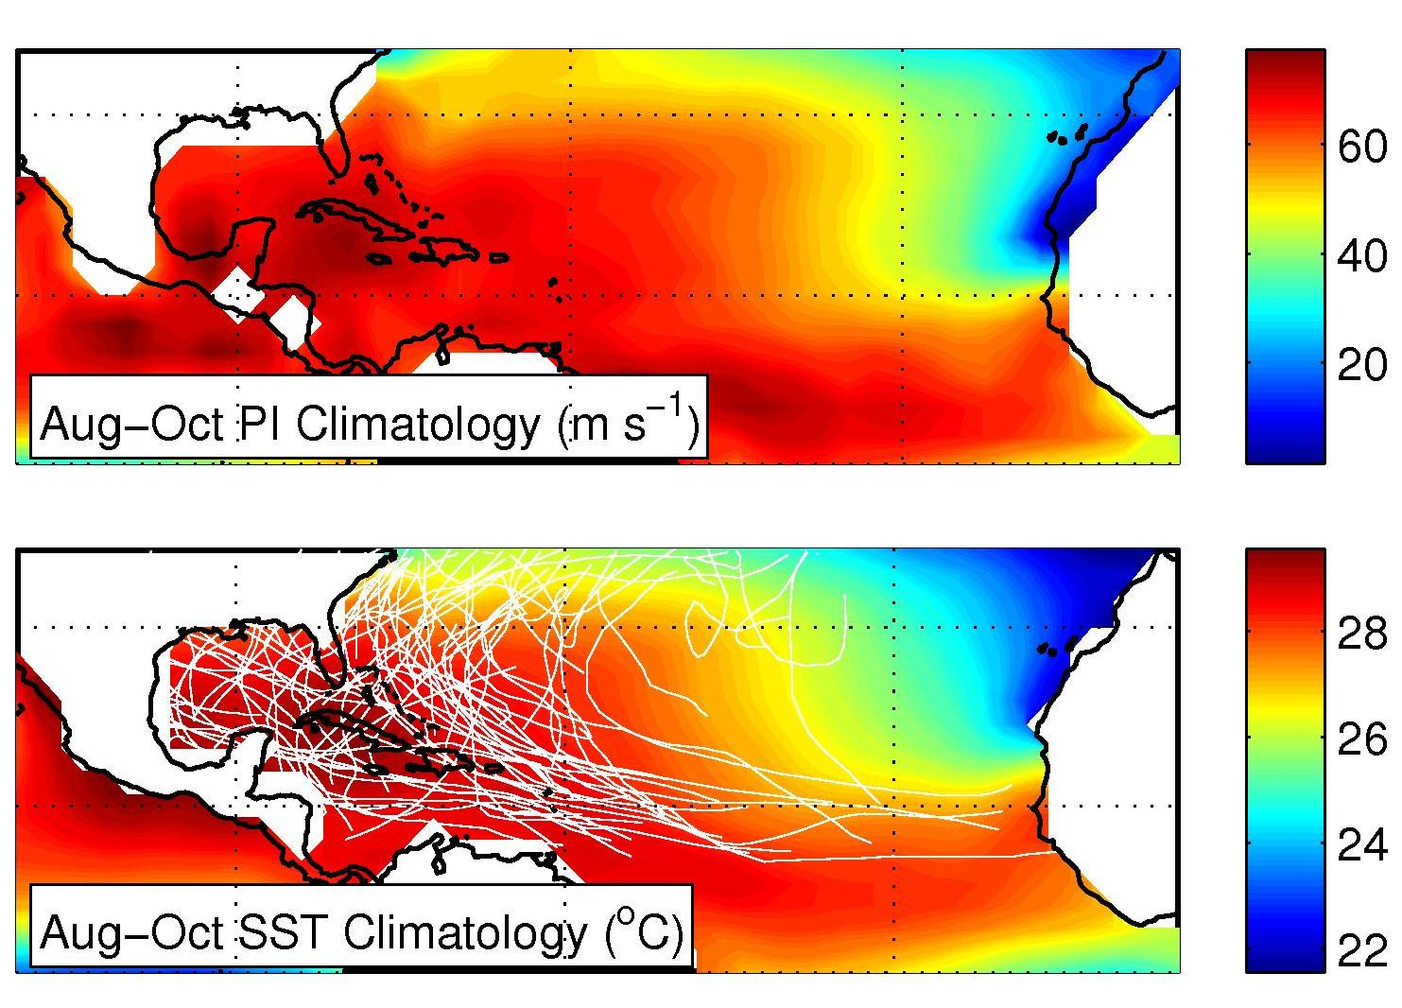
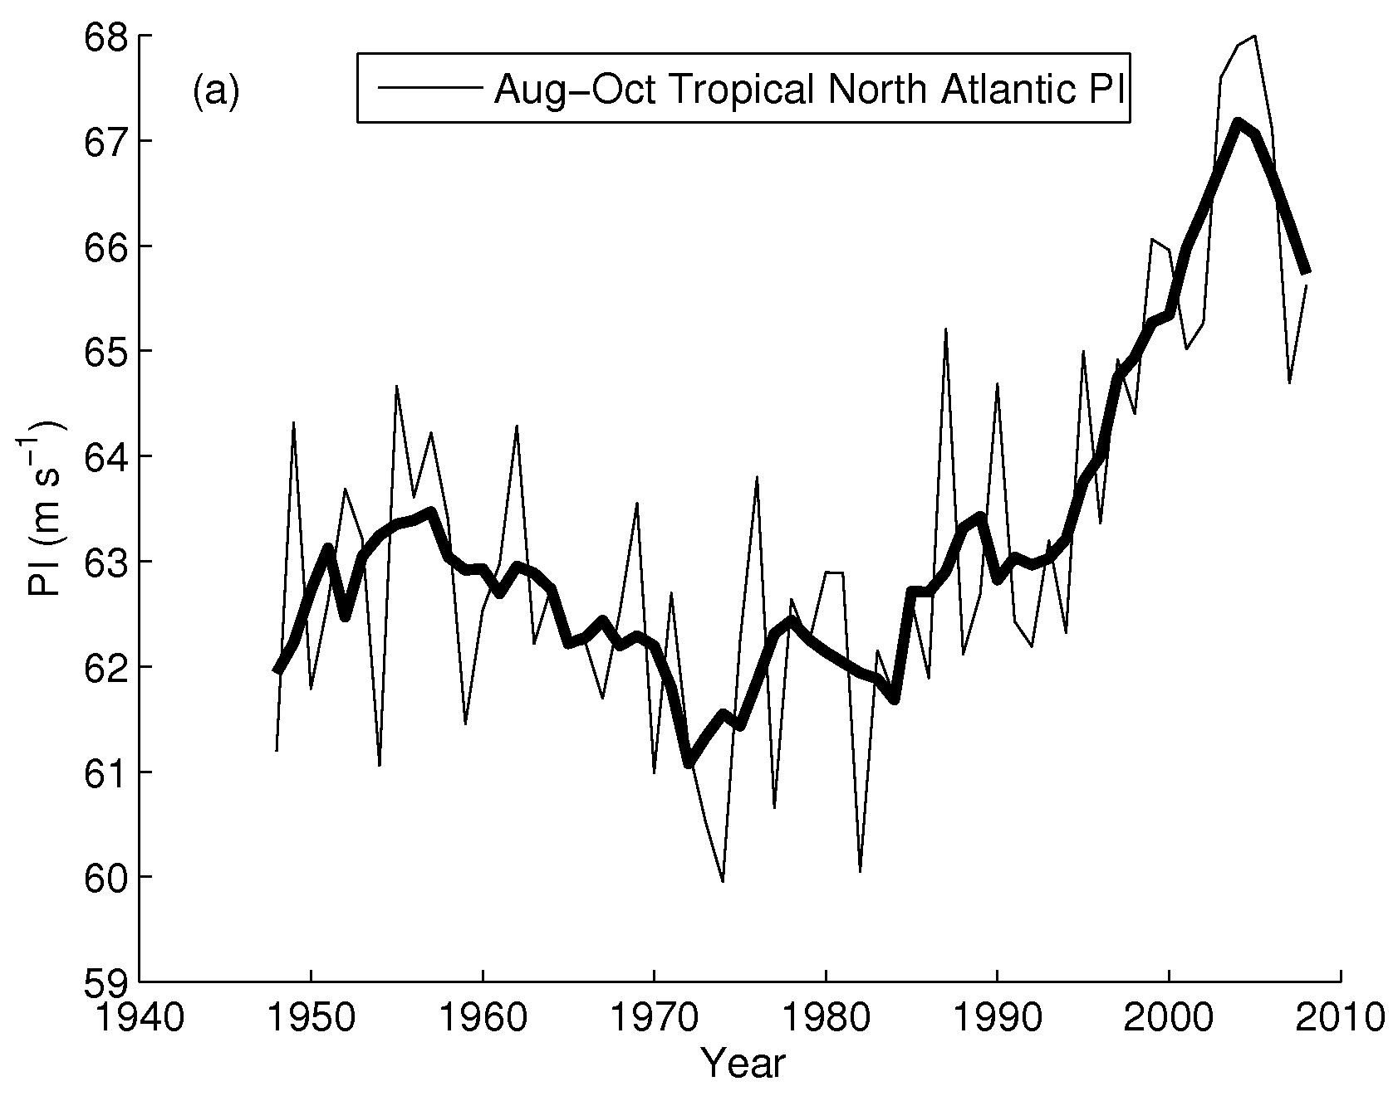
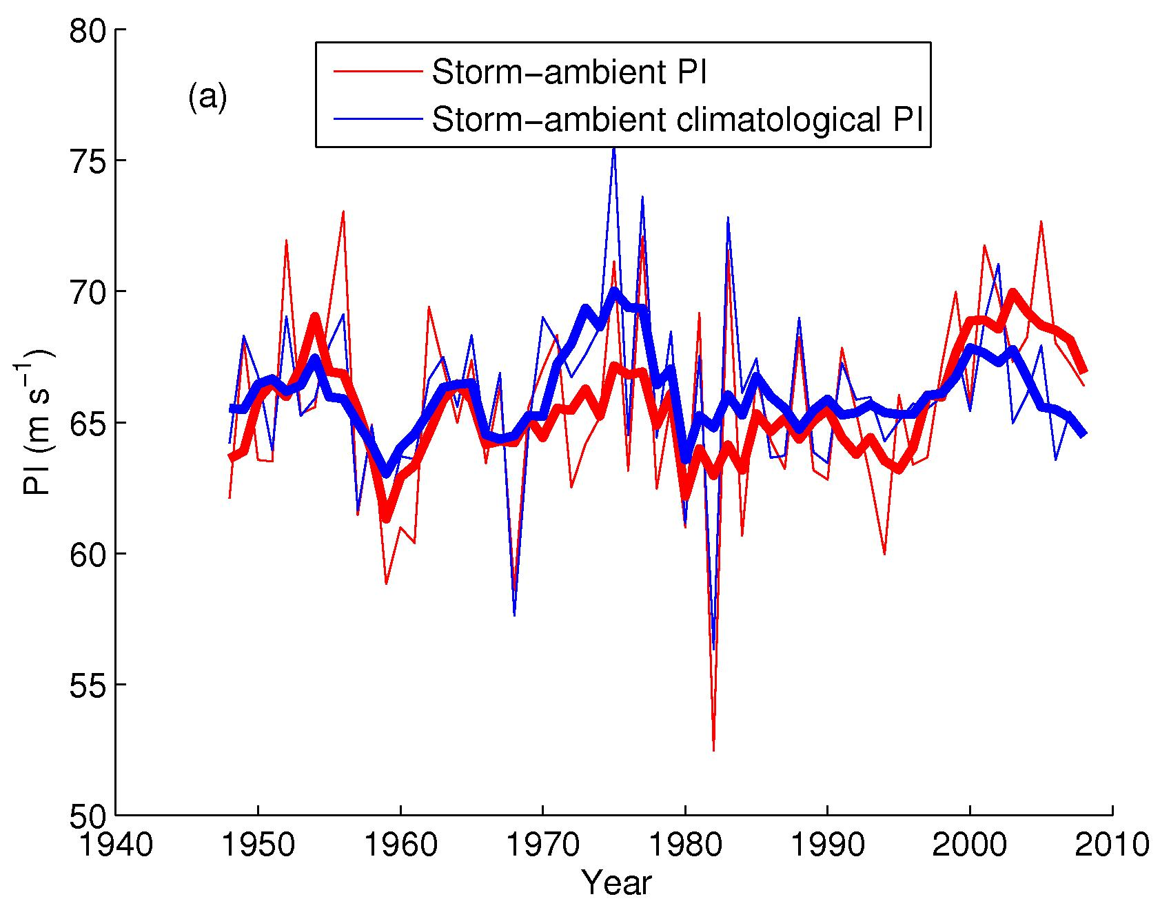
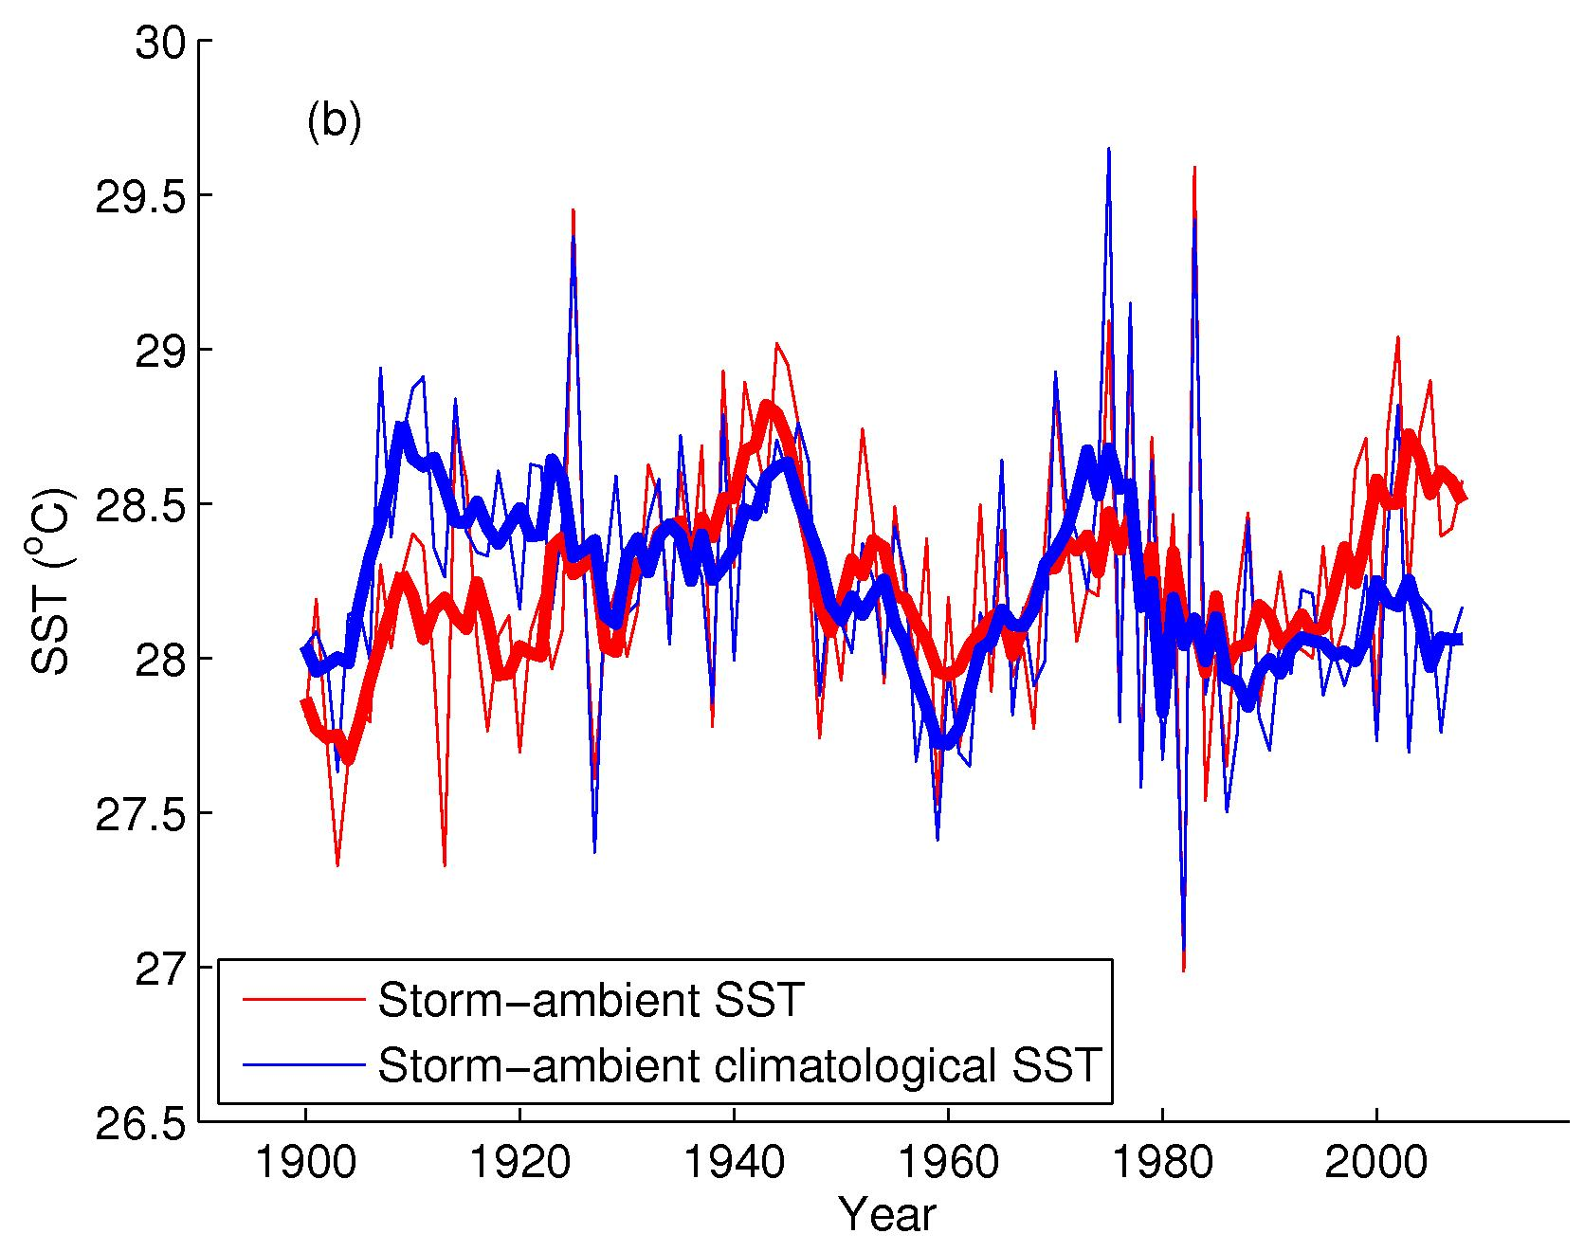
Atlantic Hurricanes trends: dependency on tracks Kossin and Camargo, Climatic Change (2009)

Slide 6
Objective:
Contributions of natural variability and anthropogenic trend to North Atlantic potential intensity
CCM3 simulations
GOGA: global SST
TAGA: tropical Atlantic SST
POGA (not shown)
16 ensemble members, 1856-2006
Idealized simulations:
Warm Atlantic, Cold Atlantic
Warm Tropical Atlantic, Cold Tropical Atlantic

Slide 7
PI GOGA & Reanalysis I Climatological Annual Maximum

Slide 8
PI GOGA and Reanalysis II JJASON – Atlantic Hurricane season

Slide 9
PI Anomaly GOGA and Reanalysis Atlantic Main Development Region (MDR)

Slide 10
PI GOGA & TAGA

Slide 11
PI GOGA & TAGA II

Slide 12
Climate Change and Internal Variability (AMO) indices
Ting et al.
2009

Slide 13
Regression Patterns: PI and AMO & CC indices
CC

Slide 14
Regression time-series:

Slide 15
Role of extra-tropics: Idealized SST patterns

Slide 16
Summary
Remote SST reduces trend of North Atlantic PI (confirming Vecchi and Soden 2007).
Remote SST also slightly reduces AMO effect on PI in the North Atlantic.
Differences of PI for GOGA and TAGA related to the AMO not due to Pacific (POGA) or Atlantic extra-tropical SST: causes are not clear.
Late 20th century PDI upward trend (Emanuel 2005) probably not dominated by climate change, but internal variability (AMO) as hinted in DelSole et al. 2010.
Next step analysis of PI in the 21st century in the CMIP5 simulations.

