Slide 1
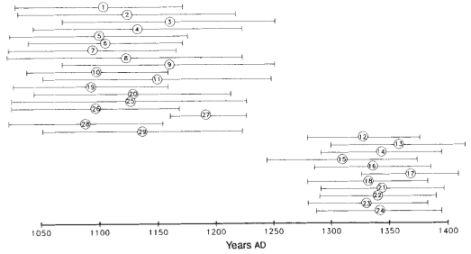
Are Simulated SW North American Megadroughts Forced?
Sloan Coats, Jason E. Smerdon, Richard Seager, and Benjamin I. Cook
Journal of Climate, In Preparation
Stine, 1994
GloDecH Meeting
Lamont Doherty Earth Observatory, Columbia University
October 16, 2013

Slide 2
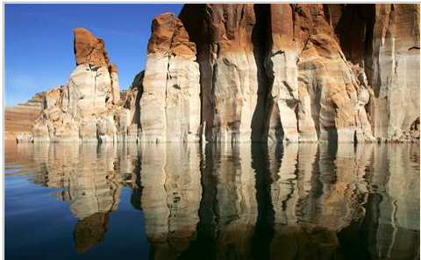
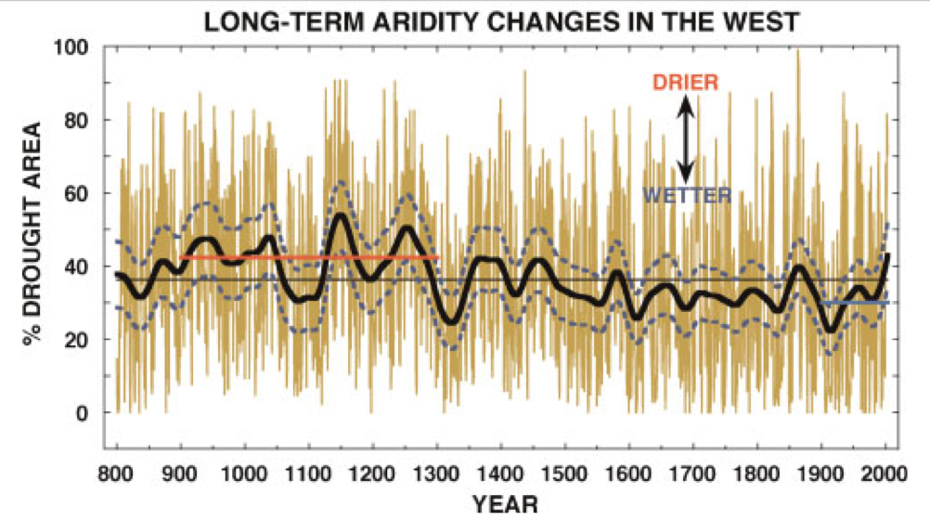
Why Southwestern North America?
16% of the U.S. population (U.S. Census Bureau, 2009).
Half of domestic food crop production (Parker, 2007).
Water supply is fickle and unpredictable (Schlenker et al., 2007).
David McNew/Getty Images
Last millenium has
decadal to century scale “megadroughts”.
Cook et al., 2009

Slide 3
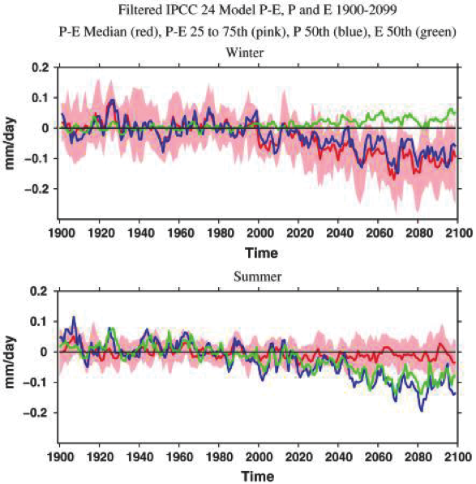
Projecting Future Hydroclimate
Drying trend over SW in median P-E for 24 IPCC AR4 Models
Seager and Vecchi, 2010

Slide 4
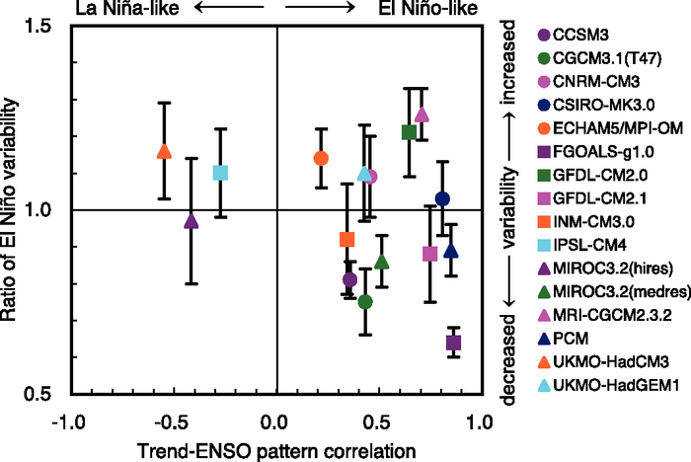
But Tropical Pacific is dominant driver of SW hydro…
IPCC AR4
…and there is little agreement in simulated future state of TP.

Slide 5
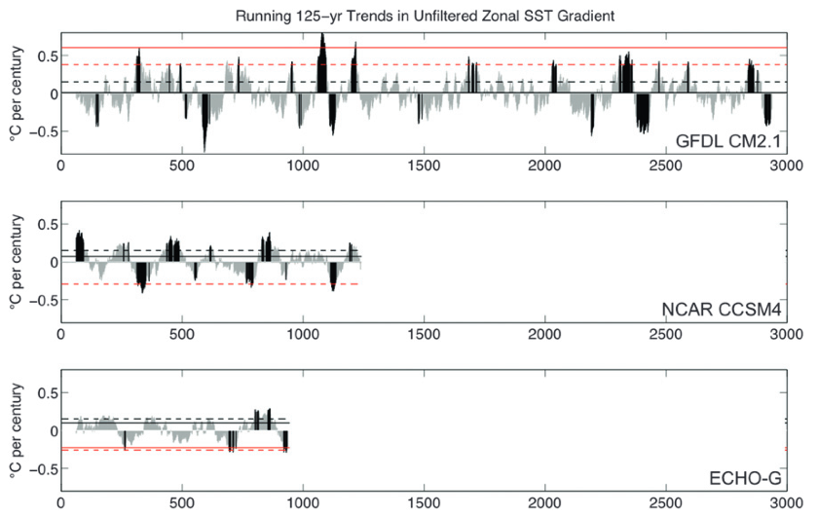
What do the observations say?
La Niña-like trend in TPGR (1880-2005)
Karnauskas et al., 2009
Obs TP trend (--) and Sim TP trend (--) within the magnitude of 125-year trends from simulated internal variability
Karnauskas et al., 2012

Slide 6
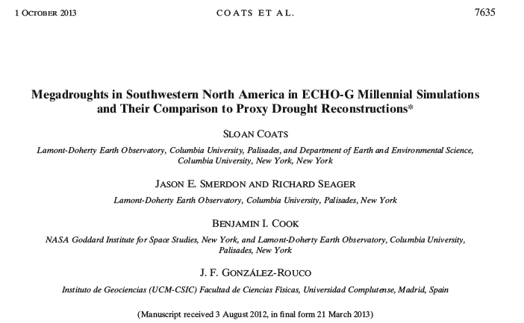
What do model’s say?
So are unforced megadroughts a robust model response and is that at all realistic? And how feasible is projecting future hydroclimate states?

Slide 7
Two Research Questions
Do state-of-the-art AOGCMs simulate megadroughts?
Are these driven by variations in the exogenous forcing conditions and/or the oceanic boundary conditions?

Slide 8
Methods: Creating a hydroclimate index
JJA PDSI from the NADA is ground truth.
JJA PDSI was calculated for models:
  6 forced LM simulations appended to historical simulations (0850-2005).
  2.5x2.5 lat-lon grid.
  Net radiation and precipitation as inputs.
Hydroclimate timeseries was created by averaging the PDSI over the Southwest region of NA (125°W-105°W, 25°N-42.5°N ).

Slide 9
Methods: Identifying drought
Droughts identified using the 2 start 2 end method from Coats et al., 2013a.
Droughts ranked using drought density method also from Coats et al., 2013a.
Top five are chosen for analysis of dynamics that drive persistent drought.
Results not dependent on “arbitrary” metric (Coats et al., 2013a).

Slide 10
Do models simulate megadroughts?
Models simulate drought features that are characteristic (persistence and severity) of the proxy estimated megadroughts.
There is a range in the characteristics of model simulated megadroughts (some models do better than others).
No agreement in drought timing and no statistically significant correlations between PDSI timeseries.
Paleoclimate estimated drought variability

Slide 11
Winter/Summer? Precip/Evap?
Megadroughts result from anomalously low winter (DJF) precipitation over the SW.
Pattern is characteristic of that driven by the La Niña.

Slide 12
ECHO-G simulations showed the same megadrought precip pattern, but it wasn’t forced by La Niña…
CCSM model simulates megadroughts forced by
the TP.
**Statistically significant connection between megadroughts and a mode of variability at the 99% level using a distribution and auto-correlation preserving bootstrapping method.

Slide 13
Another angle: Composite 200mb DJF height anomaly during megadroughts
Cross-hatching indicates that 4 of 5 identified droughts show the same sign anomaly as the composite at that gridpoint.
Positive height anomaly is reminiscent of the pattern forced by La Niña.

Slide 14
Analysis of CCSM
What is happening in the TP during the identified megadrought periods?
Why does only the CCSM model exhibit a connection between megadroughts and the TP?

Slide 15
Mean state change or a change in TP variability?
-Well documented physical mechanisms for mean state change in TP (Vecchi et al., 2011). Model’s have shown multidecadal modulation of ENSO variability (Wittenberg et al., 2006).
-Megadrought periods in CCSM have approximately average Niño3.4 statistics.
-Megadrought periods are consistent with a shift toward a more La Niña-like mean state.

Slide 16
Is the change in mean-state forced?
First EOF of LP-filtered Temp over TP: CCSM Control
—PC; —TPGR
First EOF of LP-filtered Temp over TP: CCSM Forced
—PC; —TPGR
TPGR on multidecadal timescales in CCSM is consistent with the internal CPO mode of variability.

Slide 17
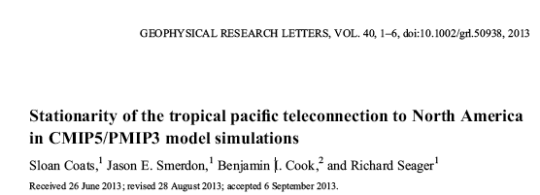
What is different about CCSM?
Very strong, realistic and stationary teleconnection between SW and TP for CCSM!

Slide 18
Hypothesis
Stochastic atmospheric variability (and internal modes of coupled atmosphere ocean variability outside of the TP)…can produce storm track shifts that are uninterrupted by tropical Pacific influence because of the weak (and non-stationary) ENSO teleconnection on multidecadal timescales… from Coats et al., 2013a
Correlation between SW PDSI timeseries and SST for LM

Slide 19
Conclusions
Models simulate megadroughts that are characteristic of the paleo-proxy record.
These drought are not tied to changes in the exogenous forcing.
Atmosphere-only megadroughts are not a robust model characteristic. Models with strong, stationary teleconnections simulate TP driven persistent drought.

Slide 20
Discussion
If CCSM model behavior is characteristic of the actual climate system then regional hydroclimate is perhaps more predictable, though operational prediction of the TP has yet to exceed ~1 year.
We must better understand atmosphere only driven hydroclimate change as these models will be used to create future projections.
These types of analyses are an important addition to statistical rescaling of model output such as in Ault et al., 2012; 2013 (getting the right answer for the wrong reason—or vice versa).

