Slide 1
A Metrics Framework for Interannual-to-Decadal Predictions Experiments
L. Goddard, on behalf of the US CLIVAR Decadal Predictability Working Group & Collaborators: Lisa Goddard, Arun Kumar, Amy Solomon, James Carton, Clara Deser, Ichiro Fukumori, Arthur M. Greene, Gabriele Hegerl, Ben Kirtman, Yochanan Kushnir, Matthew Newman, Doug Smith, Dan Vimont, Tom Delworth, Jerry Meehl, and Timothy Stockdale
Paula Gonzalez, Simon Mason, Ed Hawkins, Rowan Sutton,
Rob Bergman, Tom Fricker, , Chris Ferro, David Stephenson

Slide 2
US CLIVAR Decadal Predictability Working Group
Formally approved January 2009
Objective 1: To define a framework to distinguish natural variability from anthropogenically forced variability on decadal time scales for the purpose of assessing predictability of decadal-scale climate variations in coupled climate models.
Objective 2: Work towards better understanding of decadal variability and predictability through metrics that can be used as a strategy to assess and validate decadal climate prediction simulations.

Slide 3
Proposed FRAMEWORK for Verification:
1. Feasibility (of particular model/fcst system)
- Realistic, and relevant, variability? - Translation of ICs to realistic and relevant variability?
2. Prediction skill – Quality of system; quality of information
- Where? What space & time scales? - Actual anomalies & ‘decadal scale trends’ - Conditional skill? - Values of ICs: higher correlations, lower RMSEs
3. Issues – for research, for concern i.e. limited ability to quantify uncertainty; limited understanding of processes, etc.

Slide 4
Outline
Objective
Framework
Metrics & examples of results
Statistical significance
Website
Issues relevant to verification endeavor
Bias correction
Spatial scale
Stationarity/reference period

Slide 5
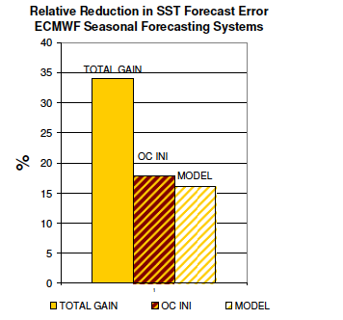
Motivation: Forecasts need verification
… for tracking improvements in prediction systems
Example from SI:
Recent improvements to ECMWF seasonal forecast system came in almost equal parts from improvements to the model and the ODA
(Balmaseda et al. 2009, OceanObs’09)
Example from SI:
NCEP-CFS reaches parity with statistical fcsts for ENSO
… for comparison against other systems and other approaches
(Saha et al. 2004, J.Clim)

Slide 6
How “good” are they?: Deterministic Metrics
Regional Average (15°x15°); 5-Year Means:
(Courtesy: Doug Smith)
Grid Scale; 10-Year Means:
ECHAM5 + MPI-OM
3 member perturbed IC ensemble
Starting every 5 years Nov from 1955 to 2005
(Keenlyside et al. 2008, Nature)
Notes:
Deterministic metrics is really what we are currently set up to do, until we have a good way of assigning uncertainty that is specific to the climate forecast,
not the model, not the emission scenario, etc.
For that need probabilistic calibration, which we really don’t have enough data, or at least an idea of the “climatological” odds.
How is anomaly calculated?

Slide 7
Outline
Objective
Framework
Metrics & examples of results
Statistical significance
Website
Issues relevant to verification endeavor
Bias correction
Spatial scale
Stationarity/reference period

Slide 8
Asking Questions of the Initialized Hindcasts
Question 1: Do the initial conditions in the hindcasts lead to more accurate predictions of the climate?
Question 2: Is the model's ensemble spread an appropriate representation of forecast uncertainty on average?
Question 3: In the case that the forecast ensemble does offer information on overall forecast uncertainty, does the forecast-to-forecast variability of the ensemble spread carry meaningful information?
Time scale: Year 1, Years 2-5, Years 2-9
Spatial scale: Grid scale, spatially-smoothed

Slide 9
Asking Questions of the Initialized Hindcasts
Question 1: Do the initial conditions in the hindcasts lead to more accurate predictions of the climate?
Mean Squared Skill Score and its decomposition
(from Murphy, Mon Wea Rev, 1988)

Slide 10
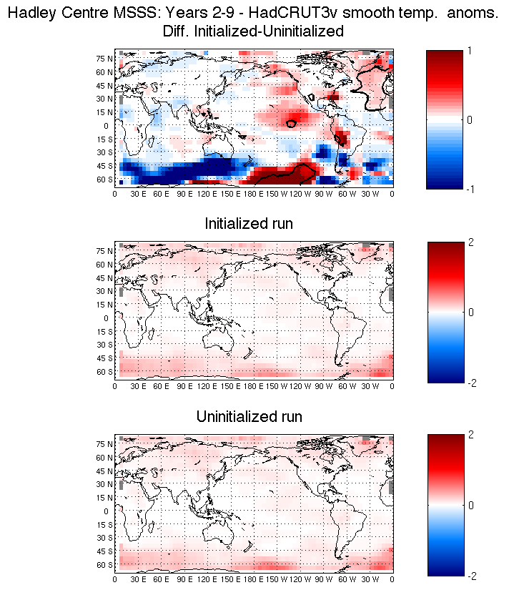
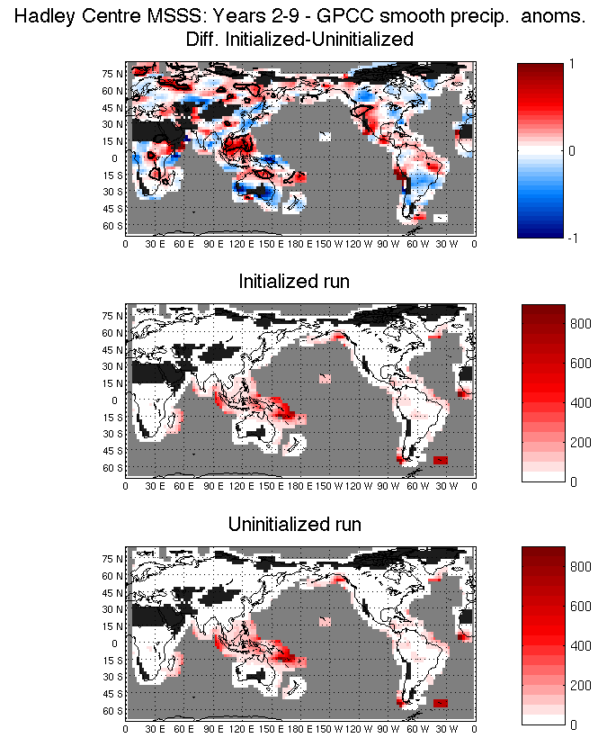
Deterministic Metrics: Mean Squared Skill Score (MSSS)
MSSS
MSSS
: MSE
: MSE
: MSE
: MSE

Slide 11
Deterministic Metrics: Mean Squared Skill Score (MSSS)
MSSS
MSSS
: MSE
: MSE
: MSE
: MSE

Slide 12
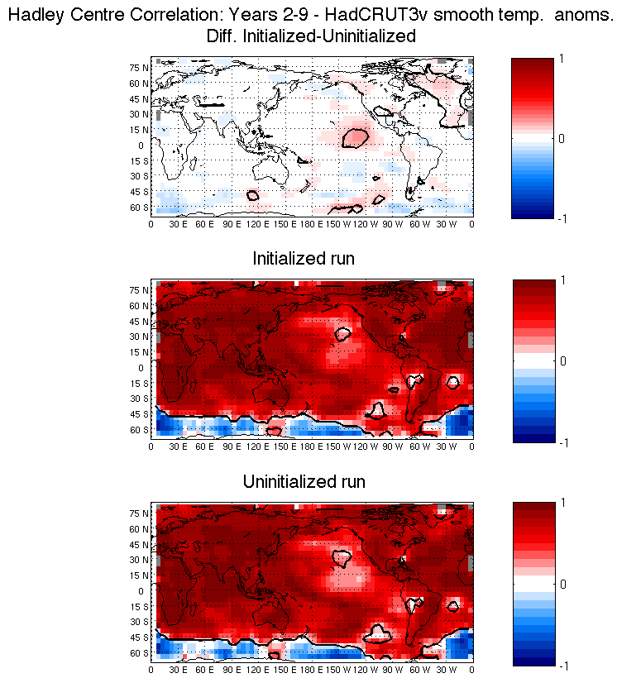
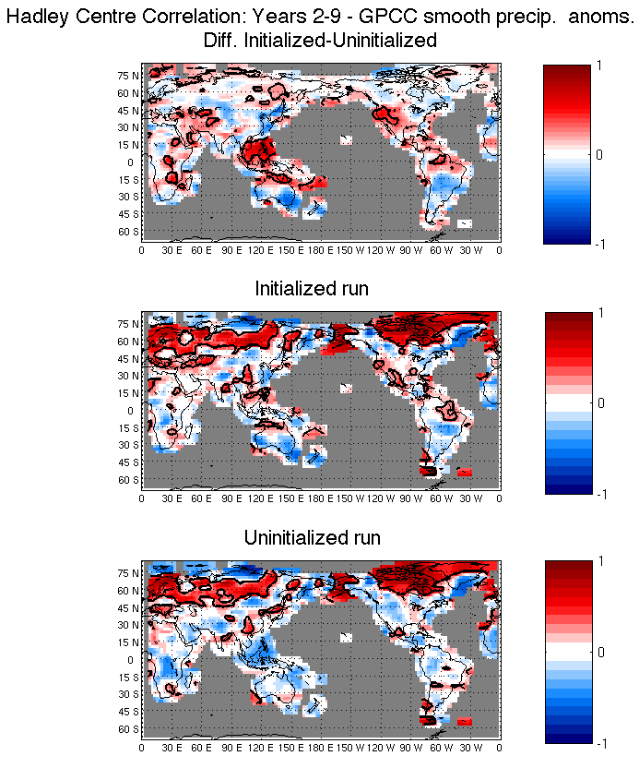
Deterministic Metrics: Anomaly Correlation

Slide 13
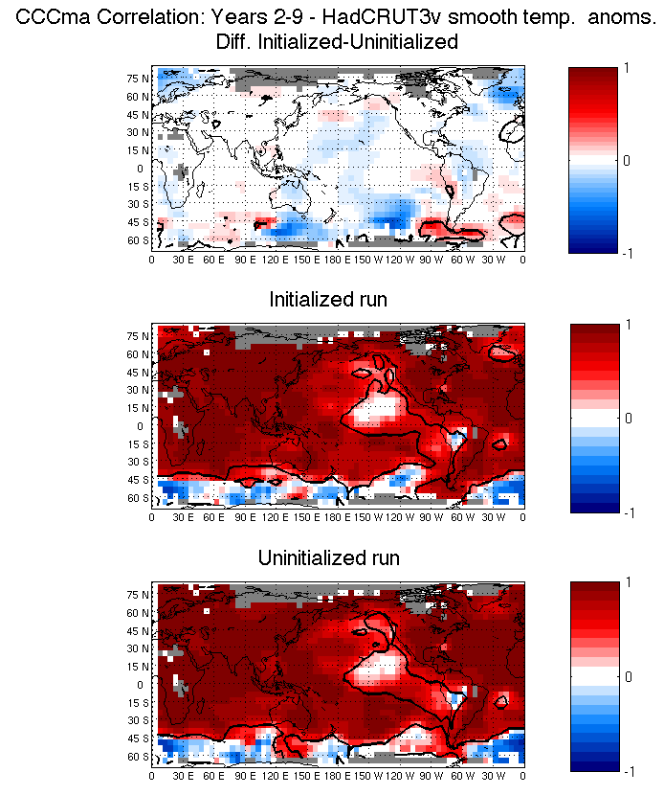
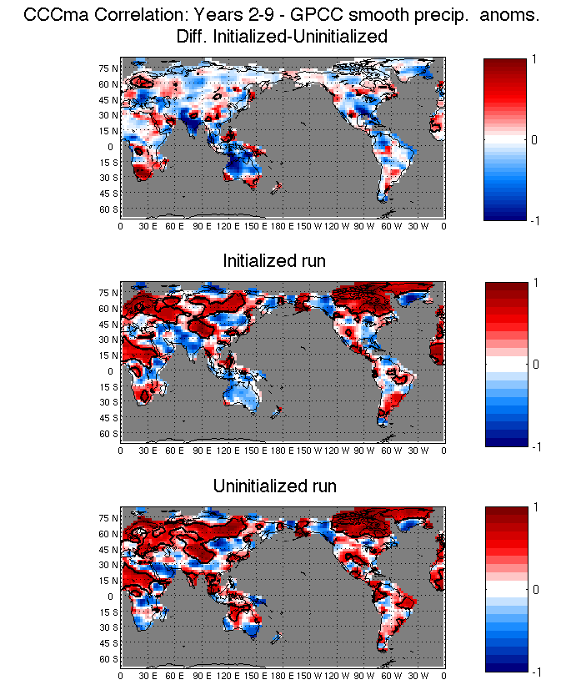
Deterministic Metrics: Anomaly Correlation

Slide 14
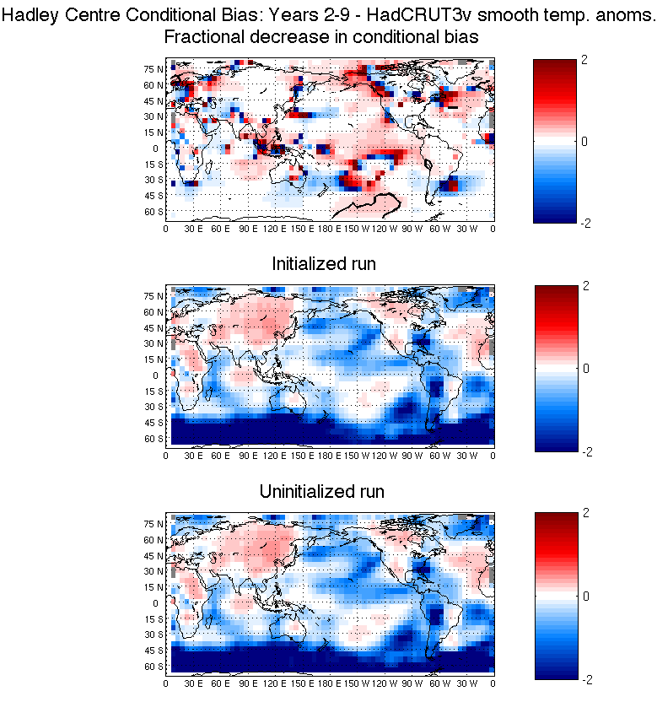
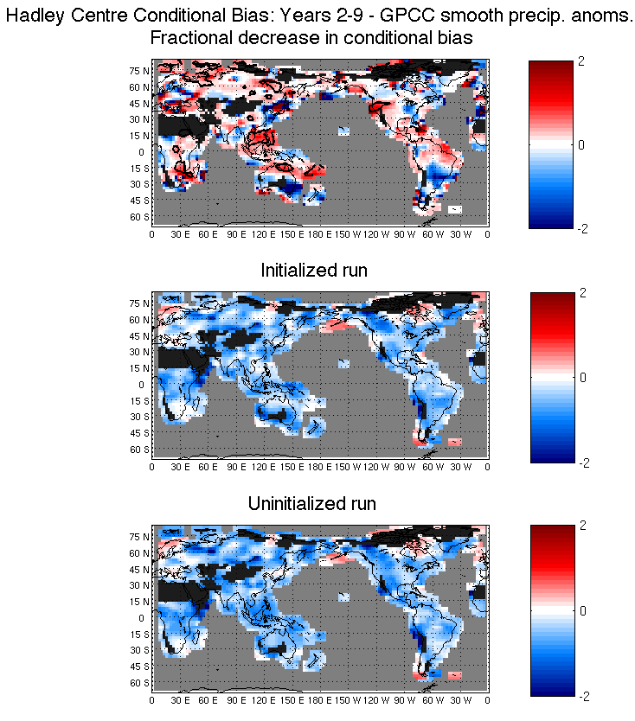
Deterministic Metrics: Conditional Bias

Slide 15
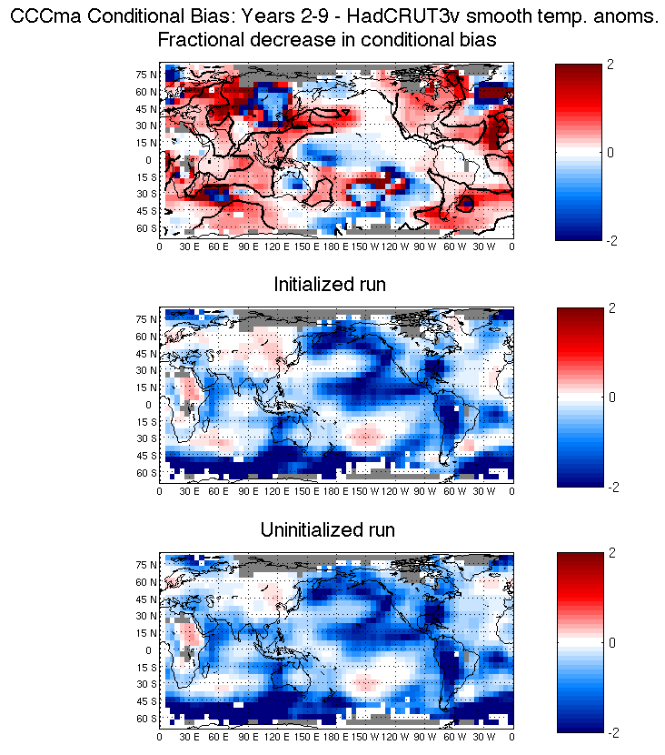
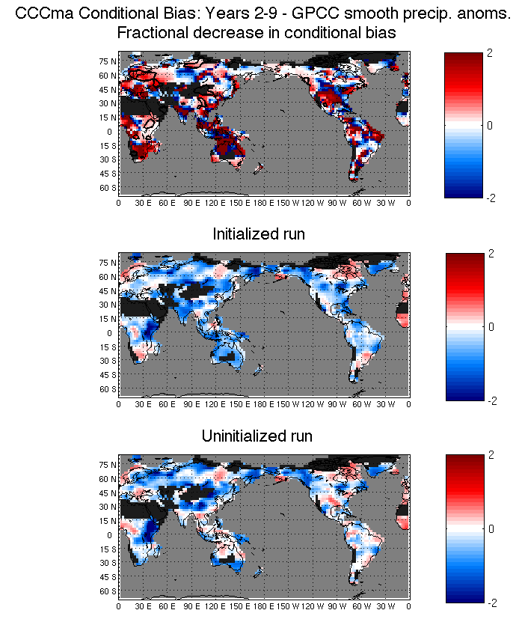
Deterministic Metrics: Conditional Bias

Slide 16
Asking Questions of the Initialized Hindcasts
Question 2: Is the model's ensemble spread an appropriate representation of forecast uncertainty on average?
Question 3: In the case that the forecast ensemble does offer information on overall forecast uncertainty, does the forecast-to-forecast variability of the ensemble spread carry meaningful information?
Continuous Ranked Probability Skill Score (CRPSS)
CRPSS = 1 – (CRPS_{fcst}/CRPS_{ref})
Q2: fcst uncertainty = avg ensemble spread ref uncertainty = standard error of ensemble mean
Q3: fcst uncertainty = time varying ensemble spread ref uncertainty = avg ensemble spread

Slide 17
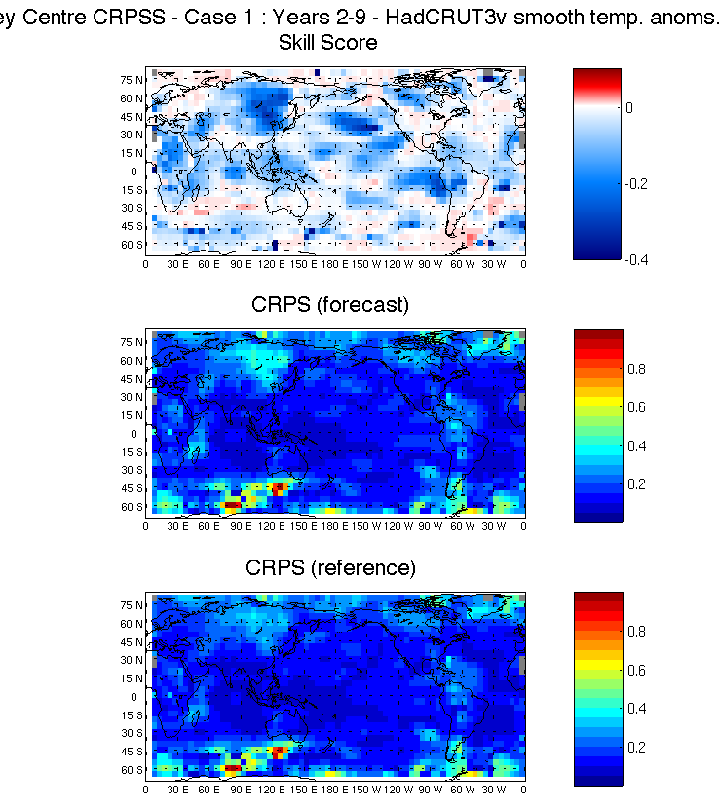
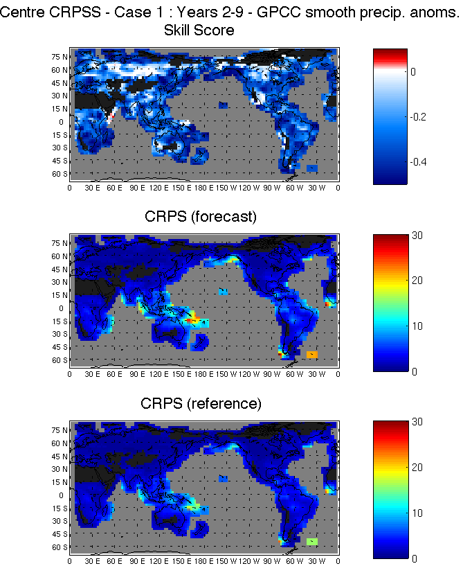
Probabilistic Metrics: CRPSS
(Case 1: Ens Spread vs. Std Err)

Slide 18
Statistical Significance: Non-parametric bootstrap
Re-sampling, with replacement: k=1,M (~1000) samples
Start out with nominally n=10 start times. Draw random start times as pairs up to n values. i.e. 1st draw: i=1 → e.g. I(i,k)=5 (1980), so i=2 → I(i+1,k)=6, etc. up to i=10 For each I(i,k), draw N random ensemble members, E, with replacement
If p-value <= α, then
r_{fx} is significant at
(1-α)x100% confidence
Fraction < 0
= p-value
M samples
R_{fx}
0

Slide 19
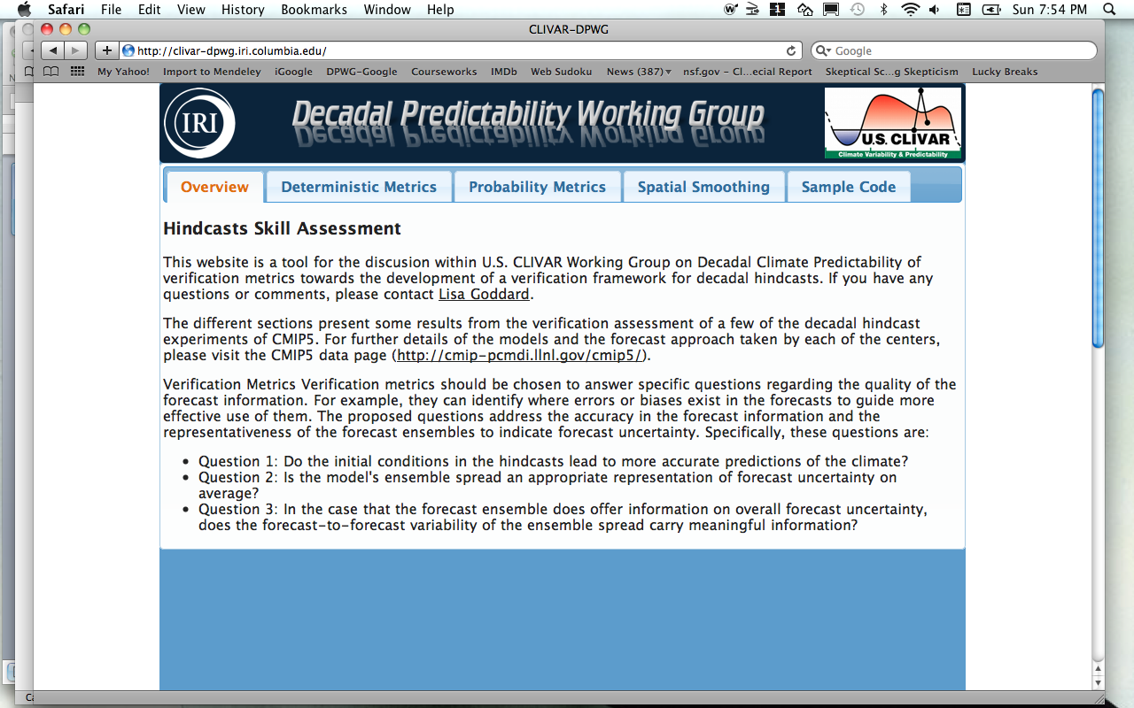
Proto-type Website: Work in progress
http://clivar-dpwg.iri.columbia.edu

Slide 20
Outline
Objective
Framework
Metrics & examples of results
Statistical significance
Website
Issues relevant to verification endeavor
Bias correction
Spatial scale
Stationarity/reference period

Slide 21
Issues relevant to verification
Spatial scale for verification
Bias (mean and conditional)
Mean bias MUST be removed prior to use or verification of forecasts (WCRP, 2011)
Forecast uncertainty
Conditional bias MUST be removed prior to assigning forecast intervals
Stationarity / reference period

Slide 22
Spatial Scale: Signal-to-noise
GPCP Precipitation Anomalies
Based on de-correlation scales, and S2N considerations, advocating
Temperature smoothing: 15 longitude x 10 latitude
Precipitation smoothing:
10 longitude x 5 latitude
(Goddard, Gonzalez, & Jensen, in prep)

Slide 23
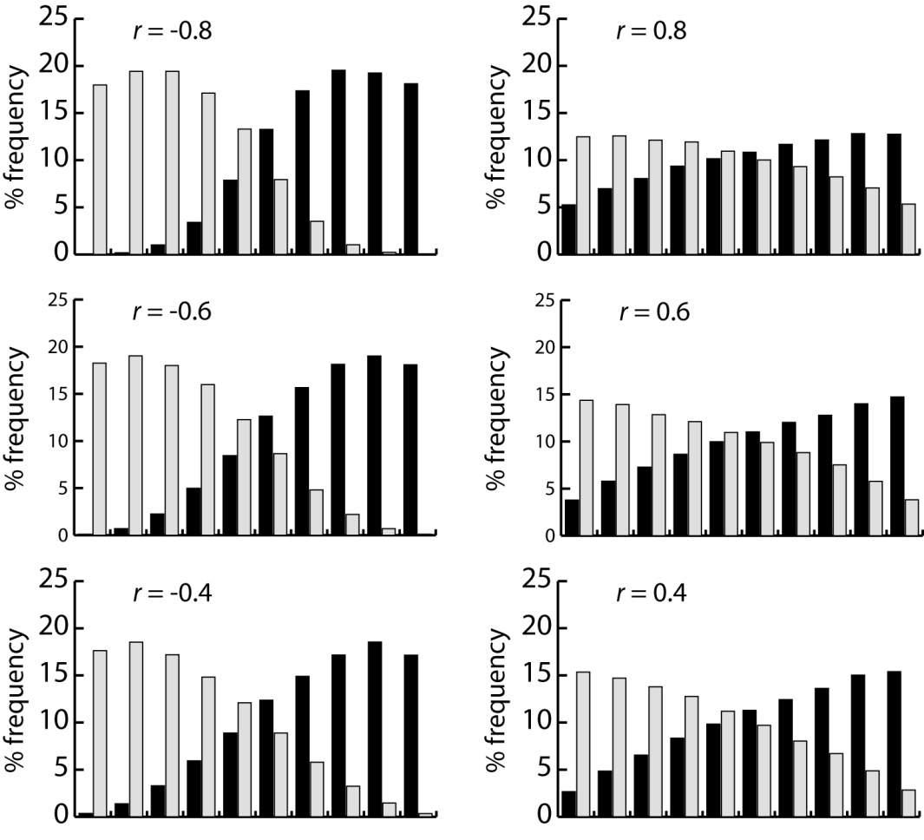
Effect of Conditional Bias on Reliability
Conditional rank histograms - 9-member ensemble fcsts
Normally distributed variable
Ensemble-mean variance = Observed variance
Ensemble spread = MSE
Grey bars are positive anomalies Black bars are negative anomalies
(Mason, Goddard, and Gonzalez, in prep.)

Slide 24
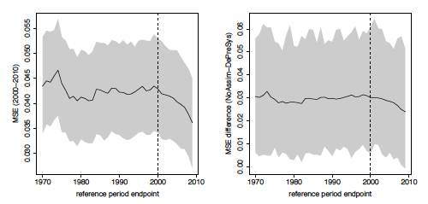
Issues: Non-stationarity
Effect of out-of-sample reference period (pre-2000) vs in-sample (post-2000)
MSE of Global Mean Temperatures for 2001-2010)|
Reference Period = 1950 - endpoint
MSE (Initialized hindcasts)
MSE (Initialized hindcasts)
(Fricker, Ferro, Stephenson, in prep.)

Slide 25
Summary
US CLIVAR Working Group on Decadal Predictability has developed a framework for verification of decadal hindcasts that allows for common observational data, metrics, temporal structure, spatial scale, and presentation
The framework is oriented towards addressing specific questions of the hindcast quality and suggestions for how they might be used.
Considerable complementary research has aided this effort in areas of bias and forecast uncertainty, spatial scale of the information, and stationarity impacts on reference period.
Paper to be submitted to Climate Dynamics.

