Slide 1
A unifying view of climate change in the Sahel
linking intra-seasonal, inter-annual and longer time scales
Alessandra Giannini, Seyni Salack, Tiganadaba Lodoun,
Abdou Ali, Amadou T Gaye and Ousmane Ndiaye
to appear in Environ Res Lett

Slide 2
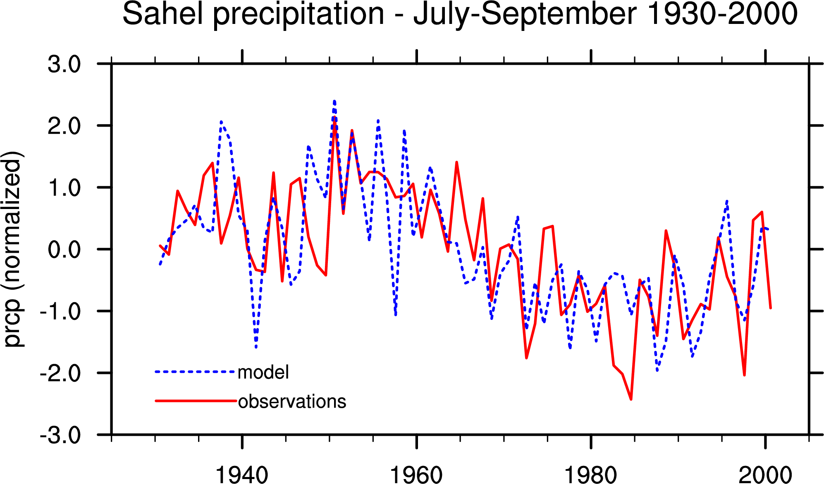
Oceans caused Sahel drought
Oceans explain late 20th century downward trend,
and recent upward trend.
Giannini, Saravanan and Chang 2003, in Science

Slide 3
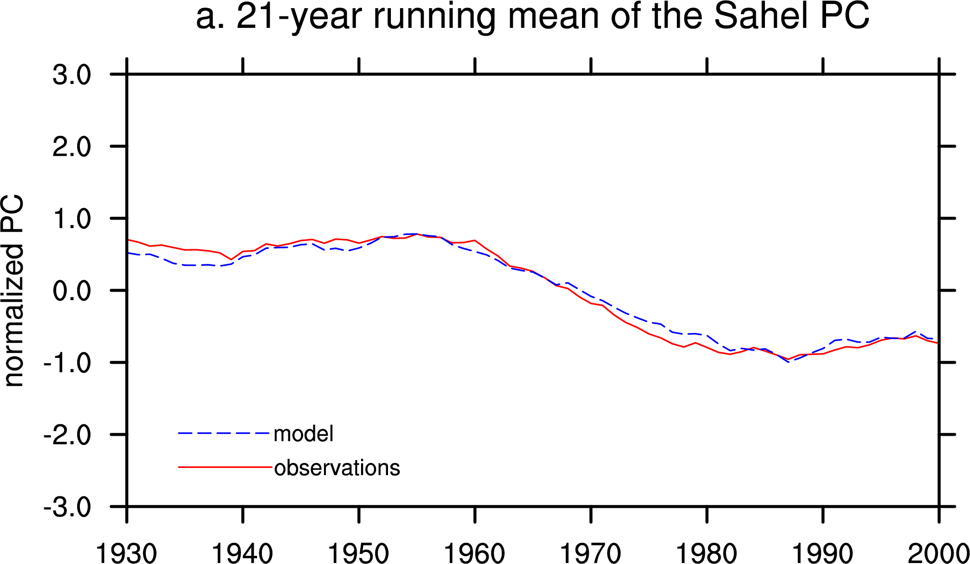
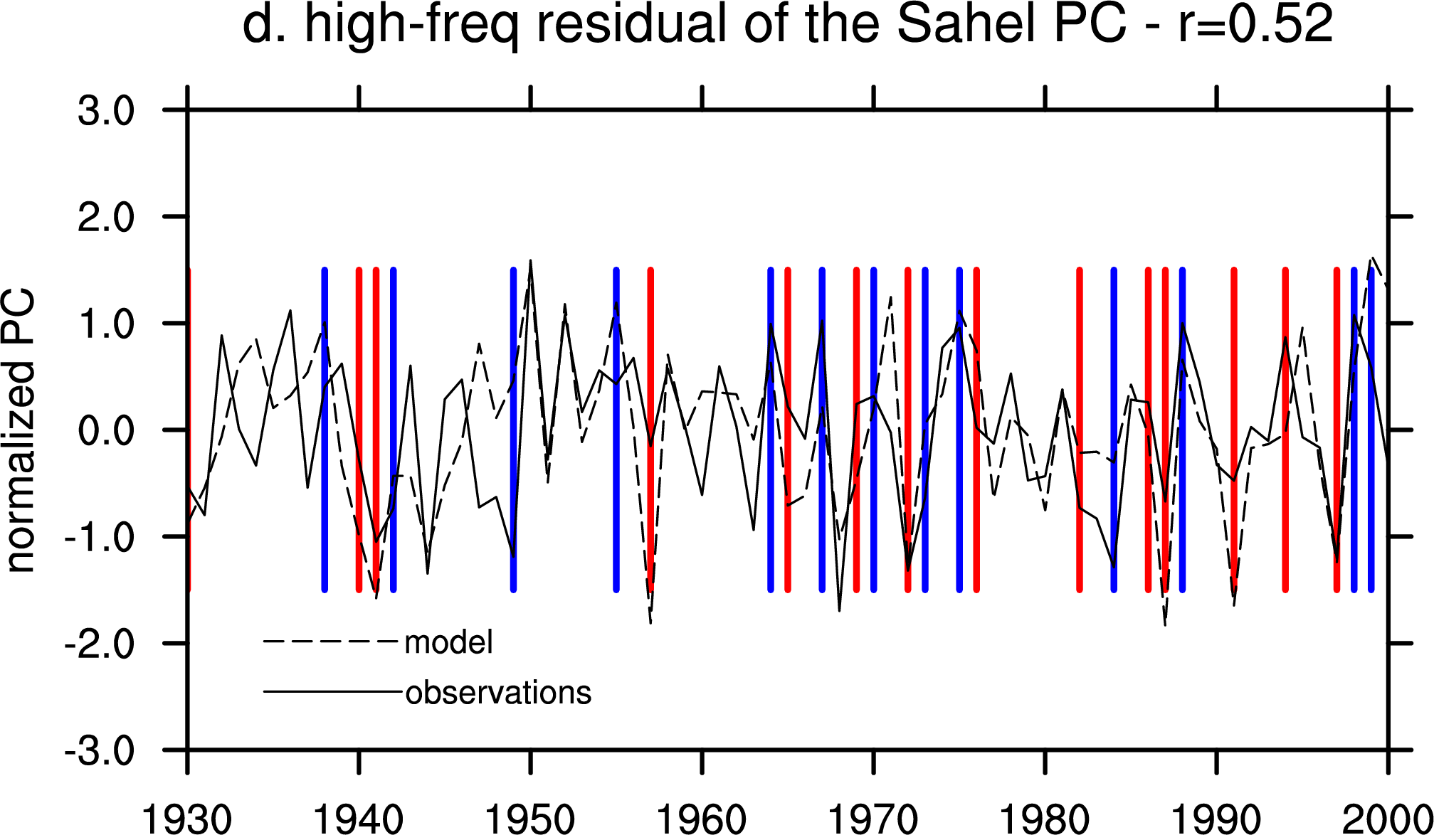
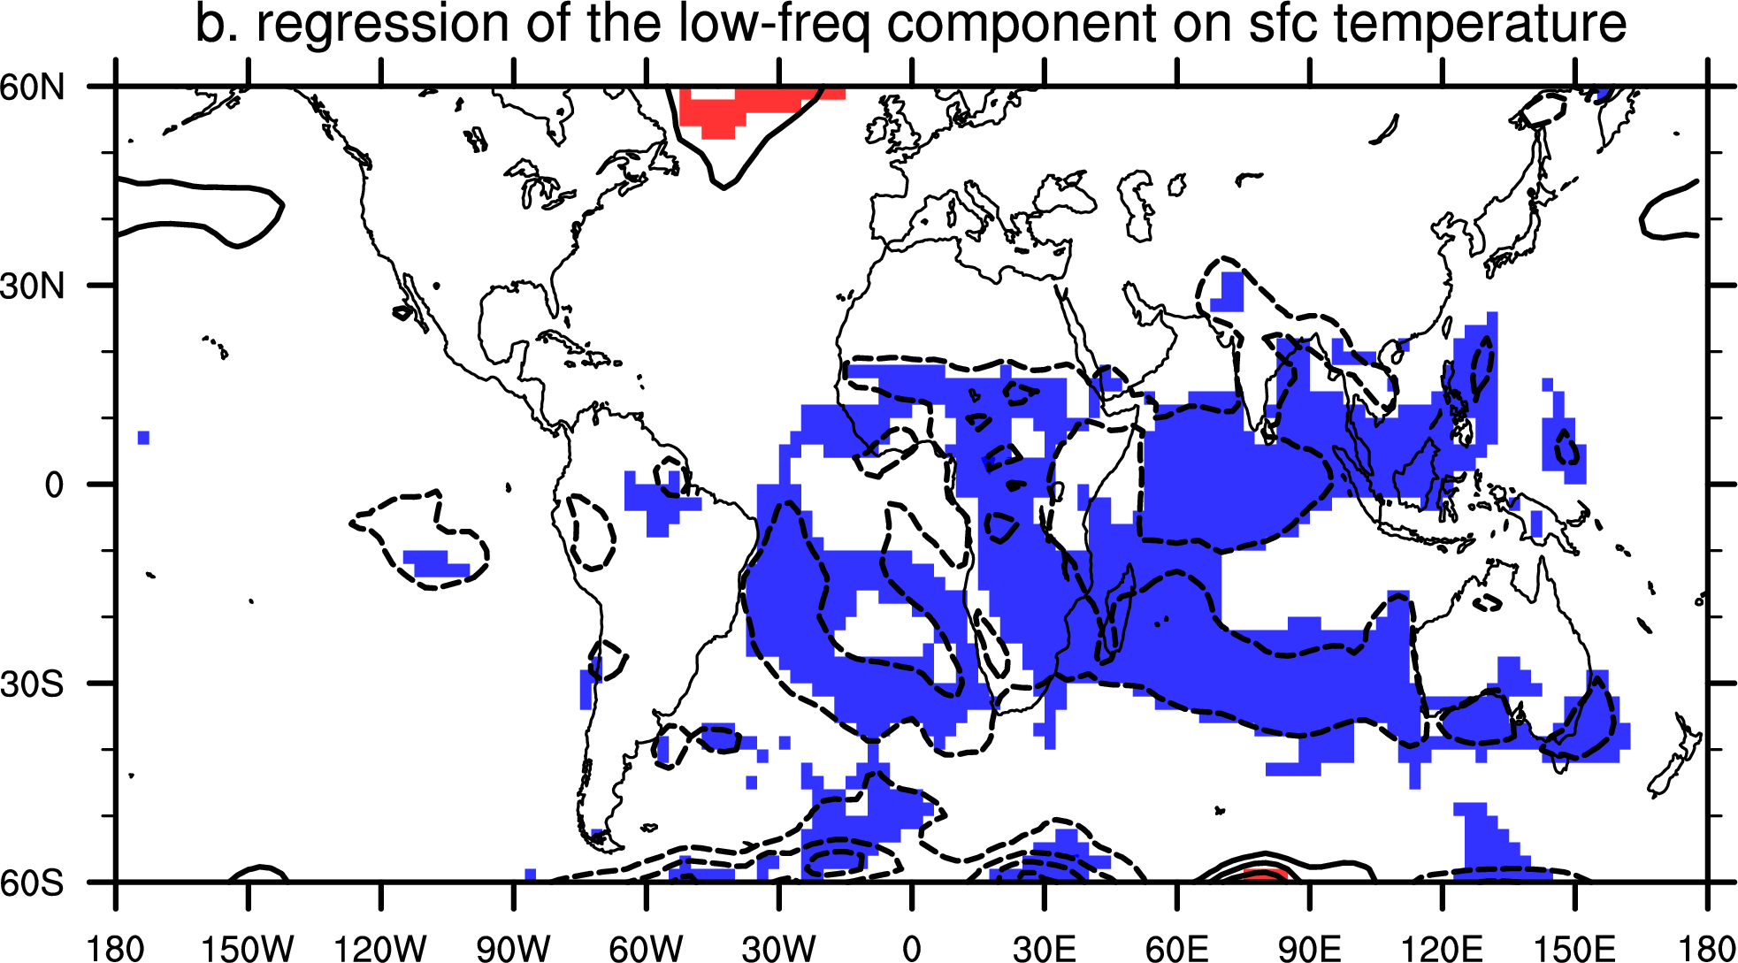
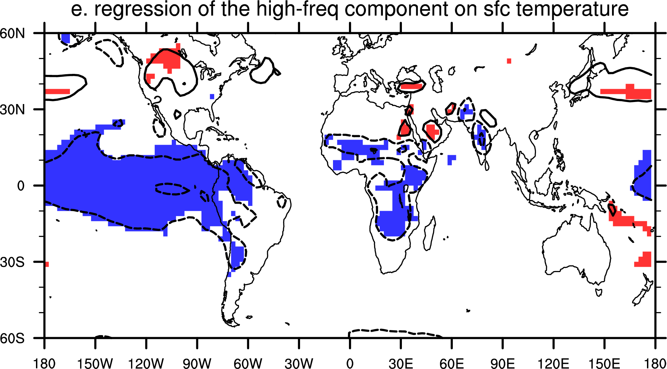
The influence of the oceans on the climate of the Sahel
is dominant: Atlantic and Indian/interdecadal, Pacific/interannual
Giannini, Saravanan and Chang 2003, in Science

Slide 4
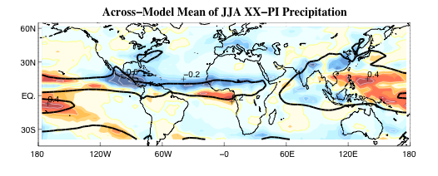
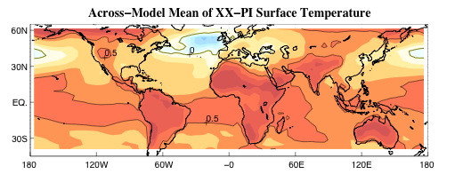
The CMIP3 multi-model ensemble average
broadly captures such influence
Biasutti and Giannini 2006, in Geophys. Res. Lett.
change between end of 20th century and pre-Industrial
in 19 coupled models
precipitation
change
surface
temperature
change

Slide 5
Influence of the oceans on the climate of the Sahel
ENSO/tropical Pacific dominates interannual time scale
Atlantic and Indian Oceans explain multi-decadal persistence
of wet and dry epochs
… OR…

Slide 6
A re-interpretation of the
influence of the oceans on the climate of the Sahel
global tropical oceans control vertical stability
via deep convection,
setting upper tropospheric temperature globally
[Neelin et al 2003; Chiang and Sobel 2002]
Atlantic Ocean provides the moisture necessary to meet
the increased vertical stability
via the monsoonal flow.

Slide 7
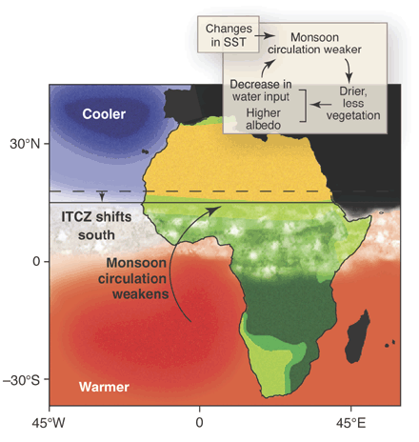
Reinterpreting the influence of the Atlantic Ocean
on the monsoon…
Zeng, Science 2003

Slide 8
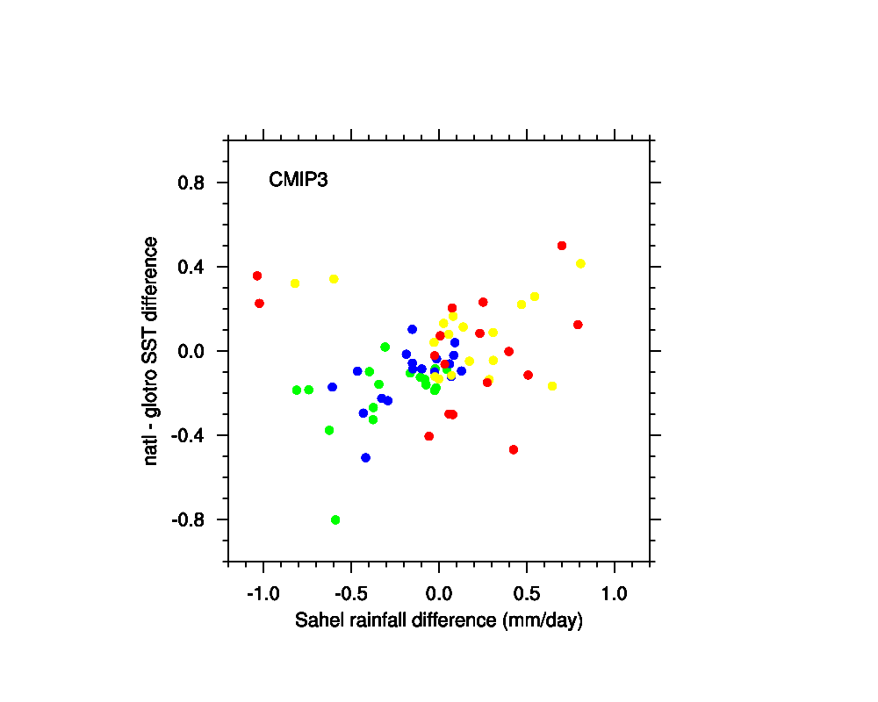
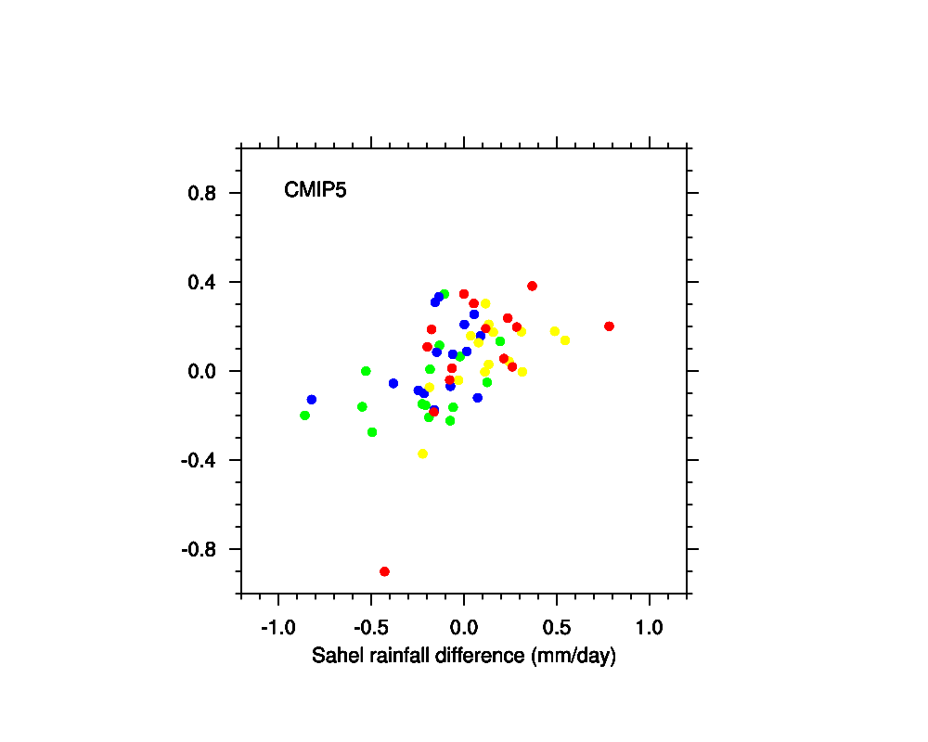
The difference between sub-tropical North Atlantic
and global tropical SST
explains past drought and potential future recovery
Past
Green: end 20th century – pre-Industrial
Blue: end – beginning 20th century
Future
Yellow: mid-21st (A1B) – end 20th
Red: end 21st – end 20th

Slide 9
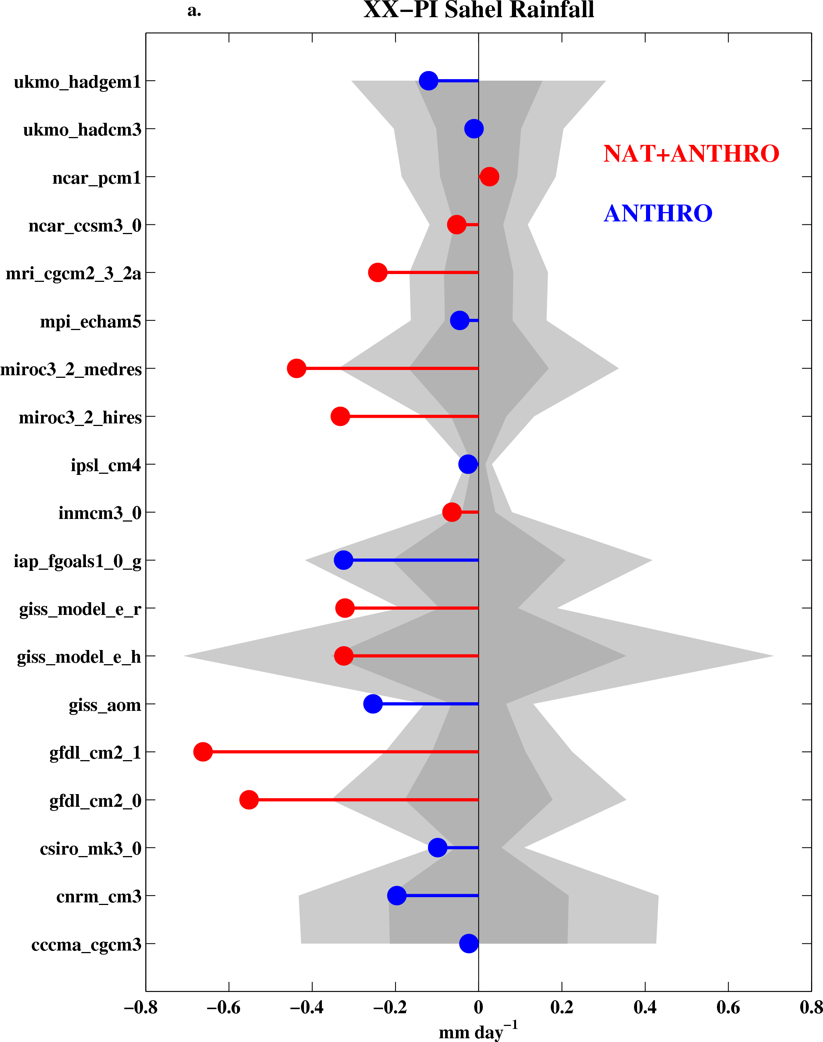
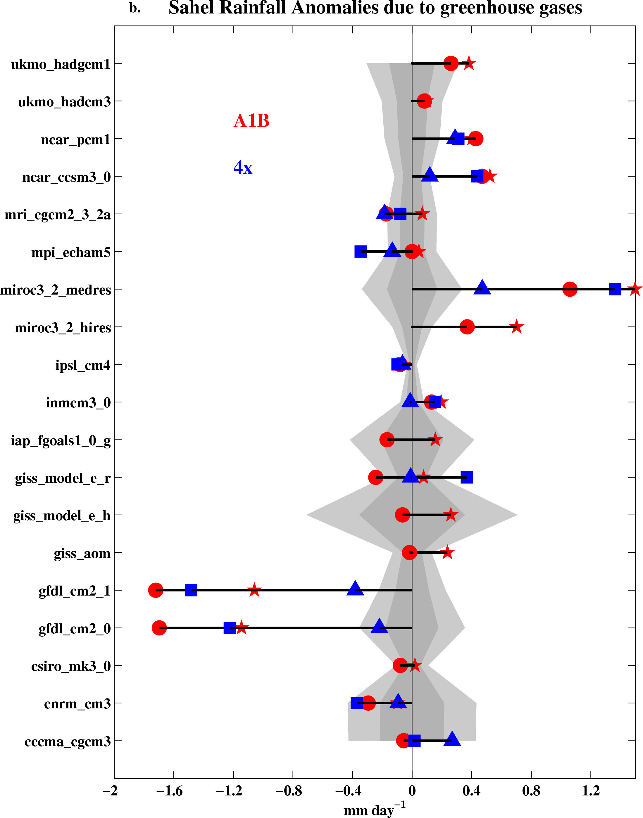
IPCC AR4 simulations – past and future climate changes
Biasutti and Giannini 2006, in Geophys. Res. Lett.

Slide 10
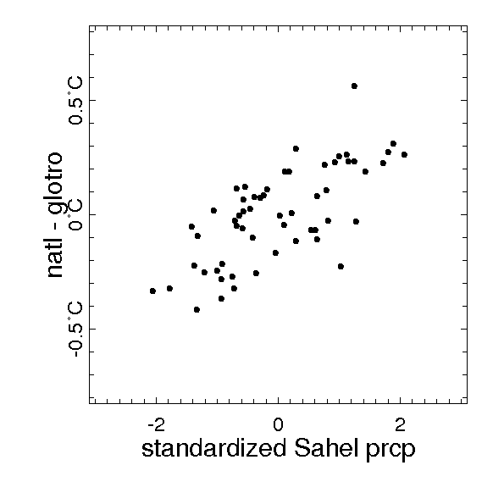
Subtropical N Atlantic minus global tropical mean SST
is a good predictor of Sahel rainfall
Sahel SPI is from Ali and Lebel (2009)
[1950-2006]
Correlations:
Sahel SPI and NAtl-glotro SST = 0.62
Sahel SPI and Indian O SST = -0.51
Sahel SPI and N-S Atl = 0.48
Sahel SPI and NAtl – global SST = 0.50
Sahel SPI and Nino3 = -0.28
Notes:
http://iridl.ldeo.columbia.edu/expert/home/.alesall/.alilebel/.SahelPrecipitationIndex/T/1/shiftGRID/DATA/-3/3/RANGE//long_name/%28standardized%20Sahel%20prcp%29def/home/.alesall/.hadisst-natl.cdf/.aprod/home/.alesall/.hadisst-glotro.cdf/.aprod/sub/T/%28Jan%201950%29%28Dec%202006%29RANGE/T/%28May%201950%29%28Oct%202006%29RANGE/T/6/boxAverage/T/12/STEP/dup%5BT%5Daverage/sub/DATA/-0.8/0.8/RANGE//long_name/%28natl%20-%20glotro%29def/fig:/scatter/:fig//XOVY/1/psdef//fntsze/30/psdef//plotborder/150/psdef/
http://iridl.ldeo.columbia.edu/expert/home/.alesall/.alilebel/.SahelPrecipitationIndex/T/1/shiftGRID/SOURCES/.KAPLAN/.EXTENDED/.v2/.ssta/T/%28May%201950%29%28Oct%202006%29RANGE/T/6/boxAverage/T/12/STEP/dup%5BT%5Daverage/sub/Y/cosd/mul/dup/X/-75/-15/RANGE/Y/10/40/RANGE%5BX/Y%5Daverage/exch/Y/-20/20/RANGE%5BX/Y%5Daverage/sub%5BT%5Dcorrelate/
http://iridl.ldeo.columbia.edu/expert/home/.alesall/.alilebel/.SahelPrecipitationIndex/T/1/shiftGRID/SOURCES/.KAPLAN/.EXTENDED/.v2/.ssta/T/%28May%201950%29%28Oct%202006%29RANGE/T/6/boxAverage/T/12/STEP/dup%5BT%5Daverage/sub/Y/cosd/mul/X/50/90/RANGE/Y/-15/15/RANGE%5BX/Y%5Daverage%5BT%5Dcorrelate/
http://iridl.ldeo.columbia.edu/expert/home/.alesall/.alilebel/.SahelPrecipitationIndex/T/1/shiftGRID/SOURCES/.KAPLAN/.EXTENDED/.v2/.ssta/T/%28May%201950%29%28Oct%202006%29RANGE/T/6/boxAverage/T/12/STEP/dup%5BT%5Daverage/sub/Y/cosd/mul/dup/X/-60/0/RANGE/Y/5/30/RANGE%5BX/Y%5Daverage/exch/X/-45/15/RANGE/Y/-25/5/RANGE%5BX/Y%5Daverage/sub%5BT%5Dcorrelate/
http://iridl.ldeo.columbia.edu/expert/home/.alesall/.alilebel/.SahelPrecipitationIndex/T/1/shiftGRID/SOURCES/.KAPLAN/.EXTENDED/.v2/.ssta/T/%28May%201950%29%28Oct%202006%29RANGE/T/6/boxAverage/T/12/STEP/dup%5BT%5Daverage/sub/Y/cosd/mul/dup/X/-60/0/RANGE/Y/0/60/RANGE%5BX/Y%5Daverage/exch/Y/-60/60/RANGE%5BX/Y%5Daverage/sub%5BT%5Dcorrelate/
http://iridl.ldeo.columbia.edu/expert/home/.alesall/.alilebel/.SahelPrecipitationIndex/T/1/shiftGRID/SOURCES/.Indices/.nino/.EXTENDED/.NINO3/T/%28May%201950%29%28Oct%202006%29RANGE/T/6/boxAverage/T/12/STEP/dup%5BT%5Daverage/sub%5BT%5Dcorrelate/

Slide 11
Models say that IF the subtropical North Atlantic warms up
more than the global tropics, then the Sahel could get wetter…
Is this what has been happening?
How?

Slide 12
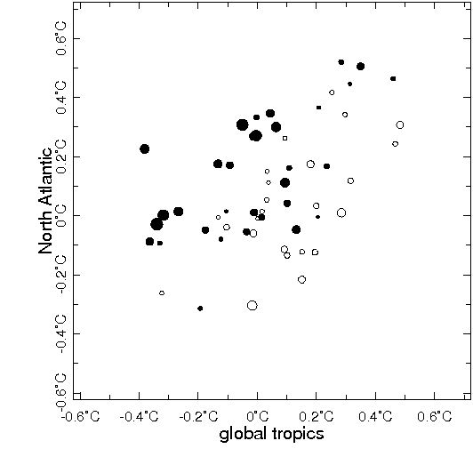
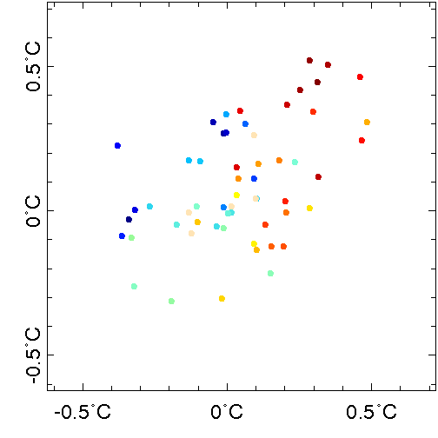
North Atlantic and global tropics
in the interannual variability of Sahel rainfall –
rainfall index is from Ali and Lebel (2009)
open circles are negative anomalies,
full dots are positive anomalies
years since 1950
blue is early
red is late

Slide 13
Mechanisms to connect dynamics of variability and change:
Indian Ocean/warming of the tropical oceans
⬅➔ controls vertical stability
⬅➔ related to frequency of daily rainfall?
Atlantic Ocean/
⬅➔ controls moisture supply
⬅➔ related to intensity of daily rainfall?
[Giannini, Biasutti, Held and Sobel 2008, in Climatic Change]

Slide 14
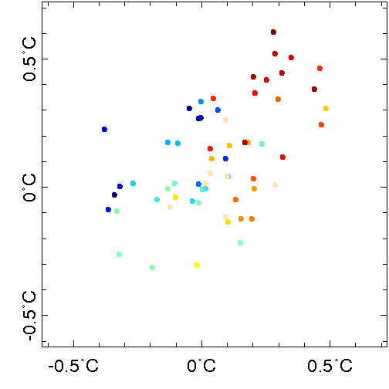
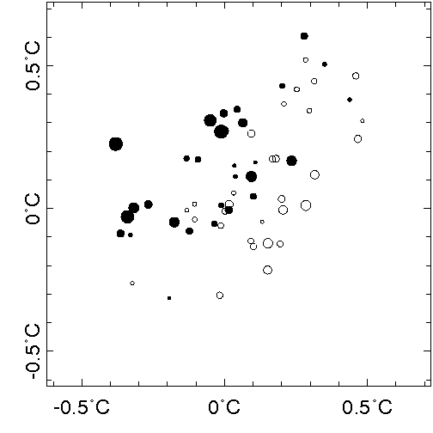
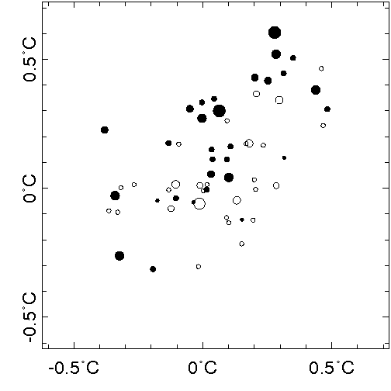
North Atlantic and global tropics
in frequency (left) and intensity (right)
of daily rainfall in Senegal (1950-2010)
open circles are negative anomalies,
full dots are positive anomalies

Slide 15
The recent recovery in rainfall
across the West African Sahel
may be explained by changes in intensity
more than in frequency of precipitation
consistent with:
influence of oceans
expectation of GHG-induced climate change
Thanks to: S Salack, T Lodoun, A Ali, AT Gaye and O Ndiaye

