Slide 1
Tropical Pacific Ocean forcing of the
1998-99 decadal shift in global precipitation
Lyon, Barnston, DeWitt, Climate Dynamics (revised)

Slide 2
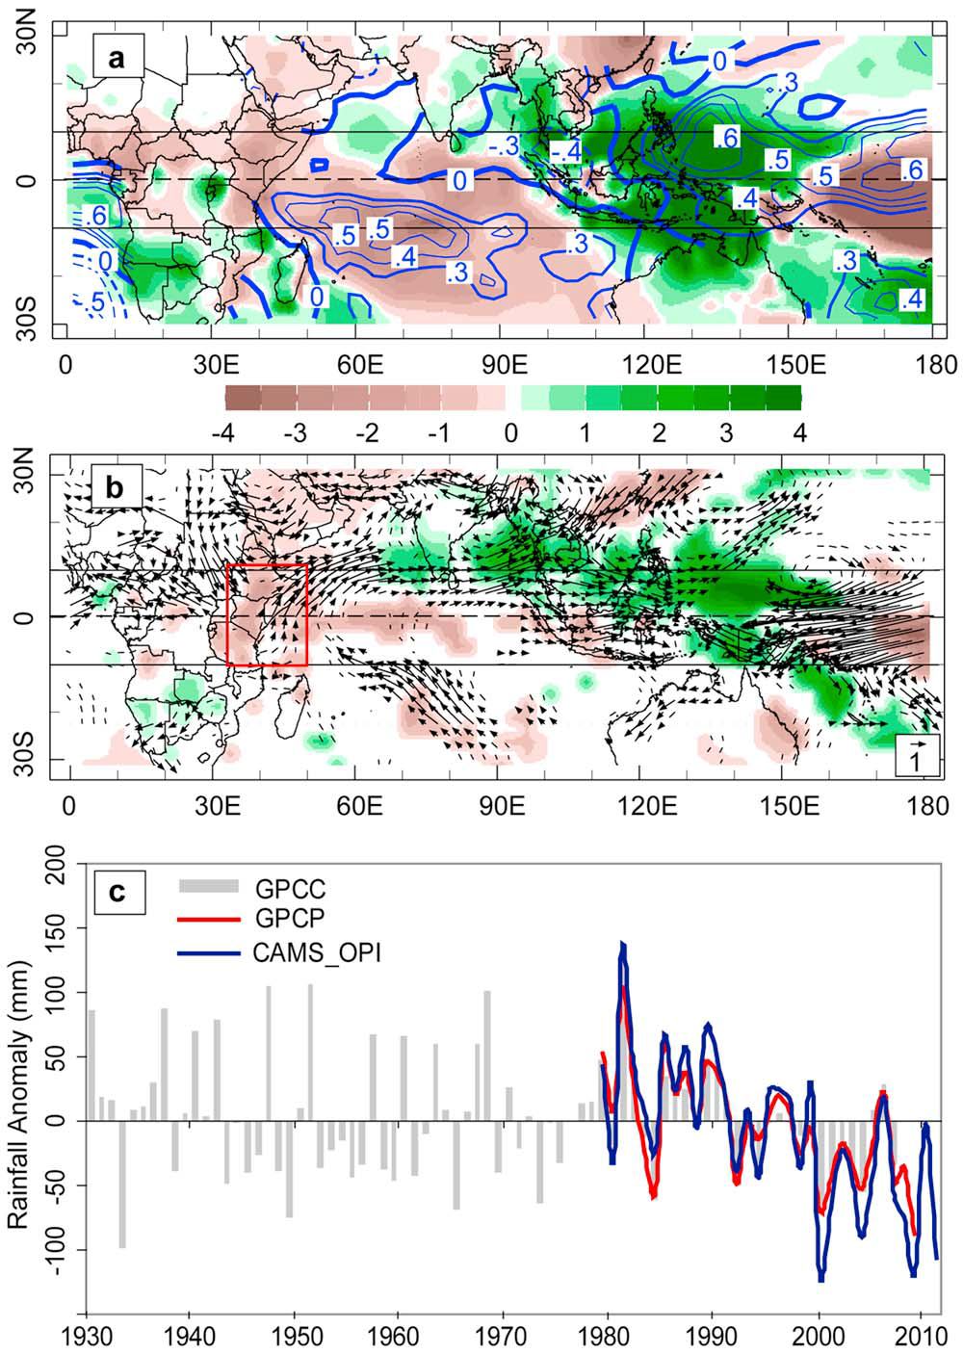
MAM 2011
PRCP Anomaly
MAM 1999-2011
AVG PRCP Anomaly
East Africa
MAM PRCP Anomaly

Slide 3
MAM Avg. SST Anomaly
1999-2012
MAM Avg. PRCP, V850
Anomalies 1999-2012
CMAP PRCP > 6 mm/day
Red → 1979-1998
Blue →1999-2011

Slide 4
1st EOF Loadings
MAM PRCP 1979-2011
PC1

Slide 5
Linearly remove ENSO and GW
Signals from ERSST (and HAD SST):
→ Compute EOF of Residual Anomalies
EOF1 Pacific Domain
EOF1 Indo-Pacific Domain
PCs and GW Trend

Slide 6
GPCC PRCP Difference:
(1999-2010) minus (1977-1998)
(1946-1976) minus (1977-1998)
Statistically Significant Pooled
PRCP Anomalies

Slide 7
EOF1 of R2 850hPa Wind for MAM
1979-2012
As Above but for 20CR
(1930-2008)
PCs

Slide 8
R2 Composite 200hPa
Stationary Wave for MAM
1999-2012
EOF1 of R2 200 hPa
Stationary Waves for MAM
1979-2012
PC1

Slide 9
Do Climate Model Simulations Capture
the Recent Observed Patterns and the Shift?
Use the ECHAM4.5 (captures climo, used in IRI fcsts)
Full Simulations
POGA Runs (with slab ocean model)

Slide 10
PRCP Anomalies: (1999-2011) minus (1979-1998)
Full Simulation
POGA

Slide 11
Model PRCP Leading EOFs
Full Simulation
POGA
PCs

Slide 12
EOFs of Model 850 hPa Wind Field
Full Simulation
POGA
PCs

Slide 13
Composite and EOF of Model 200 hPa Stationary Waves
POGA Composite
1999-2011
POGA EOF1
Loadings
PC

Slide 14
Conclusions
A climate shift akin to that of 1976-77 occurred in 1998-99
Shift is identified in multiple observational fields (PRCP, V850, SW200)
ECHAM4.5 simulations and POGA runs capture the salient, observed
features quite well
POGA runs are able to capture observed features, indicting the fundamental role
played by the tropical Pacific SSTs in generating teleconnections
For East Africa, results strongly suggest that multidecadal variability in the
Pacific is the main driver of the recent “long rains” decline
- - - - - - - - - - - - - - - - - - - - - - - - - -
Interesting that in MAM the Pacific has direct relationship to East Africa
rainfall, vis-à-vis OND, when the progression is Pacific → Indian → East Africa. Why?
What are the physical mechanisms that lead to the rainfall decline in East Africa?
Are there additional factors leading to the severity of recent MAM droughts in EA?
Climate Change → A wetter East Africa? What do the models get right (now)?

