Slide 1
Climatology and variability of rainfall
in the
20th Century Reanalysis
Michela Biasutti and Dong Eun (Donna) Lee
Lamont Doherty Earth Observatory of Columbia University

Slide 2
The 20th Century Reanalysis, version 2 (Compo et al.)
Uses the NCEP atmospheric-land GCM
Hadley Center SST and sea ice as boundary conditions
Assimilates only surface pressure observations
Spans 1871 to 2008
Uses an Ensemble Kalman Filter (producing 56 realizations)

Slide 3
The Ensemble Kalman Filter
Courtesy of Eugenia Kalnay, through google!
http://www.jcsda.noaa.gov/documents/meetings/2009summercoll/Kalnay1_KalmanFilter.pdf

Slide 4
Why focus on (tropical) rainfall?
Attribution of climate trends require knowing the trends in oceanic precipitation. Can the 20CRv2 fill the gaps?

Slide 5
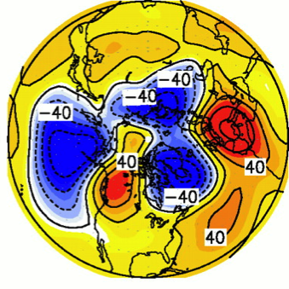
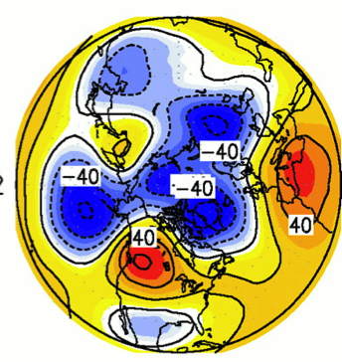

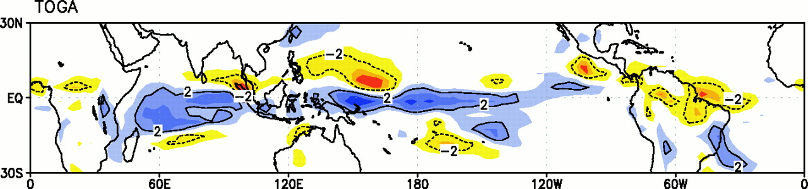
Why focus on (tropical) rainfall?
Attribution of climate trends require knowing the trends in oceanic precipitation. Can the 20CRv2 fill the gaps?
Example: the idea that trends in the NAO are forced by the warming of the Indian Ocean rests on simulations that produce enhanced rainfall for warmer SST. Can we confirm or reject this link?
obs
togax2
Hoerling et al. 2001

Slide 6
Climatology: seasonal means
OBS
20CRv2
DJF
Not bad
Too much
MAM
JJA
SON

Slide 7
Climatology: MAM seasonal means
OBS
20CRv2
NCEP2

Slide 8
Climatology: Sahel
20CRv2 (shaded)
GPCP (contour)
WEST AFRICA (15W-15E)

Slide 9
Climatology, JJA India:
the pattern is fine, the magnitude is off
GPCP
20CRv2
20
20

Slide 10
Variability of seasonal means:
Can we trust the 20CRv2 estimates for the pre-satellite era?
Does the 20CRv2 reproduce the rainfall anomalies (land and ocean) over the satellite era?
How does it compare with (i) models that only know SST and (ii) reanalyses that assimilate more data?
How important is the quality and density of the assimilated data, that is, how much does the fit with observations vary over time?

Slide 11
Seasonal cycle of the anomaly pattern correlation over 1979-2008
Northern Mid Latitudes
Tropics
Land Only
Land+Ocean
20CRv2
CCM3-AMIP
NCEP-DOE
ERA-Interim

Slide 12
Temporal anomaly correlation over 1979-2008
DJF

Slide 13
DJF

Slide 14
DJF

Slide 15
Mediterranean Winter
SST
CCM3_AMIP
.15
SST + SLP
20CReV2
.87
ALL OBS
ERA-int
.97
NCEP-DOE
.88

Slide 16
20CRv2
87
CCM3_AMIP
15

Slide 17
Southwest US Winter
SST
CCM3_AMIP
.58
SST + SLP
20CRv2
.86
ALL OBS
ERA-int
.97
NCEP-DOE
.93

Slide 18
Southwest US Winter
20CRv2
Each 20CRv2 ensemble member tracks observations as well as the ensemble mean. Largest spread and worst fit go together.
.86
CCM3_AMIP
.58

Slide 19
NORDESTE Brazil
20CRv2
In tropical locations, the 20CRv2 spread is similar to AMIP integrations (with only SST forcing), but correlations are consistently better across the ensemble
.76
CCM3_AMIP
.60

Slide 20
Temporal anomaly correlation over 1979-2008
JJA
JJA correlation is weaker than in DJF overall and especially over North America, where convective processes have a larger role.

Slide 21
p
The monthly JJA correlation between observed rainfall and 20CRv2 mid-troposphere vertical velocity is worse than the correlation with simulated rainfall, indicating that problems arise outside the convective parameterization.
ω

Slide 22
Temporal anomaly correlation over 1979-2008
JJA
JJA correlation is weaker than in DJF overall and especially over North America, where convective processes have a larger role.

Slide 23
0.4
0.4

Slide 24
How does 20CRv2 perform in the Sahel?
CCM3
.21
.40
AM2
.60
NSIPP1
.60
.58
.37
.65
ERA-I
.15
.65
NCEP-II
.71

Slide 25
The signal to noise ratio identifies places where SST is important (GOGA and 20CRv2) and where atmospheric large scale circulation is important (20CRv2 only).
20CRv2
CCM3 GOGA
DJF
JJA

Slide 26
21
60
NSIPP1
CCM3
60
AMIP runs
AM2
REANALYSES
ERA-int
15
NCEP-DOE
71

Slide 27
Changing observing system & its impact on the reanalysis
Pressure Error (hPa)
Number of Observations
Compo, G. P., Whitaker, J. S., Sardeshmukh, P. D., Matsui, N., Allan, R. J., Yin, X., Gleason, B. E., et al. (2010). The Twentieth Century Reanalysis Project. Quart. J. Roy. Meteor. Soc.

Slide 28
Time evolution of regional pattern correlations (20CRv2,OBS) for seasonal mean rainfall
DJF
JJA
Tropics
N. Mid. Lat.
CRU TS3p1 ; CMAP

Slide 29
Rainfall Stations used by TS3p1

Slide 30
Conclusions:
20CRv2 captures the winter variability of rainfall in the mid-latitudes with great accuracy (comparable to ERA-interim).
Summer rainfall and tropical rainfall are not captured well enough to constrain the long-term trends. Indeed, the weak correspondence to observations in both 20CRv2 and ERA-interim suggests great caution in interpreting rainfall trends in GOGA runs. (S/N ratio over tropical oceans is larger for GOGA than 20CRv2. Is it model dependent, or s because of the integration designs?)
More observations can further improve the 20CRv2 performance, but even a sparse record is sufficient to constrain seasonal variability in the winter mid-latitudes.

