Slide 1
A mild Little Ice Age and unprecedented recent warmth in an 1800-year long lake sediment record from West Spitsbergen
Billy D’Andrea
LDEO

Slide 2
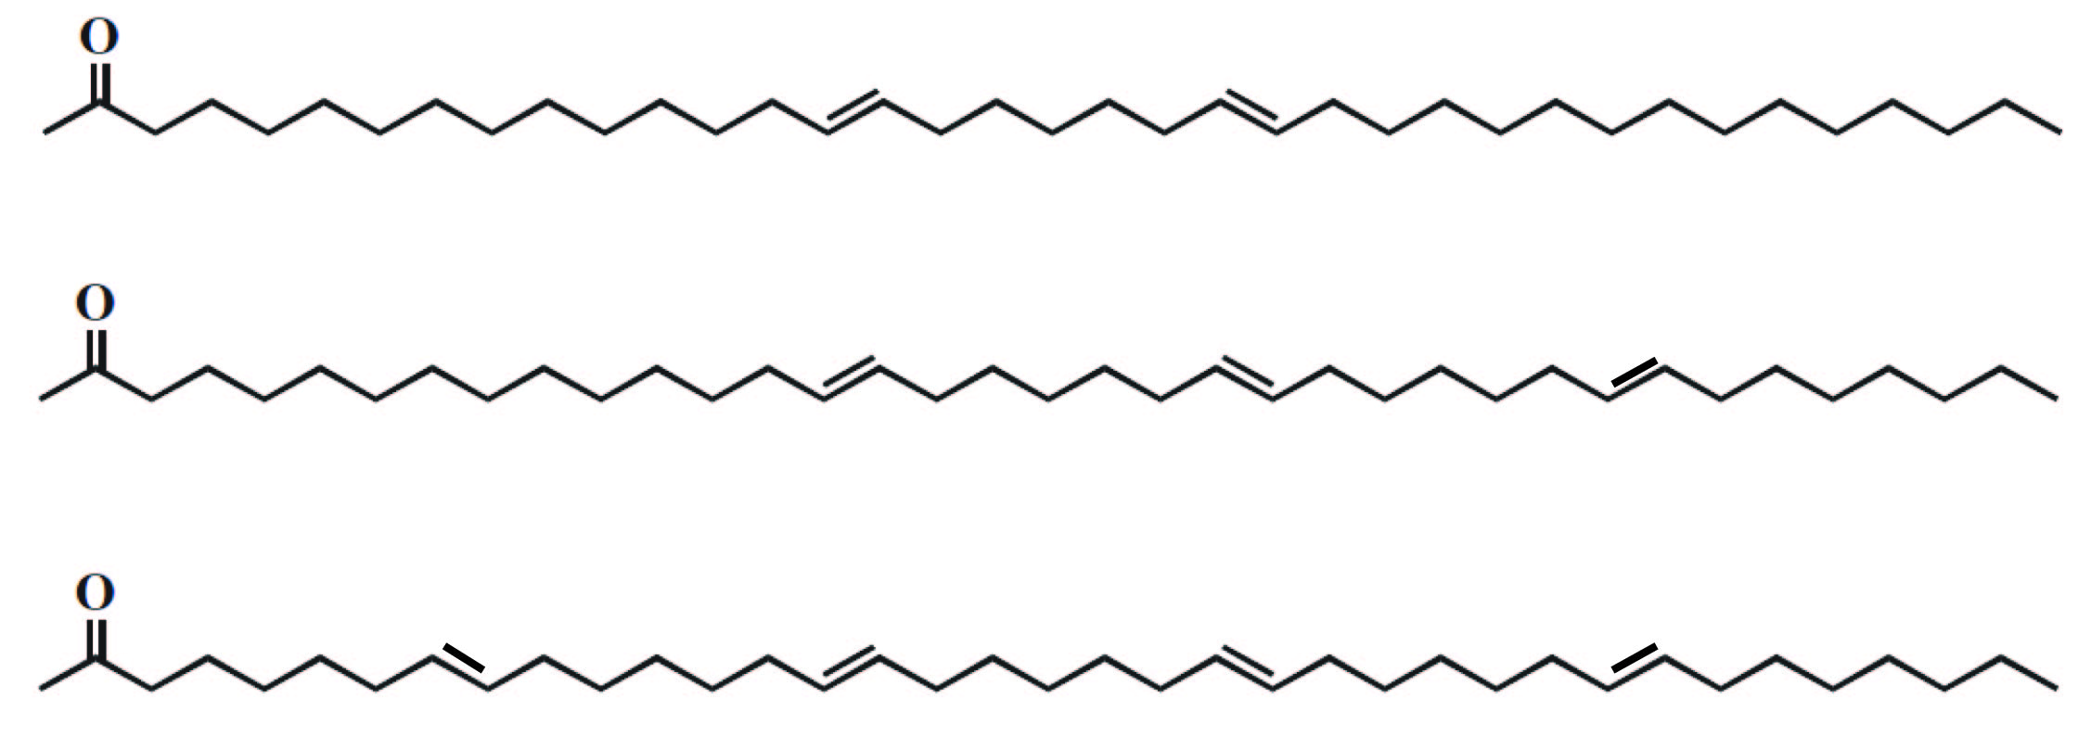
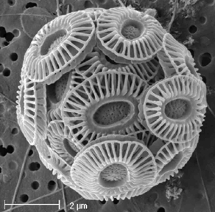
Alkenones
Long-chain ketones
  37-39 carbon atoms
Biomarkers specific to Haptophyte algae
Persistent in sediments
C₃₇
C₃₈
C₃₉
Retention time
Tetra-
Tri-
Di-
Emiliania huxleyi

Slide 3
Alkenone thermometry
C₃₇
C₃₈
C₃₉
Retention time
Tetra-
Tri-
U^{K}₃₇
Di-
Well established for ocean
Müller et al, 1998
Brassell et al., 1986
Prahl and Wakeham, 1987
SST

Slide 4
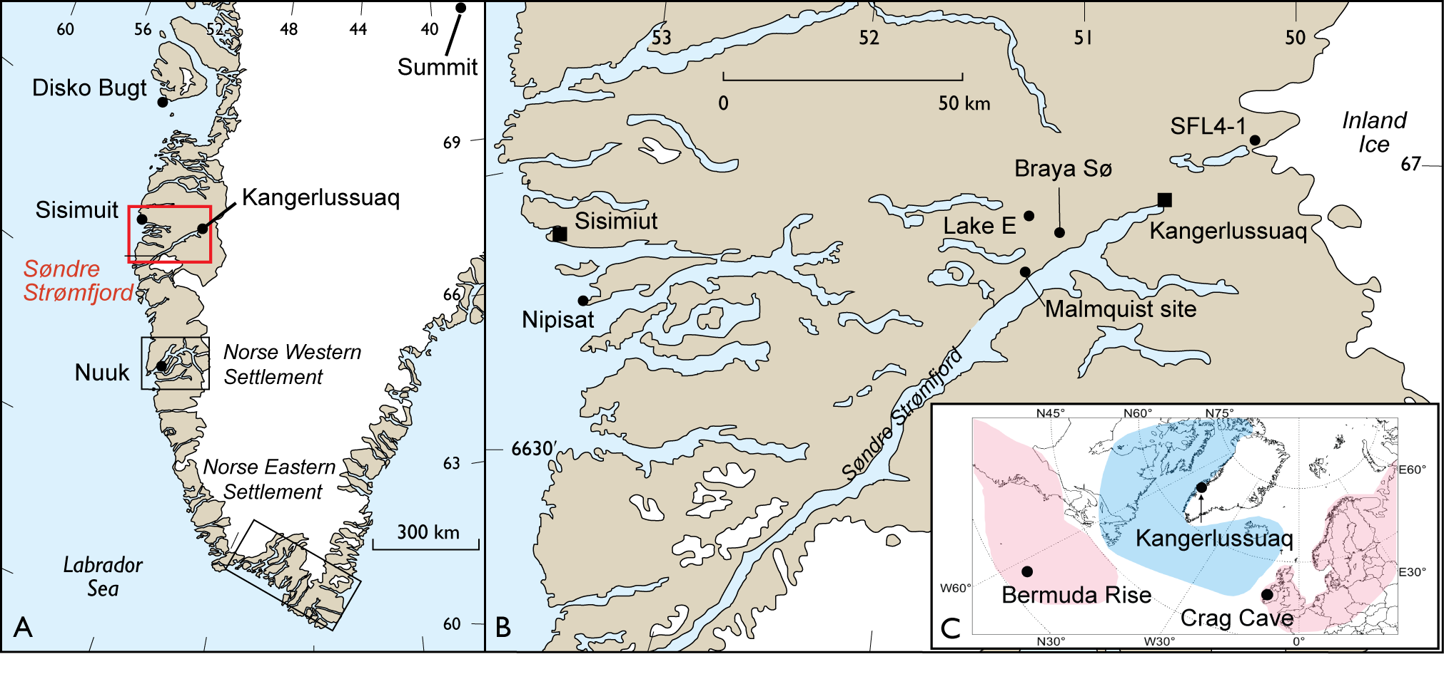
Initial work in Kangerlussuaq, West Greenland

Slide 5
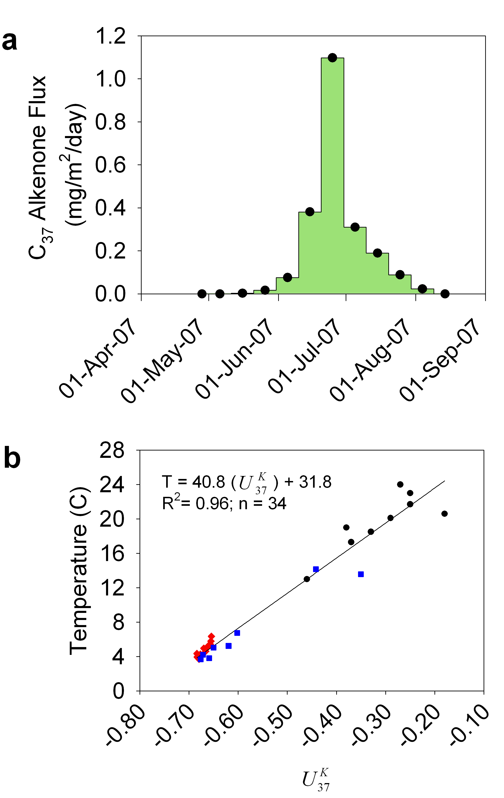
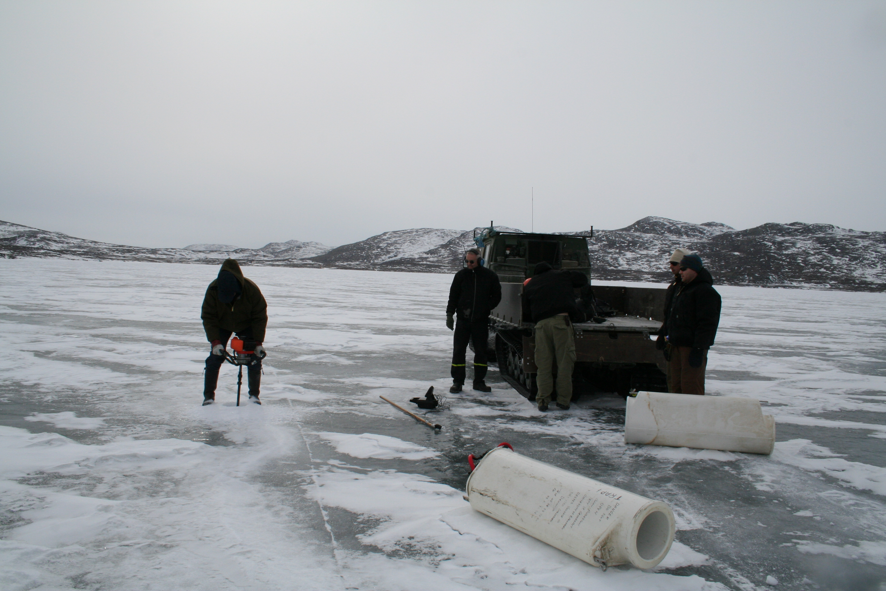
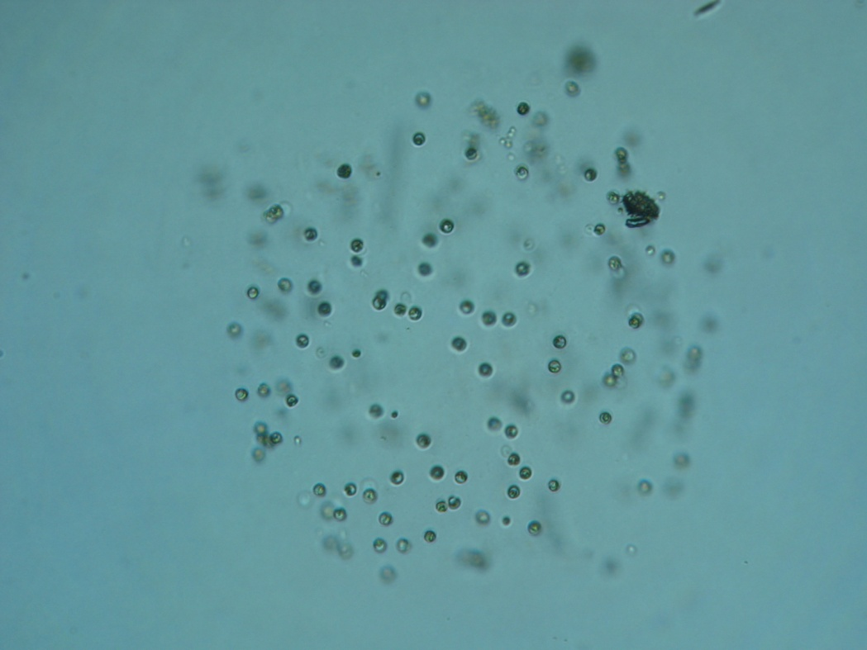
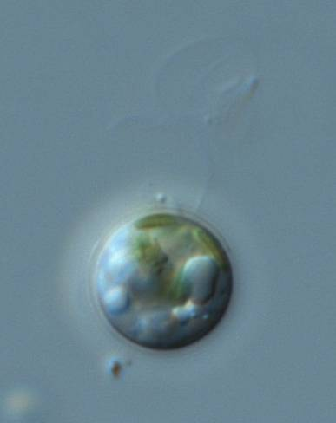
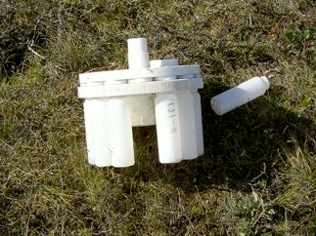
Alkenones are produced in summer
Record summer temperature
10 μm
D’Andrea et al. (2011) PNAS

Slide 6
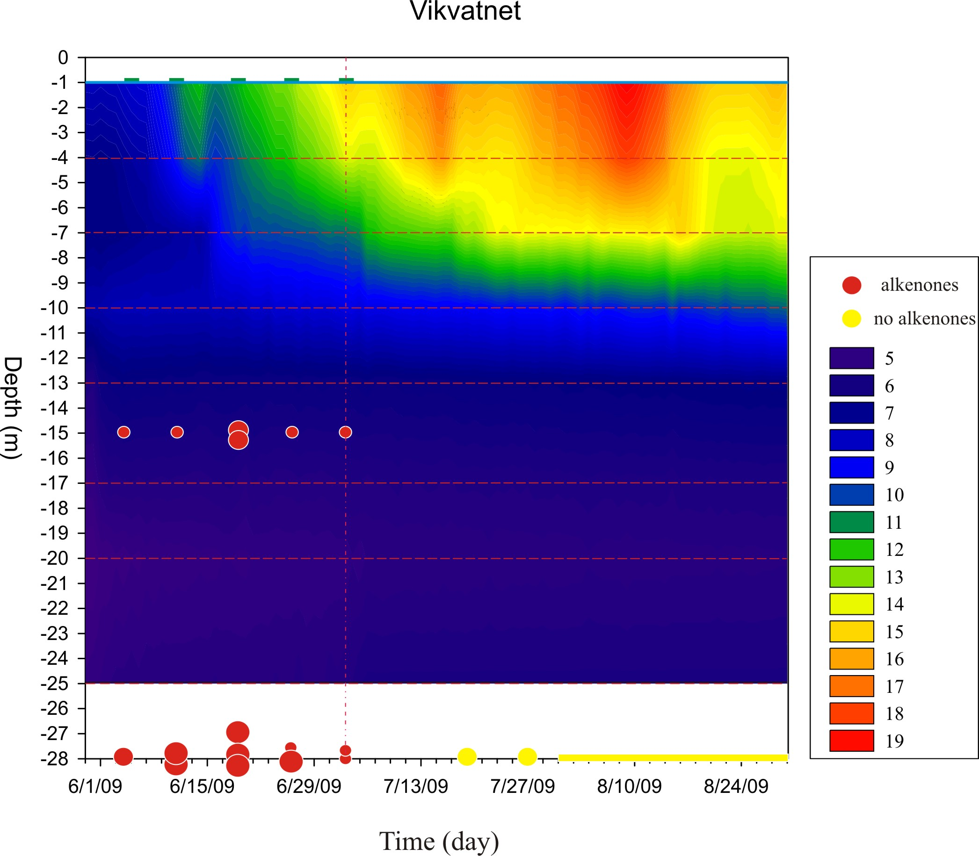
Calibrating the thermometer
Collected and filtered water
samples to measure unsaturation
Compared with water temperature
Lake depth
May
June
July
More saturated

Slide 7
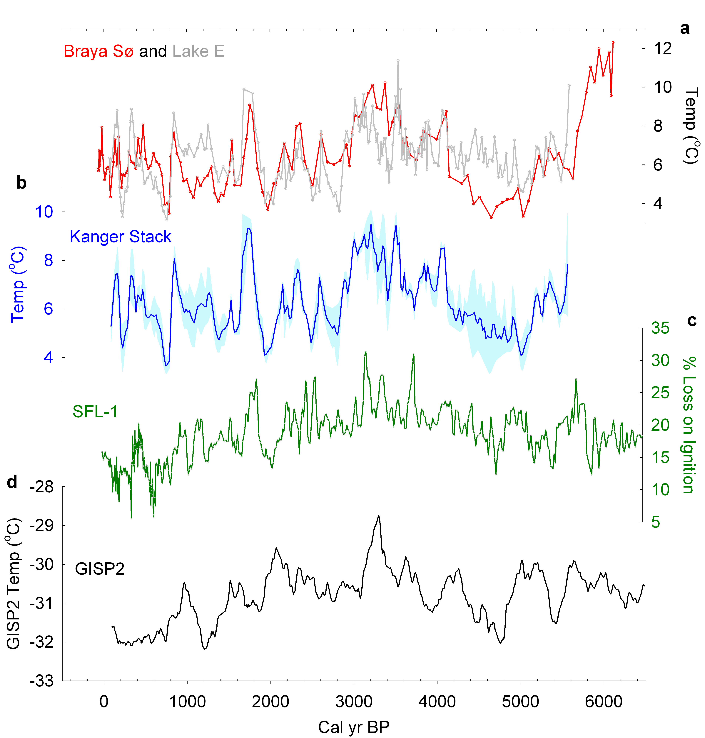
Willemse & Tornqvist, 1999
Alley, 2004
D’Andrea et al. (2011) PNAS

Slide 8
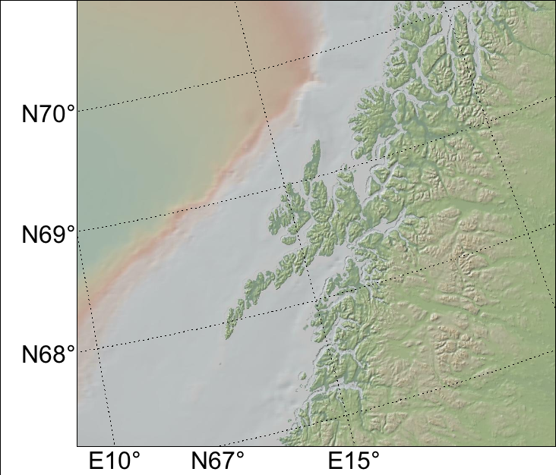
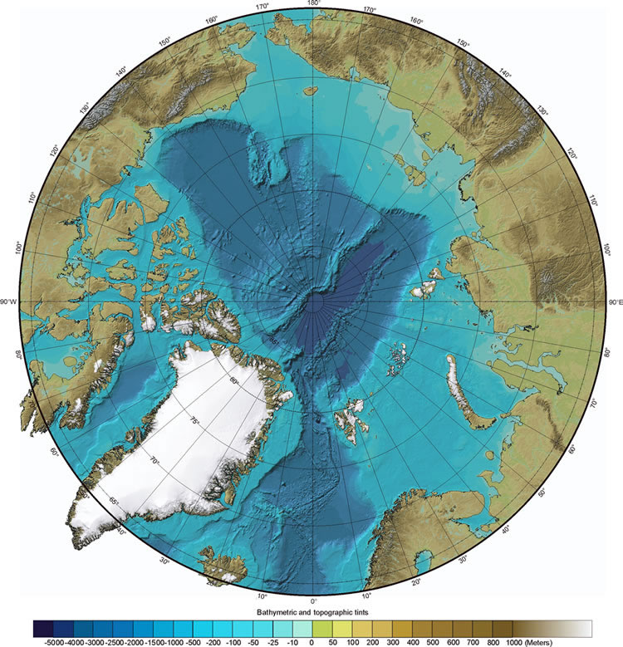
In situ calibration in time
Lofoten, Norway (Vikvatnet)
Lake water depth (m)
spring
summer

Slide 9
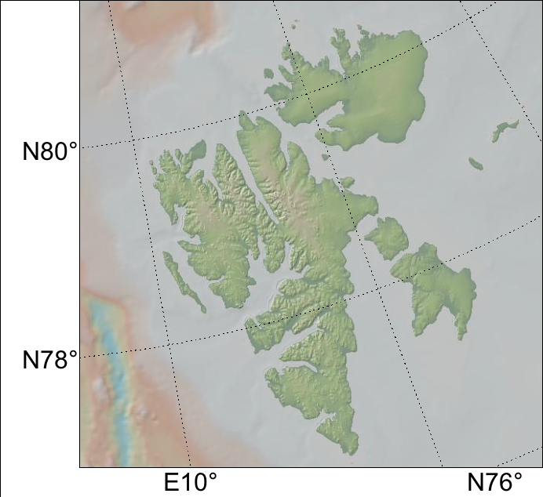
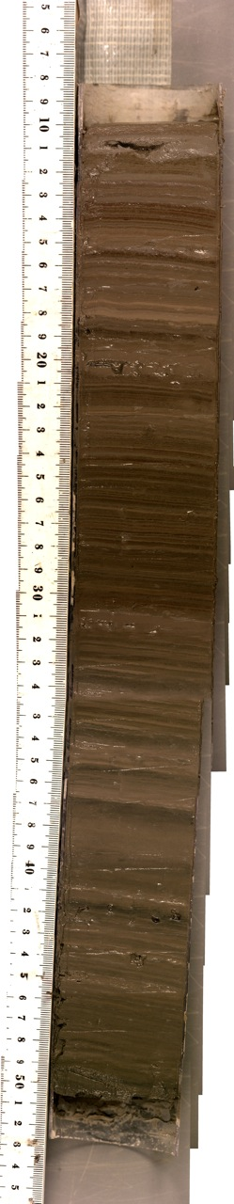
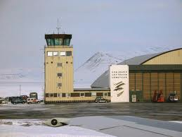
Instrumental calibration
Kongressvatnet, Svalbard
2,000 year temperature reconstruction

Slide 10
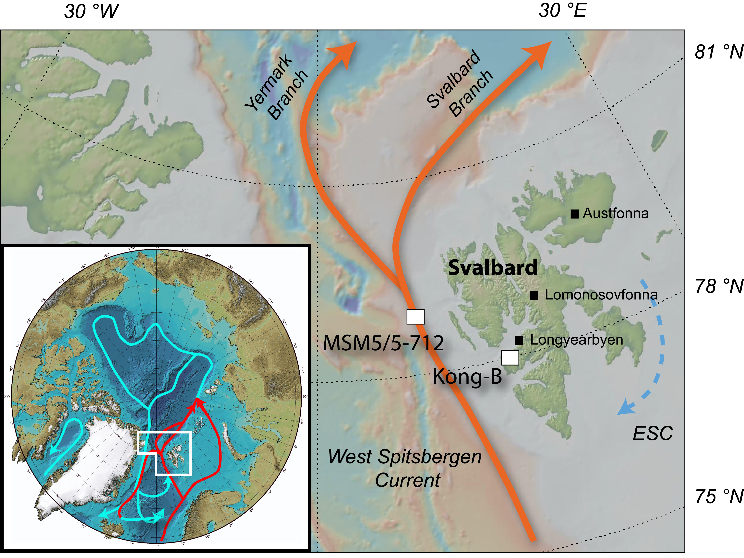

Slide 11
Kongressvatnet

Slide 12
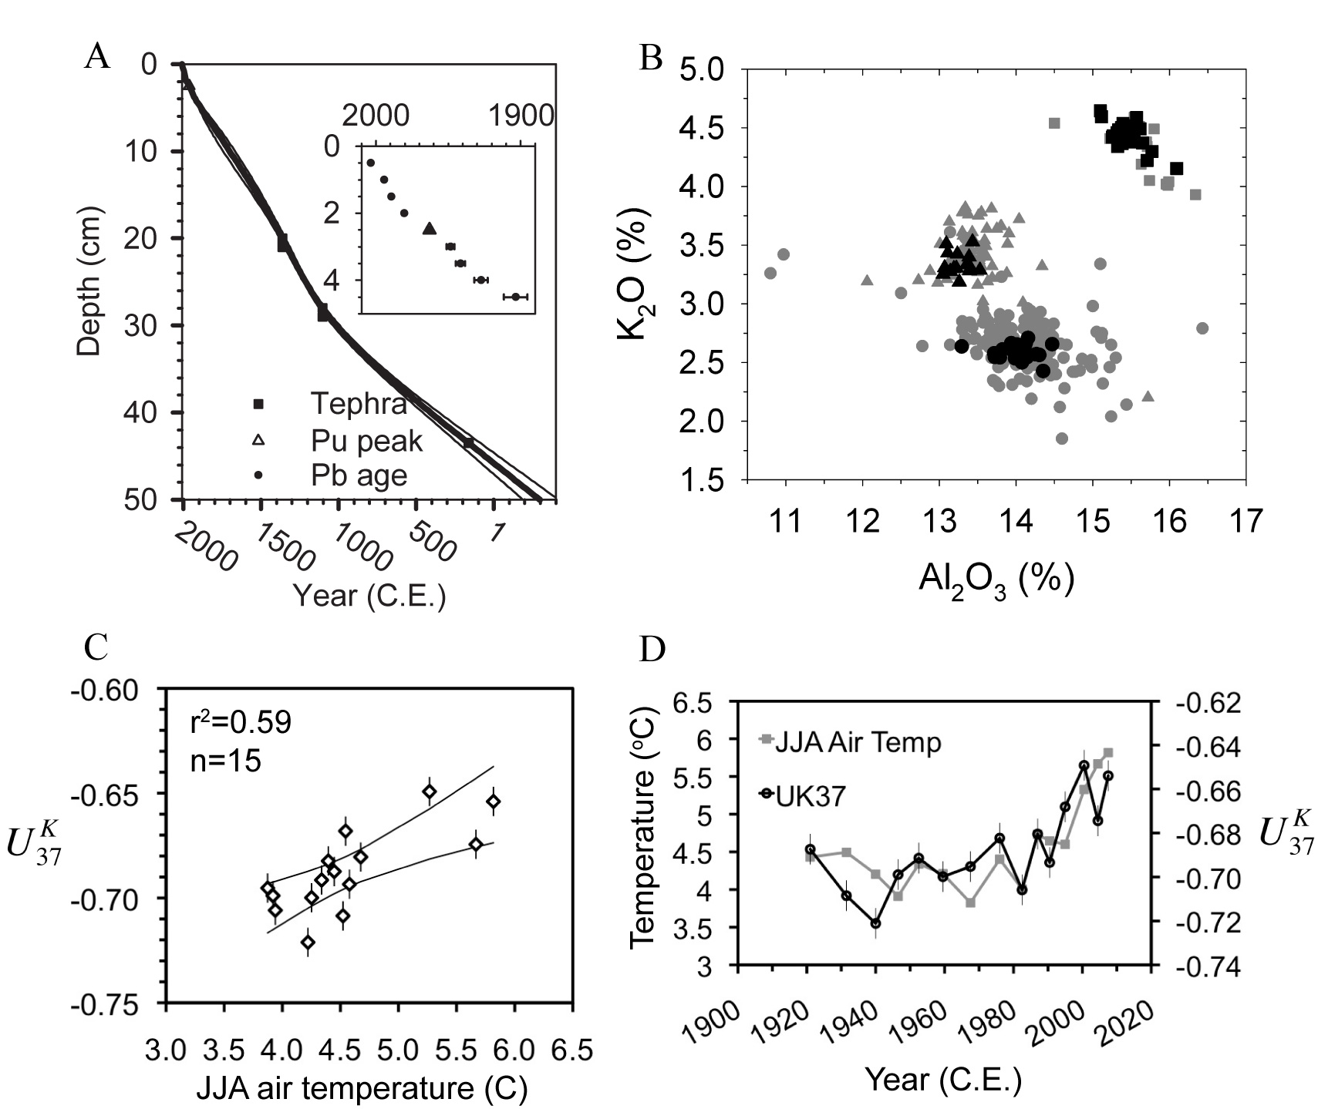
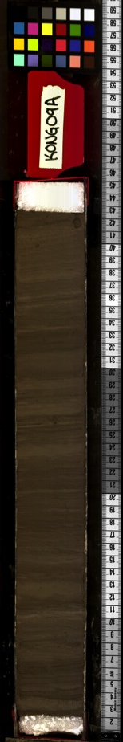
D’Andrea et al. (2012, accepted) Geology

Slide 13
SE
2σ
JJA Temp (°C)
Periods of glacier expansion followed by retreat on West Spitsbergen
First two episodes correspond to apparent summer cooling
Most recent “LIA” does not (18-19th centuries)

Slide 14
NAO impact on Svalbard winter precip
SVALBARD longitude
Dickson et al., 2000, J of Clim

Slide 16
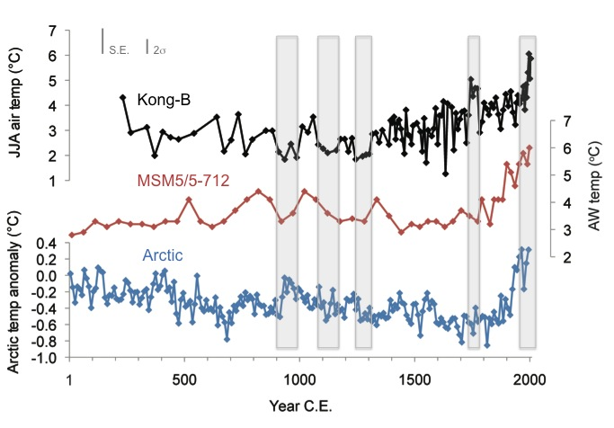
Influence of the West Spitsbergen Current
No cooling trend over past 2 ka
Similarities to Fram Strait temp record
Modest warming 1600-1900 AD
Spielhagen et al. 2011
Kaufman et al. 2009
D’Andrea et al. 2012

Slide 17
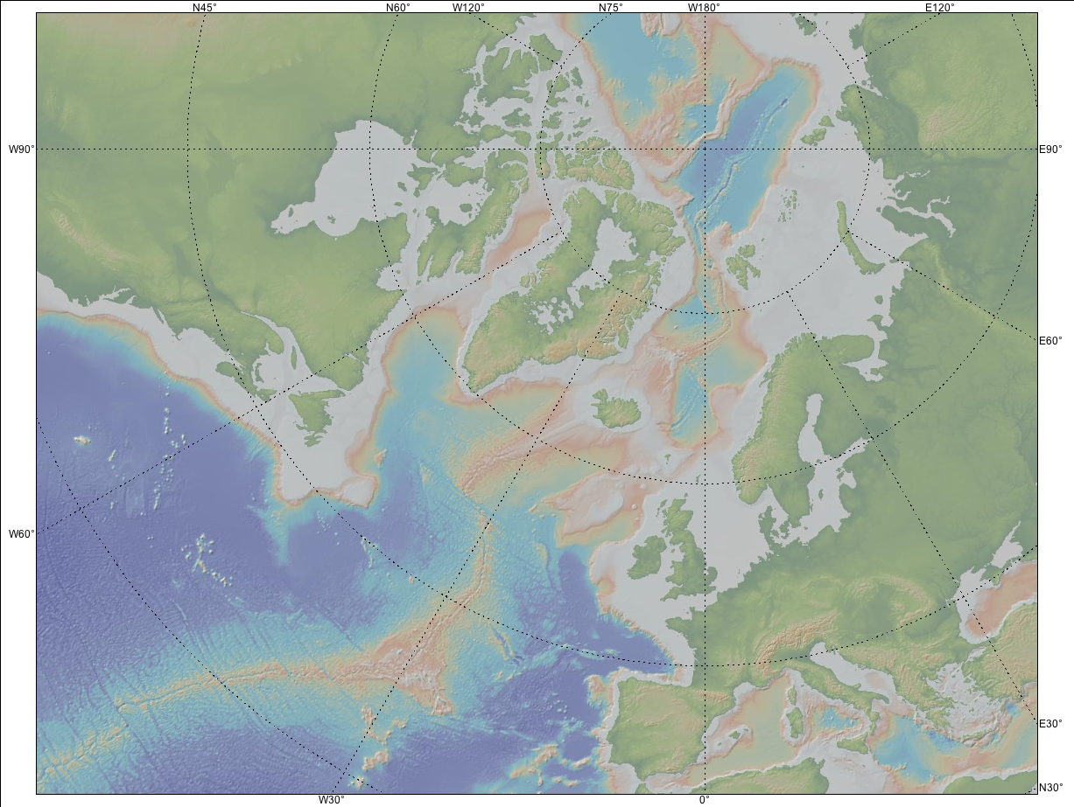
Fram Strait
West Spits Lake
N Iceland Shelf
Mid Norwegian Slope
Gardar Drift
Feni Drift

Slide 18
SST (ºC)
Sicre et al., 2011; RAPiD 21-3K alkenone SST, Gardar Drift
SST (ºC)
Sejrup et al., 2011: P1003 δ¹⁸O Mid-Norwegian Slope
δ¹⁸O
SST (ºC)
Richter et al., 2009: ENAM9606, NAC, Mg/Ca SST, Feni Drift
SST (ºC)
D’Andrea et al., West Spitsbergen

Slide 19
North Atlantic 2k
Records of NAC do not tell very consistent story, except:
  MCA-LIA transition
  Warming after 1600 AD
Summer temperature important for some but not all glacier advances in past 2ka on W Spits
  18-19th century summers not cold
Warming from 1980s to present unprecedented for W Spits in past 2 ka, including during MCA

Slide 20
T_{anom} (ºC)
Sicre et al., 2011; RAPiD 21-3K alkenone SST, Gardar Drift
SST (ºC)
Sejrup et al., 2011: P1003 δ¹⁸O Mid-Norwegian Slope
δ¹⁸O
SST (ºC)
Richter et al., 2009: ENAM9606, NAC, Mg/Ca SST, Feni Drift
SST (ºC)
D’Andrea et al., West Spitsbergen

Slide 21
Divine et al., 2011
Lomonosovfonna Ice Cap
Cold winter temps (?) during 18-19th centuries from ice core δ¹⁸Ο
Could also be due to increased winter season precip?

Slide 22
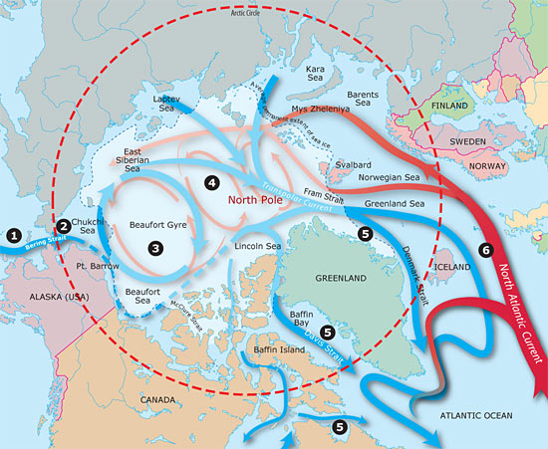
whoi.edu

Slide 23
Instrumental Data, Longyearbyen
Nordli, 2010

Slide 24
U^{K}₃₇ calibrations from lakes
D’Andrea et al, 2011
D’Andrea et al, in press

Slide 25
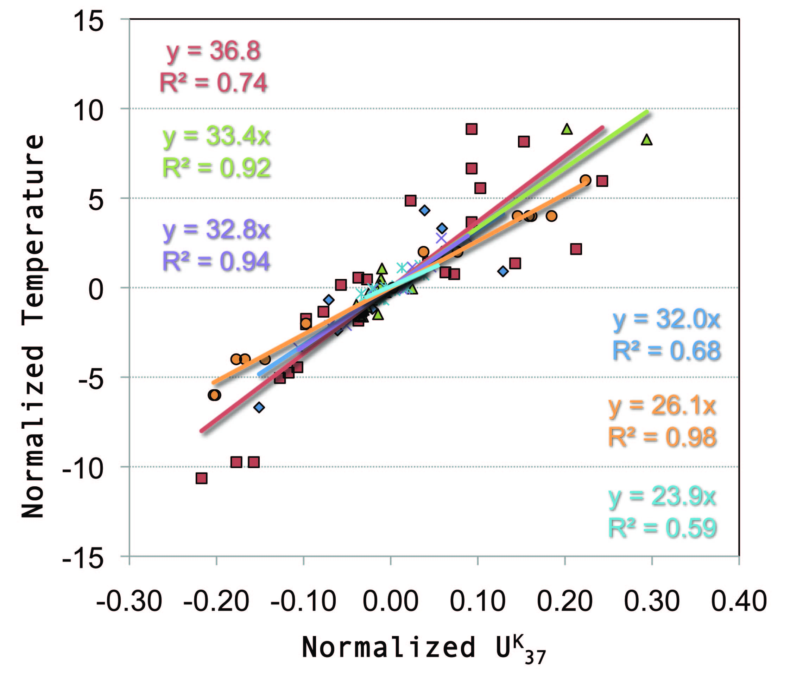
Common temp sensitivity?
T = 32.0 (U^{K}₃₇)
R² = 0.79
N = 98
- Can quantify past temperatures relative to a reference period
Additional calibrations will provide further validation

