Slide 1
The Importance of the Montreal Protocol in Protecting the Earth’s Hydroclimate
Yutian Wu
Courant Institute of Mathematical Sciences
New York University
Lorenzo M. Polvani and Richard Seager
Lamont-Doherty Earth Observatory, Columbia University
@ GloDecH Meeting, April 18th, 2012

Slide 2
Antarctic Ozone Hole and 1987 Montreal Protocol
Molina and Rowland 1974 – synthetic chlorofluorocarbons (CFCs) could probably lead to destruction of atmospheric ozone
Farman et al. 1985 – first observational evidence for large losses of total ozone in Antarctic
Significant negative environmental consequences of ozone loss – increase in surface UV-B radiation (290-320nm), skin cancer, eye damage, damage to ecosystems and marine phytoplankton
1987 Montreal Protocol on Substances That Deplete the Ozone Layer

Slide 3
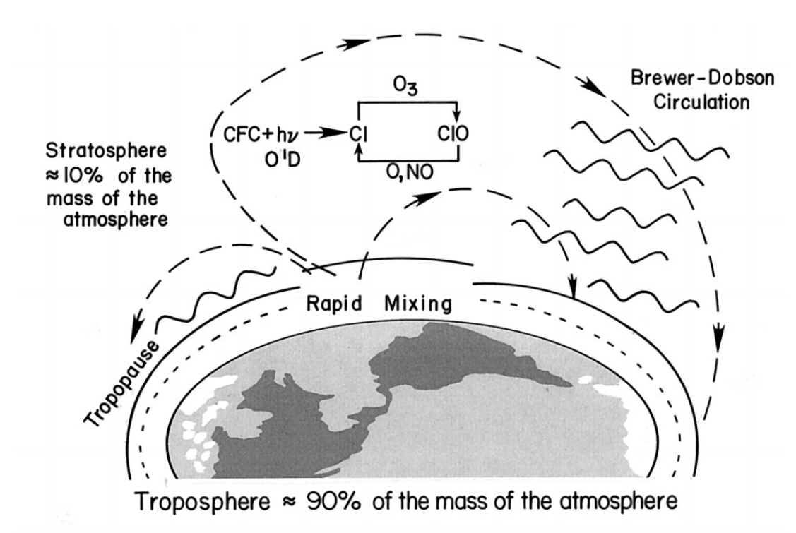
catalytic chain reaction
(Molina and Rowland 1974)
Schematic diagram illustrating the breakdown of CFCs and catalytic destruction of ozone in the middle and upper stratosphere.
Solomon S. 1999. Reviews of Geophysics.

Slide 4
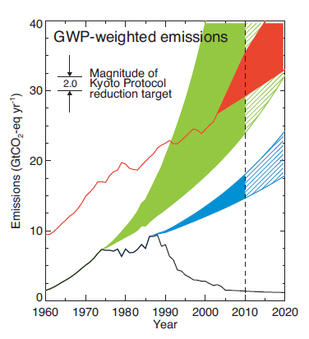
Montreal Protocol is Working
CFCs and other ozone depleting substances (ODSs) are decreasing and the amounts of total ozone column are no longer decreasing
Reduced the Earth’s greenhouse warming effect
Baseline ODS conditions as measured in the past and projected in the future
ODS projections for a world with no regulations from the Montreal Protocol (2-3% annual growth)
ODS projections for a world with no early warning by Molina and Rowland in 1974 (3-7% annual growth)
IPCC SRES A1B scenario for CO₂ in the past and projected for the future
Velders et al. 2006. PNAS.

Slide 5
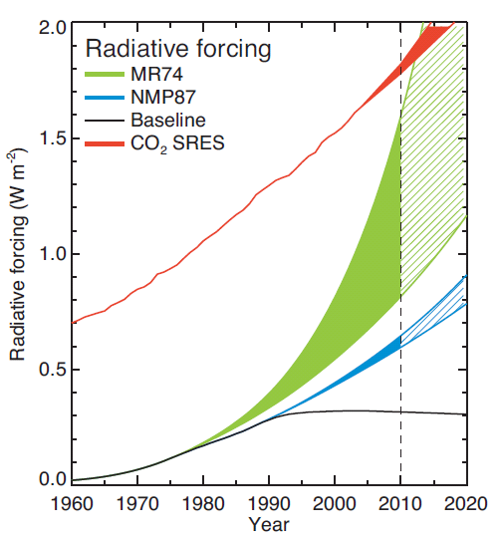
Montreal Protocol is Working
CFCs and other ozone depleting substances (ODSs) are decreasing and the amounts of total ozone column are no longer decreasing
Reduced the Earth’s greenhouse warming effect
1.8 W/m²
0.8-1.6 W/m²
“The MR74 projection that ODS radiative forcing could almost have matched that of anthropogenic CO₂ in 2010 …”
Velders et al. 2006. PNAS.

Slide 6
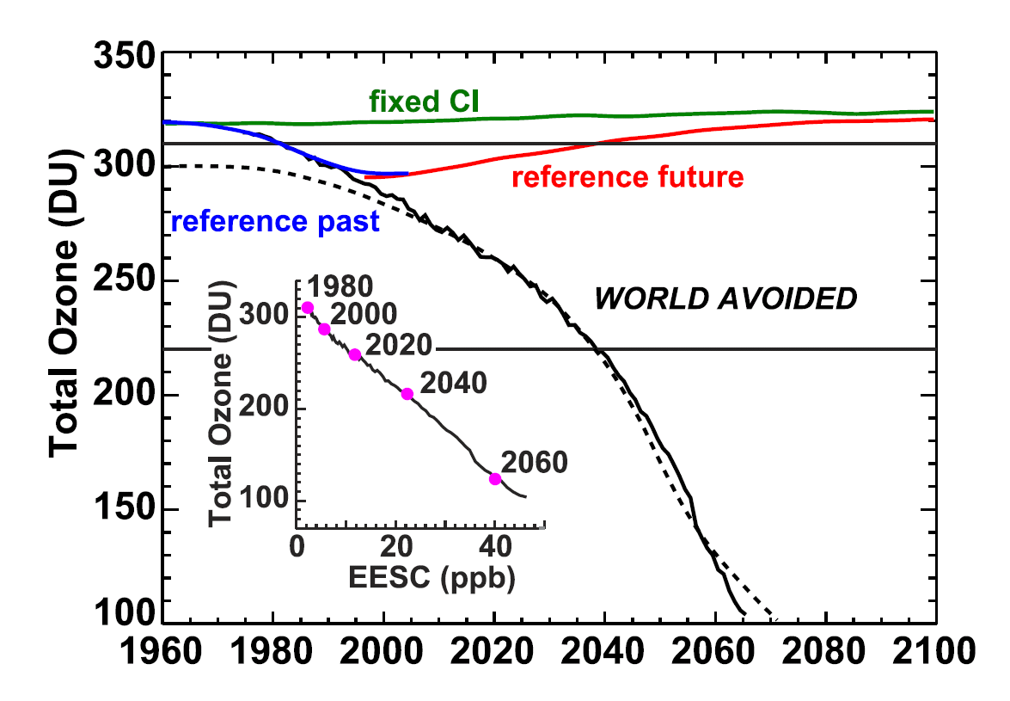
What would happen without Montreal Protocol?
P. A. Newman et al. 2008 - the ‘World Avoided’ scenario if CFCs had never been regulated
Fully coupled Goddard Earth Observing System (GEOS) chemistry-climate model
Assumed no early warning of Molina and Rowland (1974) and production of ODSs grow at annual rate 3%
A1B GHGs
17% (67%) ozone destroyed by 2020 (2065)
By 2065, year-around ozone depletion
By 2065, the UV index at northern midlatitude summer triples
By 2065, SH ‘permanent’ westerlies
Annual average global ozone for the ‘World Avoided’
P. A. Newman et al. 2008. Atmos. Chem. Phys.
What about atmos. circulation?

Slide 7
Our ‘World Avoided’ Simulations
To explore the hydroclimate and circulation response in absence of Montreal Protocol
NCAR CAM3.1 coupled to a slab ocean model (SOM)
Focus on the coming decade 2020-29
Instantaneously change the ozone field (stratosphere), and CFC-11, CFC-12 concentrations to P. A. Newman et al. 2008
Keep CO₂, CH₄, N₂O fixed

Slide 8
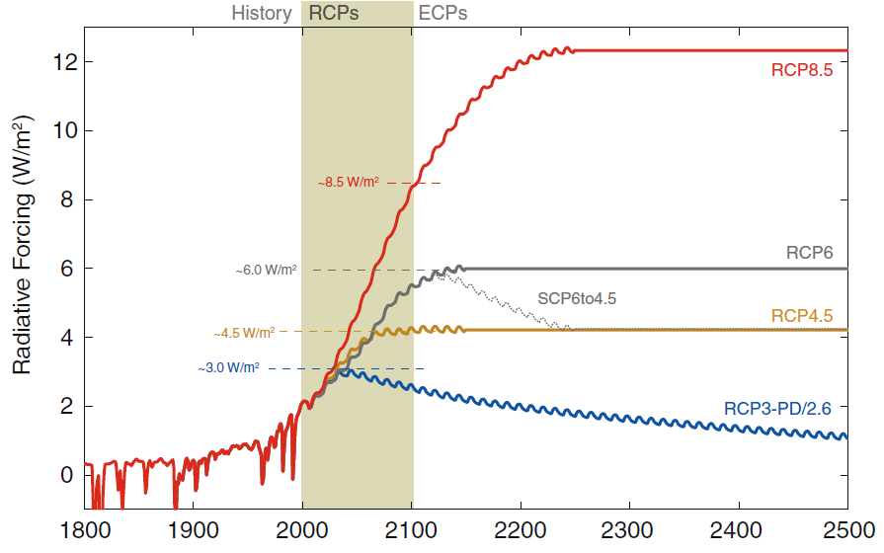
Comparisons with Global Warming Experiments
Instantaneous 2xCO₂ experiment in CAM3-SOM (Wu et al. 2012. J. Clim.)
CMIP3 (24 models) A1B scenario (2020-29)
CMIP5 (18 models) rcp4.5 scenario (2020-29)
In both A1B and rcp4.5 scenarios during 2020-29
CO₂ = 435ppmv (~37% increase relative to 1960)
Radiative forcing ~ 3 W/m²
3 W/m2
Meinshausen et al. 2011. Climatic Change.
year 2025

Slide 9
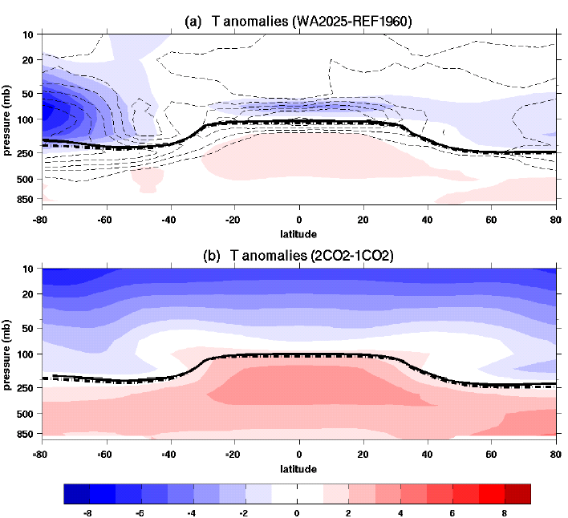
‘World Avoided’ 2020-29 Simulations
Annual Zonal Mean Temperature Equilibrium Response (Colors) (Contours: % O₃ reduction)
-60%
-20%
-50%
‘World Avoided’ with CAM3-SOM
2xCO₂ with CAM3-SOM

Slide 10
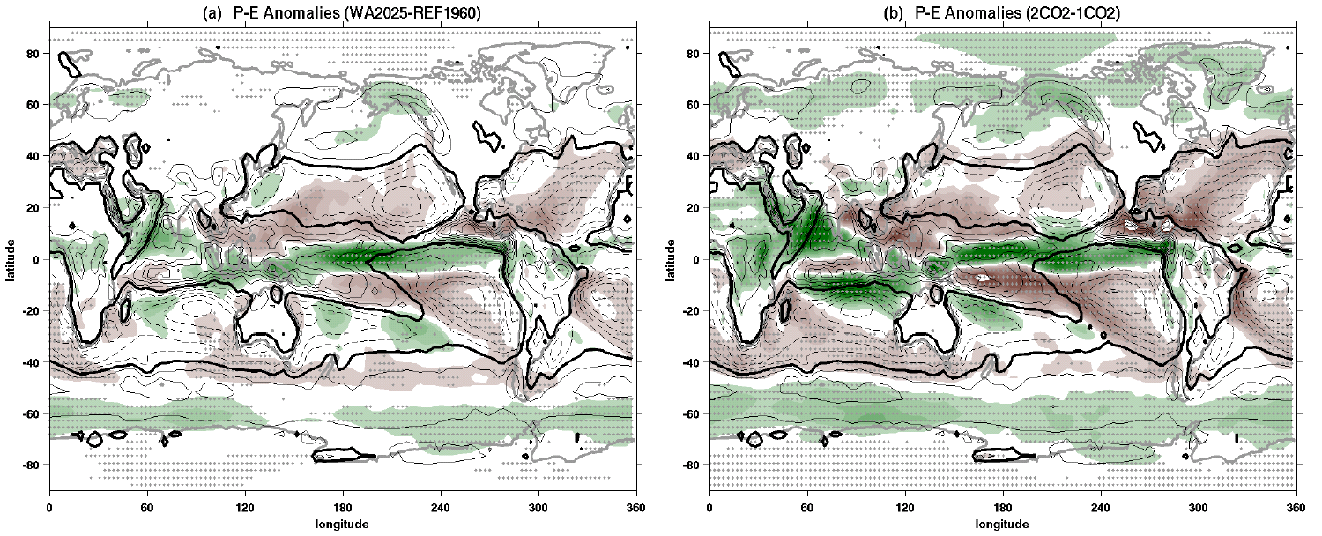
Annual Mean P-E Equilibrium Response (Colors)
(Contours: climatologies / Dots: more than 80% members agree on sign )
‘World Avoided’ with CAM3-SOM
2xCO₂ with CAM3-SOM
Global hydroclimate change in ‘World Avoided’ scenario
Subtropical drying trend and midlatitude moistening trend, in general
Large qualitative similarities
P-E Anomalies [mm/day]

Slide 11
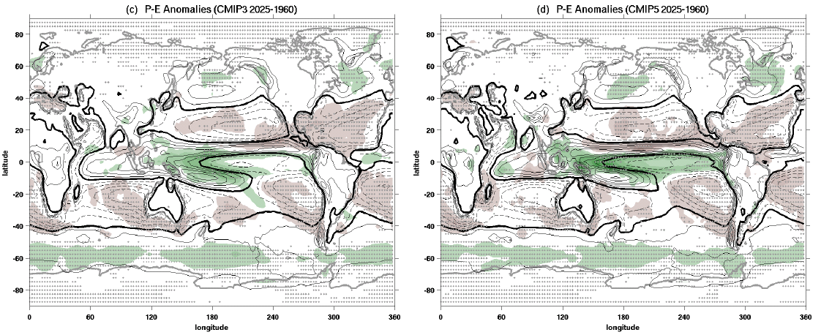
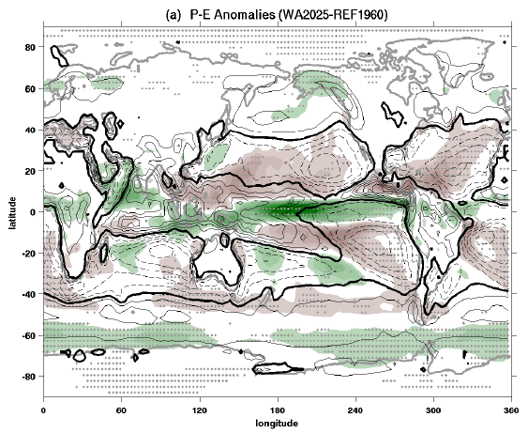
CMIP3 A1B 2025-1960
CMIP5 rcp45 2025-1960
‘World Avoided’ with CAM3-SOM
Very good agreement between CMIP3 and CMIP5
Quantitative similarities between ‘World Avoided’ and transient global warming simulation largely due to CO₂ increase
This implies that, without Montreal Protocol, the drying (moistening) trend in the subtropics (mid- and high latitudes) would DOUBLE in the coming decade because of CFC increase and ozone loss

Slide 12
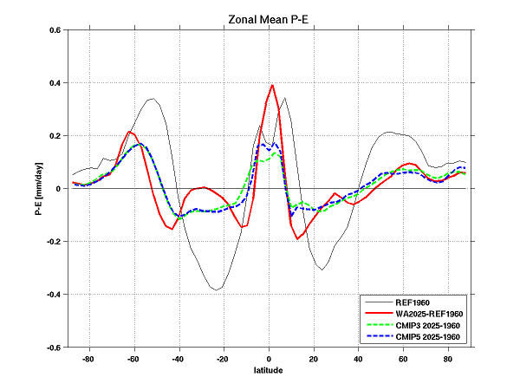
WA2025
CMIP3 & CMIP5

Slide 13
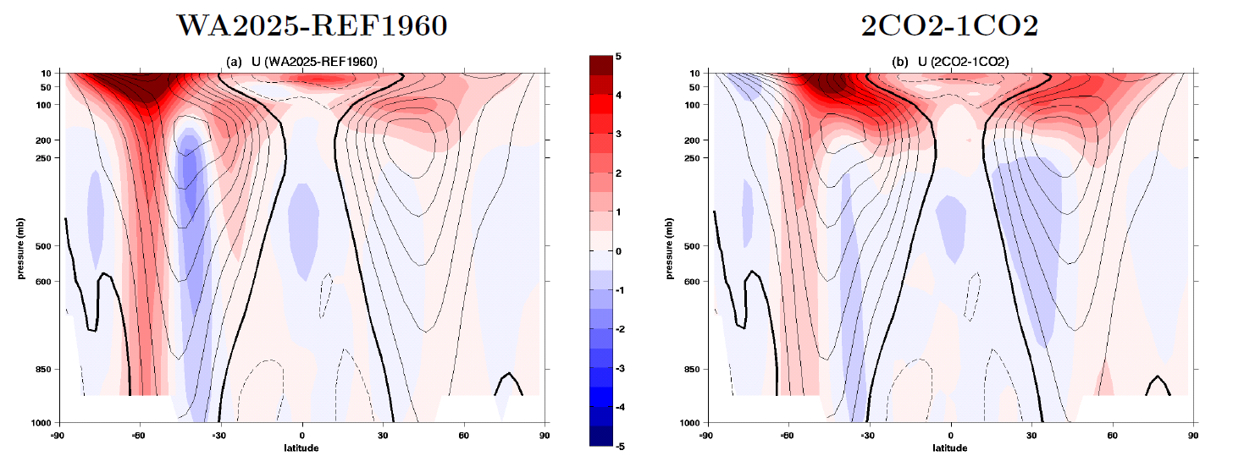
Similarities in zonal mean circulation between ‘World Avoided’ and 2xCO₂
Poleward shift of the tropospheric jet streams

Slide 14
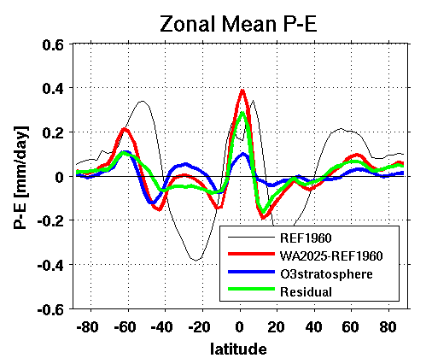
Mechanisms?
Stratospheric ozone depletion vs. increases in CFC-11 and CFC-12?
Preliminary results show both stratospheric ozone depletion and CFC increase contribute significantly to the hydrological cycle change

Slide 15
Conclusions
Without regulations on CFC use, in the coming decade:
Large ozone loss globally
Global hydrological cycle change – ‘dry gets drier and wet gets wetter’ in genera, due to CFC increase and stratospheric ozone loss
Approximately double the hydrological cycle change due to CO₂ increase alone
As a consequence of both stratospheric ozone loss and CFC increase

Slide 16
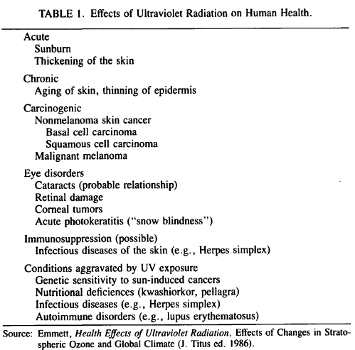

Slide 17
