Slide 1
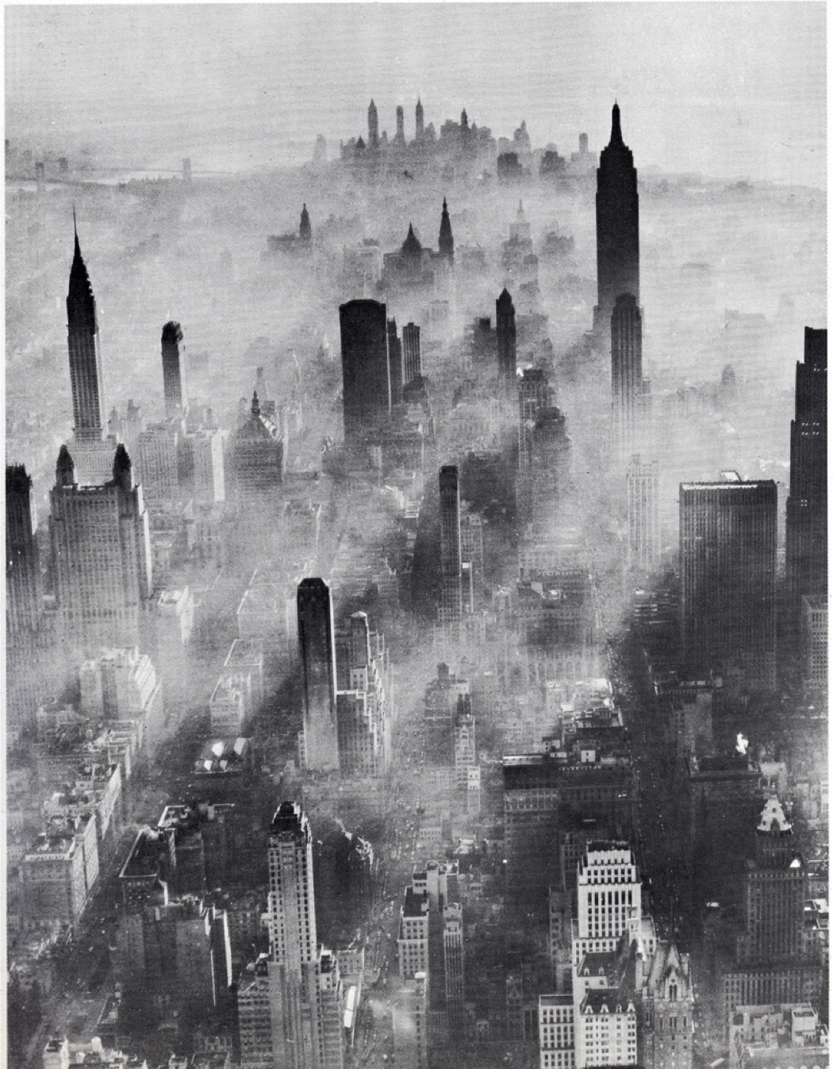








21st Century Reversal of the Surface Ozone Seasonal Cycle over the Northeastern United States
Lower Manhattan, 1948
Image Credit: Unknown
Olivia Clifton
83520601
GloDecH Meeting May 28, 2014
Acknowledgments. Arlene Fiore (CU/LDEO), Gus Correa (LDEO), Larry Horowitz (NOAA/GFDL), Vaishali Naik (UCAR/GFDL)

Slide 2
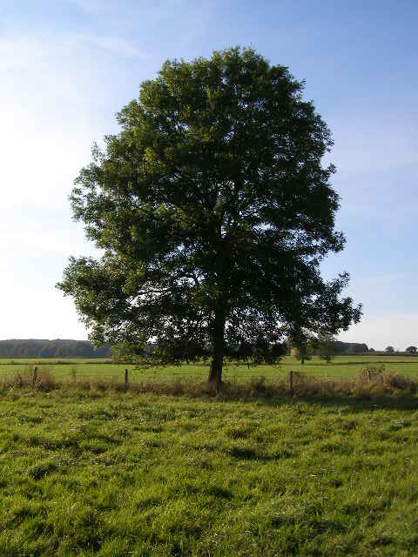
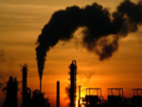

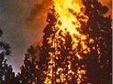


Surface Ozone (O₃): degrades air quality & is injurious to human health and vegetation
Non-methane volatile organic compounds (NMVOCs)
Carbon Monoxide (CO)
Surface O₃ = NO_{x} + sunlight +
Methane (CH₄)
Notes:
Surface O₃ forms through the photochemical oxidation of methane, non-methane volatile organic compounds (NMVOCs), or carbon monoxide (CO) in the presence of sunlight and nitrogen oxides (NO_{x}).

Slide 3
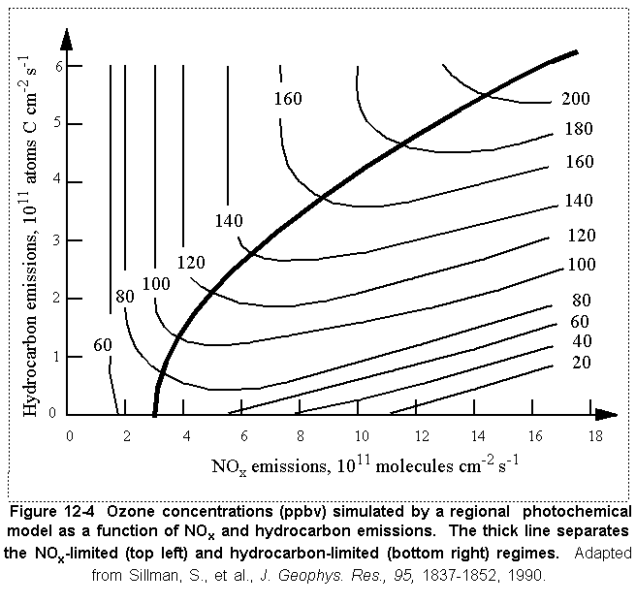
Surface O₃ levels controlled by nonlinear chemistry
OZONE CONCENTRATIONS vs. NO_{x} & VOC EMISSIONS
Ridge
NO_{x}-limited
NO_{x}-saturated
Reductions in NO_{x} emissions achieve local-to-regional decreases in surface O₃ and reductions in CH₄ emissions lower the surface O₃ everywhere [Fiore et al., 2002]
In highly polluted regions (very high regional NO_{x}), NO_{x} can destroy surface O₃
Notes:
Surface ozone levels are controlled by nonlinear chemistry
Ridge separates two photochemical regimes
NOx-limited: ozone increases with rising NOx, but remains relatively unchanged for increasing VOCs
NOx-saturated: ozone increases with increasing VOC and decreases with increasing NOx
Some background to keep in mind

Slide 4
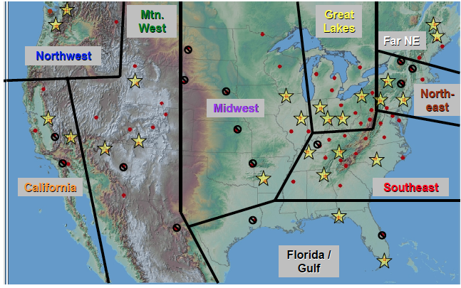
Seasonal cycle of observational surface O₃ at NE monitoring sites during 1991-1996
mean across 3 regionally representative Clean Air Status and Trends Network (CASTNet) sites [Reidmiller et al., 2008]
Regionally
representative site (each site has 4-6 years of observations)
Washington Crossing, NJ
Penn State, PA
Connecticut Hill, NY
Feb Apr Jun Aug Oct Dec

Slide 5
Seasonal cycle of observational surface O₃ at NE monitoring sites during 1991-1996
Densely populated and highly polluted region
mean across 3 regionally representative Clean Air Status and Trends Network (CASTNet) sites [Reidmiller et al., 2008]
Regionally
representative site
Feb Apr Jun Aug Oct Dec
Highest surface O₃ during the summer due to presence of precursor emissions (both NO_{x} and VOCs) and favorable meteorological conditions (i.e. high temperatures, low cloud cover, and stagnation)

Slide 6
Change in seasonal cycle of observational surface O₃ over NE due to a 26% decrease in regional NO_{x} emissions
mean across 3 regionally representative Clean Air Status and Trends Network (CASTNet) sites [Reidmiller et al., 2008]
-26% NE NO_{x}
Regionally
representative site
Solid: 1991-1996, pre-NO_{x} emission controls
Dashed: 2004-2009, post-NO_{x} emission decreases
Feb Apr Jun Aug Oct Dec
Notes:
Ok some this is the same plot as before but I’ve added a new seasonal cycle, the dashed line, which corresponds to 2004-2009
Between these two time periods there were 26% decreases in regional Nox emissions

Slide 7
Change in seasonal cycle of observational surface O₃ over NE due to a 26% decrease in regional NO_{x} emissions
mean across 3 regionally representative Clean Air Status and Trends Network (CASTNet) sites [Reidmiller et al., 2008]
-26% NE NO_{x}
Regionally
representative site
How will the surface O₃ seasonal cycle over the NE US respond to further regional as well as global precursor emission changes during the rest of 21st C?
Solid: 1991-1996, pre-NO_{x} emission controls
Dashed: 2004-2009, post-NO_{x} emission decreases
Feb Apr Jun Aug Oct Dec

Slide 8
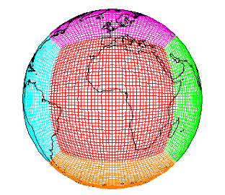
GFDL CM3 chemistry-climate model is the tool that we use to project 21st C surface O₃
Modular Ocean Model version 4 (MOM4)
&
Sea Ice Model
GFDL-CM3
cubed sphere grid
~2°x2°
48 vertical levels
GFDL-CM3
Forcing
Solar Radiation
Well-mixed Greenhouse Gas Concentrations
Volcanic Emissions
Atmospheric Dynamics & Physics
Radiation, Convection (includes wet deposition of tropospheric species), Clouds, Vertical diffusion, and Gravity wave
Atmospheric Chemistry
86km
Ozone–Depleting Substances (ODS)
Chemistry of O_{x}, HO_{y}, NO_{y}, Cly, Br_{y}, and Polar Clouds in the Stratosphere
Chemistry of gaseous species (O₃, CO, NO_{x}, hydrocarbons) and aerosols (sulfate, carbonaceous, mineral dust, sea salt, secondary organic)
Pollutant Emissions (anthropogenic, ships, biomass burning, natural, & aircraft)
Aerosol-Cloud Interactions
Dry Deposition
Donner et al. [2011]; Golaz et al. [2011]; Levy et al. [2013]; Naik et al. [2013]; Austin et al. [2013]; John et al. [2012]
Land Model version 3
(soil physics, canopy physics, vegetation dynamics, disturbance and land use)
c/o V. Naik
Notes:
So GFDL CM3 is the tool that we use to project 21st Century surface ozone.
I would like to point out that CM3 is a chemistry-climate model that includes online fully coupled tropospheric and stratospheric chemistry including gas phase and aerosols within an atmosphere-ocean GCM.

Slide 9
Evaluation of CM3 with observational surface O₃ over NE
mean across 3 regionally representative CASTNet sites [Reidmiller et al., 2008]
-10% IMW NO_{x}
-26% NE NO_{x}
OBS CM3
Regionally
representative site
Solid: 1991-1996, pre-NO_{x} emission controls
Dashed: 2004-2009, post-NO_{x} emission decreases
3 Ensemble member mean
Feb Apr Jun Aug Oct Dec
Notes:
Ok now the same plot as before, but with model seasonal cycles for the same time periods
Captures small increases during winter and early spring and small decreases during summer

Slide 10
Evaluation of CM3 with observational surface O₃ over NE
mean across 3 regionally representative CASTNet sites [Reidmiller et al., 2008]
-10% IMW NO_{x}
-26% NE NO_{x}
OBS CM3
Regionally
representative site
Solid: 1991-1996, pre-NO_{x} emission controls
Dashed: 2004-2009, post-NO_{x} emission decreases
Despite high bias, CM3 captures the overall structure of the seasonal surface O₃ changes over the NE & thus the response of surface O₃ to the NO_{x} emission controls
3 Ensemble member mean
Feb Apr Jun Aug Oct Dec

Slide 11
Evaluation of CM3 with observational surface O₃ over NE
mean across 3 regionally representative CASTNet sites [Reidmiller et al., 2008]
-10% IMW NO_{x}
-26% NE NO_{x}
OBS CM3
Regionally
representative site
Solid: 1991-1996, pre-NO_{x} emission controls
Dashed: 2004-2009, post-NO_{x} emission decreases
Despite high bias, CM3 captures the overall structure of the seasonal surface O₃ changes over the NE & thus the response of surface O₃ to the NO_{x} emission controls
3 Ensemble member mean
Feb Apr Jun Aug Oct Dec
We conclude that we can use CM3 to determine how surface O₃ will respond to future precursor emission changes
Notes:
One possible explanation for the model bias is that in the real world, precursor emission controls were imposed most strongly during the surface ozone season, whereas we do not have seasonally varying anthropogenic emissions in CM3.

Slide 12
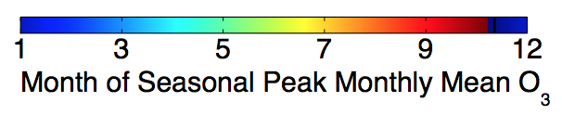
Month of peak monthly mean surface O₃ (3 ensemble member mean)
2006-2015
Feb Apr Jun Aug Oct Dec
Notes:
So now we jump to looking at the 21st Century projections. So this plot shows the month holding the peak monthly mean surface ozone over the united states during one of the first decades of the 21st Century. We see that over the eastern united states, peak monthly mean ozone occurs during the summer. On the other hand, the peak occurs over the rest of the US during cooler months. We expect this dichotomy because of the combination of regional NOx emissions and favorable meteorological conditions characteristic of the eastern US during summer.

Slide 13
Month of peak monthly mean surface O₃ (3 ensemble member mean)
2006-2015
2091-2100
Feb Apr Jun Aug Oct Dec
Clear shift in the peak from summer to winter/early spring over Eastern US
Notes:
Conclusion: clear shift….
--------
The high elevation, deep boundary layer, and long O3 lifetime characteristic of the IMW lead to higher levels of mean background O3 than in the Eastern US [Fiore et al., 2002; Jaffe, 2011; Zhang et al., 2011]. Over the Western US, background O3 typically peaks during the spring, due to the long O3 lifetime and the seasonal peak in stratospheric influence [e.g. Wang et al., 1998].

Slide 14
Month of peak monthly mean surface O₃ (3 ensemble member mean)
2006-2015
2091-2100
Under RCP8.5
RCPs created in conjunction with IPCC AR5 and CMIP5
Designed to attain a specific RF (8.5 W/m²) by 2100
The most extreme 21st C Climate scenario with doubling of global CH₄ abundance by 2100
Feb Apr Jun Aug Oct Dec
Clear shift in the peak from summer to winter/early spring over Eastern US
Notes:
So this projection of surface ozone is under a 21st century climate scenario called RCP8.5

Slide 15
Month of peak monthly mean surface O₃ (3 ensemble member mean)
2006-2015
2091-2100
Under RCP8.5
RCPs developed by CMIP effort in support of IPCC
Designed to attain a specific RF (8.5 W/m²) by 2100
The most extreme 21st C Climate scenario with doubling of global CH₄ abundance by 2100
Feb Apr Jun Aug Oct Dec
Clear shift in the peak from summer to winter/early spring over Eastern US
Investigate the drivers of this shift over NE (drastic regional NO_{x} emission decreases, changes in global CH₄ abundance, increased climate warming, or some combination?) by examining the change in seasonal cycle at beginning & end of 21st C
Evaluate the magnitude of the change in surface O₃ & the change in shape of seasonal cycle
Compare RCP8.5 with RCP4.5 (moderate; 10% decrease of global CH₄) as well as with sensitivity simulations

Slide 16
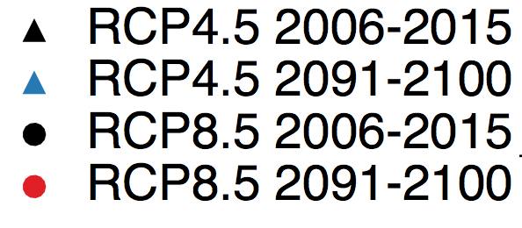
Surface O₃ seasonal cycle at beginning and end of the 21st C under RCP4.5 and RCP8.5
-10% global CH₄
+114% global CH₄
-90% NE NO_{x}
-90% NE NO_{x}
Each symbol is ensemble member; lines are ensemble member mean (3)
Feb Apr Jun Aug Oct Dec
Notes:
These seasonal cycles are over the NE as the previous slide, but monthly mean surface ozone is averaged across all the gridboxes that fall in the regional domains, instead of across a couple of regionally representative sites.
the changes in global methane abundance are in the upper right corner of the plot and the changes in regional nox emissions are in the lower left corner.
The black seasonal cycles correspond to the beginning of century and black triangles represent rcp4.5 and black circles are rcp8.5. surface O3 peaks during the summer with a smaller peak during March
Red seasonal cycle corresponds to RCP8.5 at 2100 and the blue seasonal cycle corresponds to RCP4.5 at 2100.
the 2100 seasonal cycles have different magnitudes under RCP4.5 and under RCP8.5, reflecting the different emission scenarios, but the seasonal cycles have similar shape with maxima during cooler months

Slide 17
Surface O₃ seasonal cycle at beginning and end of the 21st C under RCP4.5 and RCP8.5
-10% global CH₄
+114% global CH₄
-90% NE NO_{x}
-90% NE NO_{x}
Feb Apr Jun Aug Oct Dec
NE resembles baseline O₃ conditions by end of 21st C [NRC, 2009; Parrish et al., 2013]
Reversal of the NE surface O₃ seasonal cycle during 21st C after 2020s (not shown)
Notes:
This indicates two conclusions: that the NE becomes representative of baseline O3 conditions and that there is a clear reversal of the seasonal cycle over the NE by 2100.

Slide 18
Surface O₃ seasonal cycle at beginning and end of the 21st C under RCP8.5 and a sensitivity simulation holding all CH₄ at 2005 levels
-90% NE NO_{x} +114% global CH₄
-90% NE NO_{x} +0% global CH₄
Feb Apr Jun Aug Oct Dec Feb Apr Jun Aug Oct Dec
The doubling of global methane abundance raises the entire seasonal cycle by about 6-11 ppb, with the greatest differences between RCP8.5 and RCP8.5_2005CH4 during January through March when the O₃ lifetime is longest

Slide 19
Surface O₃ seasonal cycle at beginning and end of the 21st C under RCP8.5 and a sensitivity simulation holding all CH₄ at 2005 levels
-90% NE NO_{x} +114% global CH₄
-90% NE NO_{x} +0% global CH₄
Feb Apr Jun Aug Oct Dec
Reduced NO_{x} emissions play a role in increasing surface O₃ during the winter in highly polluted regions [US EPA, 2014]
While NO_{x} exerts a dominant influence on the shape of the surface O₃ seasonal cycle, global CH₄ abundance influences the baseline surface O₃ abundance during all months

Slide 20
Rising baseline surface O₃ by 2100 from increases in global CH₄ abundance
NE US 36-46 N 80-70W IMW US 36-46N 115-105W
- 43% IMW NOx
- 90% NE NOx
Feb Apr Jun Aug Oct Dec
RCP8.5_2005CH4_rad 2091-2100 same as RCP8.5 2091-2100 (not shown)
RCP8.5_2005CH4_chem (dashed) 2091-2100 same as RCP8.5_2005CH4 2091-2100
The CH₄ impact on surface O₃ in the model occurs mainly though atmospheric chemistry, rather than through the additional climate forcing from CH₄
Notes:
0.62 historical
4.42 rcp85
3.15 rcp85_wmgg
3.47 rcp85_2005ch4
4.03 rcp85_2005ch4_chem
3.93 rcp85_2005ch4_rad
2.24 rcp45
1.4 rcp4.5_wmgg

Slide 21


Impact of a warming climate on the surface O₃ seasonal cycle
RCP4.5_WMGG & RCP8.5_WMGG isolate impacts from a changing climate
JJA NE temp inc. by 2.5ºC
Same findings under RCP4.5_WMGG & RCP8.5_WMGG, but magnitude of each change depends on the regional temperature increases
JJA NE temp inc. by 5.5ºC
Feb Apr Jun Aug Oct Dec
Notes:
WMGG simulations hold all o3 precursors at 2005 and only well mixed green house gases are allowed to evolve to 2100 levels.

Slide 22
Impact of a warming climate on the surface O₃ seasonal cycle
RCP4.5_WMGG & RCP8.5_WMGG isolate impacts from a changing climate
JJA NE temp inc. by 2.5ºC
JJA NE temp inc. by 5.5ºC
General increases in summertime surface O₃ over NE reflect “Climate change penalty”
Wu et al., 2008
need for stricter emission controls to achieve a given level of air quality due to warming climate (but in absence of precursor emission changes)
Feb Apr Jun Aug Oct Dec

Slide 23
Impact of a warming climate on the surface O₃ seasonal cycle
RCP4.5_WMGG & RCP8.5_WMGG isolate impacts from a changing climate
JJA NE temp inc. by 2.5ºC
Broadening of the summertime peak over the NE with similar levels of surface O₃ in June-August, as opposed to a clear peak in July
JJA NE temp inc. by 5.5ºC
Feb Apr Jun Aug Oct Dec
Climate change penalty predominantly affects surface O₃ during the photochemically active season, May-September, in regions with sufficiently high anthropogenic NO_{x} emissions
Notes:
And so we also see a broadening ..
So we conclude …

Slide 24
Conclusions
Reversal of NE US high-surface O₃ season
Changing regional emissions alters high surface O₃ season
Climate change broadens surface O₃ peak in NE US
Rising global CH₄ can offset O₃ decreases from U.S. precursor reductions
NE at end of 21st C more representative of baseline O₃ conditions
Questions?

