Slide 1
Association of U.S. tornado counts with the large-scale environment on monthly time-scales
  Michael K. Tippett¹, Adam H. Sobel^{2,3} and Suzana J. Camargo³
¹ International Research Institute for Climate and Society, Columbia University, Palisades, NY
² Department of Applied Physics and Applied Mathematics and Department of Earth and Environmental Sciences, Columbia University, New York, NY
³ Lamont-Doherty Earth Observatory, Columbia University, Palisades, NY

Slide 2
Outline
How does climate control tornado activity?
  Why this is a hard question.
Atmospheric environment and tornadoes
  Short time-scales
An index relating monthly tornado activity and environment
  Derivation
  Properties

Slide 3
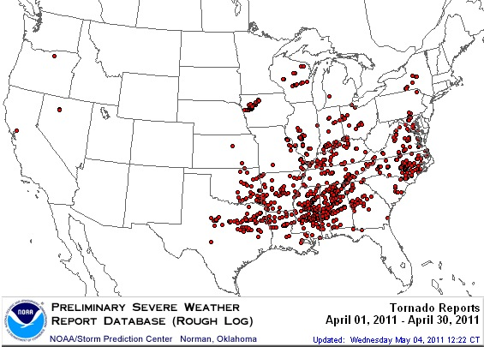
Motivation:
2011 “Year of the Tornado”
April 2011 most U.S. tornadoes any month (753).
  Previous record May 2003 (542).
  Previous busiest April 1974 (267).
Three of the top five tornado outbreaks on record.
Damage estimates = $25 billion, >2X previous record from 2010.
  WeatherUnderground
Notes:
Motivation comes from the record-breaking tornado activity that occurred this year in April.

Slide 4
Climate/tornadoes connection?
“Tornado Season Intensifies, Without Clear Scientific Consensus on Why” -- NY Times, April 25, 2011.
“The co-variability of 20 severe spring (March-May) tornado outbreaks over the contiguous US and phases of the El Niño/Southern Oscillation (ENSO) during the past 100 years presents a complicated picture of the historical relationships.” -- NOAA/ERSL Climate Attribution Rapid Response Team
outside the work of Brooks and collaborators… , “Not much research has been done on climate change effects on middle latitude severe weather.” -- Kerry Emanuel http://dotearth.blogs.nytimes.com/2011/06/01/closeup-aprils-tornado-outbreaks/
Notes:
The media began asking if there was a reason for the unusual activity. Is it ENSO? Is it climate changes?

Slide 5
Conditional probabilities
P(tornadoes | ENSO)?
P(tornadoes | Climate change)?
Two approaches
Statistical
  E[tornadoes | something] = regression
Dynamical
  Tornadoes in physical model forced by something

Slide 6
The problem with statistical and dynamical approaches
“Tornadoes, the deadliest weather disaster to hit the country this year, present a particularly thorny case.”
“Tornadoes are small and hard to count, and scientists have little confidence in the accuracy of older data.”
“The computer programs they use to analyze and forecast the climate do not do a good job of representing events as small as tornadoes.”
Harsh Political Reality Slows Climate Studies Despite Extreme Year -- NY Times 12/25/2011
“Tornadoes are not in the least bit ‘thorny.’”-- Roger Pielke, Jr

Slide 7
Observations

Slide 8
Atmospheric environment and tornadoes:
Short time-scales

Slide 9
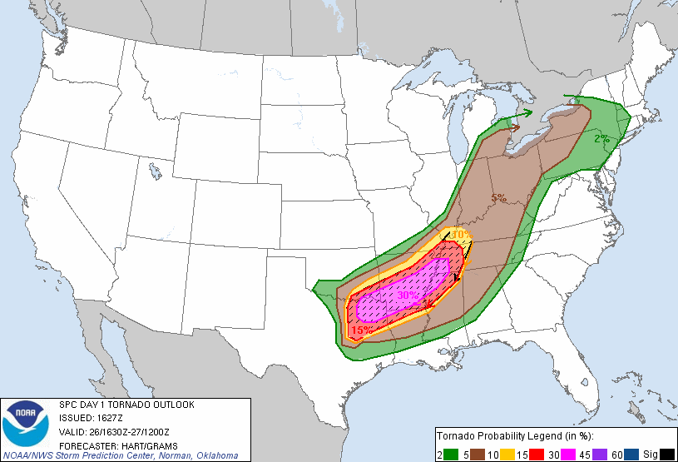
Useful relation between large-scale environmental parameters and tornado activity on short time-scales
April 26, 2011 16:30Z
Notes:
SPC convective outlook products based on underlying large scale environmental fields.

Slide 10
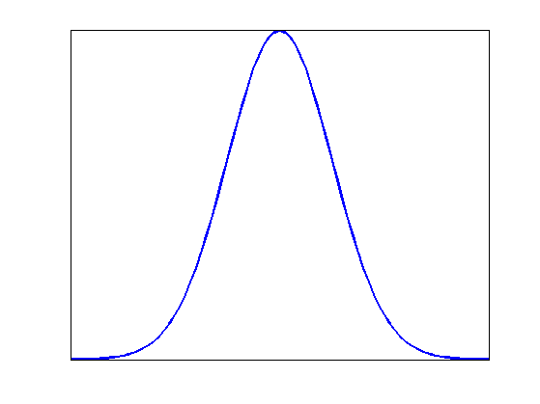

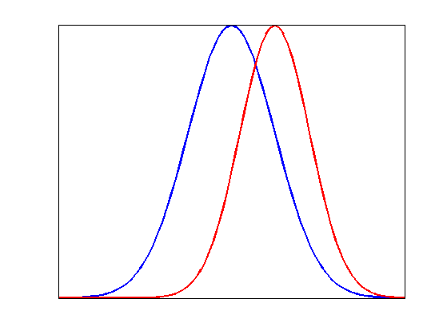
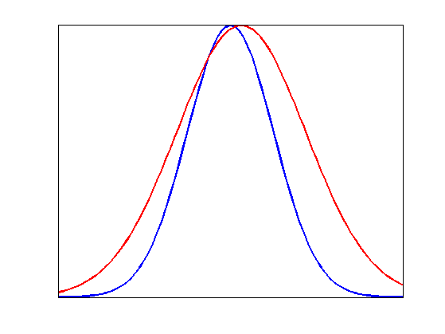
Basic Questions
Can environmental parameters explain tornado activity?
What makes one month more active than another?
Does the distribution of environmental parameters during a month determine tornado activity?
?
Changes in mean?
Changes in spread?
Easier?
Harder?
Notes:
At what time and space scales? Suppose higher frequency harder to predict.

Slide 11
What are the key environmental parameters?
Typical:
Instability, updrafts, e.g. CAPE
Shear, e.g., 0-6km shear, Storm Relative Helicity (SRH)

Slide 12
Probability of severe thunderstorm with F2 tornado, 5cm hail, or 120 km/h wind gusts
Significant severe parameter (Craven and Brooks, 2004)
CAPE x 0-6 km Shear > 10,000 m³ s⁻³
Figure from Brooks and Dotzek (2008)
Notes:
In the vicinity of a severe thunder storm, look at environmental parameters.
As CAPE and shear increase, do does the probability of a significant severe storm.
From operational US radiosonde network when soundings happened to be launched in the vicinity of severe thunderstorms

Slide 13
NCEP/NCAR 6-h reanalysis environmental parameters near severe thunderstorms 1997-1999
(Brooks et al. 2003)
Notes:
Pseudo-sounding constructed from 6-hours reanalysis data. Deep shear, CAPE.
Different weighting 2.86 log(S6) + 1.79 log(CAPE)

Slide 14
Classification of environments
(Brooks et al 2003)
Notes:
Note the similar slopes, log derivative, “sensitivities”
Percent change in p
Severe and tornadic events display roughly the same sensitivity to environment.
Generalized in the context of climate change by Trapp et al 2009 to include initiation as measured by convective precipitation.

Slide 15
6-hourly reanalysis
(Brooks et al 2003)
Notes:
NE corner of CO. Weld county. Not enough.
Too many south of Corpus Christi.

Slide 16
6-hourly reanalysis
(Brooks et al 2003)
Notes:
NE corner of CO. Weld county. Not enough.
Too many south of Corpus Christi.
Frequencies of the environments in the different regions

Slide 17
Monthly time-scales
Are monthly means of environmental parameters related to monthly tornado activity?
Likely to see impact of large-scale climate phenomena in monthly means.
Path to extended-range prediction, climate projection.
Notes:
Would seem to require less of prediction/projections

Slide 18
An index relating monthly tornado activity and environment

Slide 19
Large-scale climate phenomena potentially modulating monthly tornado activity
Precipitation (Galway, 1979)
Greenhouse gas forcing (Trapp et al., 2007, 2009)
ENSO in winter. (Cook & Schaefer, 2008)
Antecedent drought (Shepherd et al., 2009)
IAS April-May (Muñoz et al., 2011)
Notes:
Some indication of a relation between large-scale climate and tornado activity on monthly time scales.

Slide 20
Index methodology borrowed from tropical cyclone genesis
TC genesis index (Gray 1979).
Genesis index = function of the local environment
  Monthly values of
    SST
    Shear
    Humidity
    Vorticity
Climatological distributions, interannual variability, climate projections.
Notes:
Approach is similar to Brooks 2003.

Slide 21
Tropical
Cyclone
Genesis
Obs. &
Index
(annual values)
(Tippett et al., 2011)

Slide 22
Apply index methodology to monthly tornado counts
Index = exp(constants x environmental parameters)
Poisson regression
Parameters = CAPE, CIN, lifted index, lapse rate, mixing ratio, SRH, vertical shear, precipitation, convective precipitation and elevation
Estimate constants from observed climatology
  Same index at all (U.S.) locations, all months of year
  NARR data 1x1 degree grid
  SPC Tornado, Hail, and Wind Database. 1979-2010.
  All tornadoes (>F0). [F1 and greater gives smaller number, similar sensitivities]

Slide 23
Picking predictors
cPrcp
cPrcp:SRH

Slide 24
2-parameter indices

Slide 25
Why not CAPE/SRH?

Slide 26
Why not CAPE:SRH?

Slide 27
How well does the index capture climatology?

Slide 28
Log(Expected number of tornadoes)

Slide 29
Observations
Index
Obs.
Index

Slide 30
Month of Maximum Activity
Observations
Index

Slide 31
Annual cycle

Slide 32
Pattern correlation

Slide 33
Each month fit separately

Slide 34
Does the index capture interannual variability?

Slide 35
US totals
 | Jan | Feb | Mar | Apr | May | Jun | Jul | Aug | Sep | Oct | Nov | Dec
Index | 0.75 | 0.64 | 0.54 | 0.50 | 0.60 | 0.67 | 0.75 | 0.40 | 0.15 | 0.25 | 0.48 | 0.74
SRH only | 0.24 | 0.12 | 0.14 | 0.34 | 0.41 | 0.39 | 0.51 | 0.31 | -0.16 | 0.13 | 0.21 | 0.37
cPrcponly | 0.76 | 0.58 | 0.68 | 0.60 | 0.30 | 0.54 | 0.60 | 0.33 | 0.15 | 0.28 | 0.53 | 0.74
Correlation between index and observed number

Slide 49
Conclusions
Some association between environmental parameters and tornado activity on monthly time-scales.
  Climatological variability
  Interannual variability
Tornado “index” = potentially useful tool for:
  Attributing observed variability
  Extended-range prediction
  Climate projections

Slide 50
